Slide 1
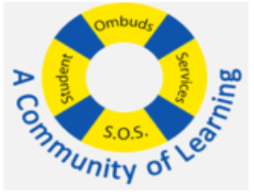

Crafting Strong Professional School Applications
___Bethune SOS Seminar___
Presenters: Tori, Ian, Foram, Nandini
Date: Wednesday, October 9th 2024
Note: This presentation contains hyperlinks to websites. The presentation will be posted online under the Bethune College Workshops webpage: https://www.yorku.ca/colleges/bethune/events-workshops/workshops/

Slide 2
MEET OUR MENTORS
Tori G.
Ian G.
Nandini B.
Foram O.
Notes:
Share your year, program and a fun fact about yourself

Slide 3

Overview
Introduction
  Professional Schools
  Graduate Schools
Common Application Components
  Personal Statements
  Autobiographical Sketch
  Letters of Recommendation
  Essay Questions
Tips & Resources
Summary
Q&A

Slide 4
Disclaimer
The information provided in this seminar gives some background information about the professional school applications. This is based on information provided by the websites of professional schools. Any experiences given by the presenters or guest speaker may not reflect experiences shared by others. They are here to deliver the presentation, answer any questions, and provide support.
We do our best to provide you the most updated information. Please ensure you obtain the latest information by conducting your own research.

Slide 5

Why this matters
There are often several components to an application.
  Schools may weigh personal statements, autobiographical sketches, essay questions, recommendation letters or interviews differently than grades.
Schools look for well-rounded candidates, they want to know who you are beyond your GPA.
  Grades can only get you so far!
Schools assess your written communication skills.
To allow you to stand out!
  Different application components let you highlight your unique skills, experiences and motivations.

Slide 6

Professional Degrees vs. Graduate Degrees
WHAT’S THE DIFFERENCE?
Professional Degree: students trained for specific professions governed by a mandatory regulatory body
  Professions requiring professional degrees: engineers, doctors, teachers, nurses, accountants, etc…
Graduate Degree: students provided further academic and/or research training for master’s or doctoral degrees
  Professions requiring graduate degrees: professors, scientists, researchers, epidemiologists, consultants, etc..
From: https://www.ouac.on.ca/planning/which-application-should-i-use/

Slide 7
Where and how to apply?
Professional School Application Portals
  Medical School → OMSAS
  Rehab Sciences → ORPAS
  Law School → OLSAS
  Teacher’s College → TEAS (consecutive education programs)
  OUAC → for bachelor’s programs like BEng/BASc (engineering) BSN (nursing), BEd (teaching), etc…
Graduate School Application Portals
  Institution-specific!
    York University → Graduate Application Form & MyFile
    University of Toronto → GradApp
    Toronto Metropolitan University → TMU’s External Online Application System
    McMaster University → McMaster Application Portal
    University of Western Ontario → Western’s Application Page (Portal is on this page)
    Etc… Search up “School Name + masters/phd application”
Programs have different deadlines!
  Keep this in mind!

Slide 8

Common Application Components
Here is a non-exhaustive list of common application components. Schools will require a different combination of these components.
Personal Statements
Letters of Intent
Autobiographical Sketches
Essay Questions
Statements
Supplementary Questions
CVs/Resumes
Recommendation Letters
Interviews

Slide 9
We will Be Going over the Following:
Personal Statements
Letters of Intent
Autobiographical Sketches
Essay Questions
Statements
Supplementary Questions
CVs/Resumes
Recommendation Letters
Interviews

Slide 10
What do These Application Components Have in Common?

Slide 11

Writing!

Slide 12
How to Prepare
Most of these components require that you write about:
Yourself
The Institution/Program you are applying to
Where to start?
Conduct Research
  Online, campus visits, program/university fairs, information sessions
  Look up the school+program to understand their values, culture and vision
  Research departments, potential advisors (for thesis-based programs)
Self-reflection
  Identify your skills, strengths, areas for improvement
  Discuss with close contacts -- friends, family, co-workers, professors
  Consider your motives → More on next slide

Slide 13

Consider Your Motives
What experiences or education made me want to pursue further studies?
When did I become interested in this field? Was there a specific moment that made me gravitate towards x career/field?
How would I fit into this program? What can I bring to this area of study?
What are my long-term goals? What do I plan on doing with the knowledge and skills I’ll have acquired once I have completed my studies?

Slide 14
Personal Statement/Essay
Letter of Intent/ Statement of Interest

Slide 15
Personal Statement / Letter of Intent Overview
Personal statements are often similar to letters of intent, especially when open-ended (i.e., with general questions that prompt your response).
You are writing about yourself, including your academic and/or professional background, your motivations, and how you align with the program or institution, as well as how you can contribute to its community.

Slide 16
Personal Statement / Letter of Intent
Personal Statement
Personal background, experiences and inspirations for applying
Explains what appeals about the school and program
Essay format
Commonly required + often has specific prompts and length
Letter of Intent
Academic background, resume and extracurricular experiences
Details specific curriculum aspects of experiential components
Business letter format and tone
From: https://bemoacademicconsulting.com/blog/college-letter-of-intent-sample

Slide 17
Personal Statement / Letter of Intent
Examples Required by Different Programs
UofT Dentistry (DDS)
  Personal Statement: Explain why you want to pursue a dental career (2 pages max.)
  Greatest Accomplishment: Outline what you consider to be your greatest accomplishment and the reasons you have chosen to highlight it (1 page max)
UoGuelph Veterinary Medicine (DVM)
  Personal Essay: Applicants will use this section of their application package to clearly and concisely reflect on their journey towards pursuing a career in veterinary medicine, share how they have prepared for the profession, as well as express and demonstrate their personal motivation and interests.
UofT Master’s in Molecular Genetics (MSc)
  Letter of Intent: Briefly describe your previous research experience and outline your future goals, and research interests e.g. tell us which professors in our department you would be interested in working with and why (2 pages max)
YorkU Master’s in Biology (MSc)
  Statement of Interest: a letter (max 500 words) addressed to the Program Admissions Committee, outlining your background in Biology and your reasons for wanting to pursue an advanced research degree
From: https://forms2.dentistry.utoronto.ca/201055113968048, https://moleculargenetics.utoronto.ca/grad-application-procedures, https://www.uoguelph.ca/ovc/dvm-program-application/, https://www.yorku.ca/science/biology/how-to-apply/#:~:text=Master%20of%20Science%20(MSc)%20in,the%20Master%20of%20Science%20degree.

Slide 18
Personal Statement / Letter of Intent - Components
Clearly express your interest in the area of study. Focus on relevant academic, personal, or professional experiences that led you to this field.
  Volunteer positions, paid positions, lab positions
Highlight skills and experiences gained from academic, non-academic, or personal activities that demonstrate your suitability for the program.
Discuss how the program aligns with your career goals and what aspects of the institution or program appeal to you.
Organize your statement in a logical way, either chronologically or by themes, ensuring that your ideas flow well together.
From: https://studentlife.utoronto.ca/wp-content/uploads/Guide-to-Writing-Personal-Statements-for-Further-Education.pdf

Slide 19
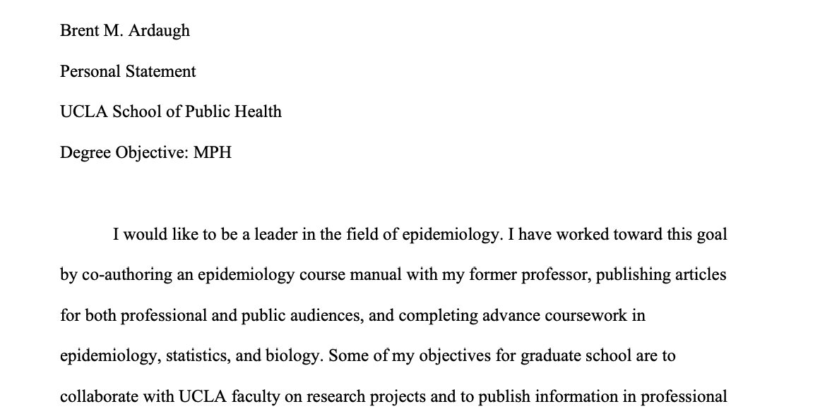
Personal Statement – Example
From Purdue’s Online Writing Lab
Heading (May not be required)
Full Name
Document Type
Recipient Institution
From: https://owl.purdue.edu/owl/job_search_writing/preparing_an_application/writing_the_personal_statement/examples.html

Slide 20
Personal Statement – Example
From Purdue’s Online Writing Lab
Goal & Program
I would like to be a leader in the field of epidemiology. I have worked toward this goal by co-authoring an epidemiology course manual with my former professor, publishing articles for both professional and public audiences, and completing advance coursework in epidemiology, statistics, and biology. Some of my objectives for graduate school are to collaborate with UCLA faculty on research projects and to publish information in professional journals as well as public-oriented media types. Moreover, I would like to continue producing classroom resources for epidemiology faculty and students.
Introduction
Concise
Brief introduction of yourself + goals
Include program + institution details
Goal
Institution
Goal
From: https://owl.purdue.edu/owl/job_search_writing/preparing_an_application/writing_the_personal_statement/examples.html

Slide 21
Personal Statement – Example
From Purdue’s Online Writing Lab
Experience
Together with my former epidemiology professor, Dr. David R. Black, I co-authored a course manual that is currently being used by more than 50 undergraduate and graduate students at Purdue University-West Lafayette. This manual comprises over 650 PowerPoint slides and supplementary materials that introduce students to the basic concepts of epidemiology. Morbidity and mortality, screening tests, study designs, and causation are just a few of the topics discussed within the manual. Dr. Black and I intend to publish this manual for two reasons: to offer students a concise resource that they can use throughout their academic and professional careers and to provide faculty members with a complete “off-the-shelf” lecture series. I have attached sample excerpts from this manual to my application.
Body
Details previous experience
Demonstrated prior knowledge in field
Prior knowledge
Reason for this experience
From: https://owl.purdue.edu/owl/job_search_writing/preparing_an_application/writing_the_personal_statement/examples.html

Slide 22
Personal Statement – Example
From Purdue’s Online Writing Lab
Skill
Writing is a population-based approach to preventing and controlling diseases. In the course of my studies, I published articles in the AMWA Journal, the official publication of the American Medical Writers Association (AMWA). Moreover, I wrote the medical writing resource for the Purdue University Online Writing Lab, a world-renowned instructional Web site for writers seeking consultation. One of my objectives for graduate school is to collaborate with the UCLA Office of Media Relations to publish articles on disease prevention and healthy living. In my articles, I would like to apply the knowledge from my UCLA epidemiology courses to provide readers with information that they can use to enhance their health and well-being. I would also enjoy opportunities to assist UCLA faculty in writing articles for professional journals and grant proposals for the National Institutes of Health (NIH). With my training in medical journalism and NIH grant writing from the AMWA, I believe that I can better serve the Los Angeles community and support the advancement of epidemiology research at UCLA.
Where skill was developed
Body
Highlighting a skill critical to the intended field of study
Provides background on where the skill was developed
Incorporating goal + skill
Skill + Goal
From: https://owl.purdue.edu/owl/job_search_writing/preparing_an_application/writing_the_personal_statement/examples.html

Slide 23
Personal Statement – Example
From Purdue’s Online Writing Lab
Epidemiology research enhances existing perception of people and their environments, and this perception leads to more effective methods to prevent and control diseases. I would like to research infectious disease epidemiology under Dr. Scott P. Layne, an epidemiology professor in your program. I prepared for this research by pursuing experience in microbiology, which consisted of lab work and studying in the classroom the physiology of these pathogens: Mycobacterium tuberculosis, Bacillus anthracis, Bordetella pertussis, Vibrio cholerae, HIV, Escherichia coli O157:H7, and Avian H5N1 Influenza. The above mentioned studying took place at the graduate level, where I was one of few undergraduate students. I will also be pursuing graduate level coursework in immunology, molecular biology, and genetics in spring 2009. I would like to apply the knowledge from these courses, in addition to the courses at UCLA, to develop strategies that protect populations from bioterrorism. Knowledge of how pathogens acquire virulent abilities, whether naturally or artificially induced, is necessary to ensure that preventative methods are adaptive to changes in pathogen evolution.
Body
Specifies faculty member
Provides relevant experience, expanding on them in detail
Expanding on goal + importance of goal
Faculty Member
Prior experience – how they prepared for their future
Details about experience
Goal
Importance of Goal
From: https://owl.purdue.edu/owl/job_search_writing/preparing_an_application/writing_the_personal_statement/examples.html

Slide 24
Personal Statement – Example
From Purdue’s Online Writing Lab
Body
Further links to the faculty member
Shows that they have done their research on Dr. Layne
Reasons to work with Dr. Layne
Importance of this research
My second research interest is monitoring pathogens in human populations. Because of my curiosity, I was particularly impressed by a related research article by Dr. Layne entitled, “Human Influenza Surveillance: The Demand to Expand.” This article was published in the Emerging Infectious Diseases Journal in 2006. In his article, Dr. Layne explained how a highthroughput laboratory network can provide faster vaccine-delivery methods and monitor changes in the epidemic Influenza strains. I would look forward to working with Dr. Layne because it is an opportunity to expand my knowledge of medically relevant pathogens. This type of research has the potential to improve the effectiveness of the existing Influenza protocol and to invest in the future health and well-being of the world’s population.
Faculty Member’s paper
Why specifically Dr. Layne
Importance of this research
From: https://owl.purdue.edu/owl/job_search_writing/preparing_an_application/writing_the_personal_statement/examples.html

Slide 25
Personal Statement – Example
From Purdue’s Online Writing Lab
Conclusion
Summarizing body – restate key information (goals, program, your future contribution)
Sounds similar to the introduction
I am requesting admission to UCLA’s MPH program in epidemiology. My previous epidemiology experience, academic preparation, and personal qualities have prepared me for the expectations of your program. My objective for graduate school is to combine rigorous academic study with hands-on experience, and I believe that Los Angeles and UCLA offer extraordinary opportunities for these endeavors. Lastly, I believe that I can contribute to your program through research, publishing, and multidisciplinary collaboration. My goal is to utilize the intellectual richness and diversity of UCLA to enhance the quality of life of the world’s people.
From: https://owl.purdue.edu/owl/job_search_writing/preparing_an_application/writing_the_personal_statement/examples.html

Slide 26
Note on Purdue’s Personal Statement Example
Some programs specifically require the identification of a faculty member to serve as your Principal Investigator (PI) as part of admission requirements, meaning that it may not be required to mention a specific researcher in any letter of intent or personal statement.

Slide 27
Autobiographical Sketch (ABS)

Slide 28

Autobiographical Sketch (ABS)
Part of all Ontario Medical School applications
Need to write about
  Employment
  Volunteer activities
  Extracurricular activities
  Awards and accomplishments
  Research
  Other
You will need to expand on:
  Type of activity (Up to 32 activities)
  Number of hours invested
150-character explanation for each activity
Must provide the email of a verifier for each activity
*Note: Only activities from age 16+

Slide 29
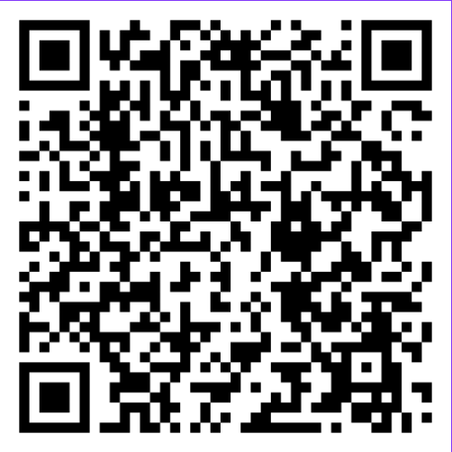
Autobiographical Sketch (ABS) - Template
Here is a template created by someone on Reddit to help you keep track of your activities.
TO EDIT, MAKE A COPY → Go to File → Make a Copy → Rename your File
Do not be afraid to keep track of your activities like this regardless of whether you will be going to Medical School.
  You may need to write about an activity in the future or use a couple as example to expand on in other application components such as the letter of intent.

Slide 30
Essay Questions
Statements
Supplementary Questions

Slide 31
Essay Questions / Statements / Supp. Qs
Examples Required by Different Programs
UofT Medicine (MD)
  2 statements answering questions (outlined on their website each year):
  Question 1 (2024/25): In what way(s) are you a product of the world around you? How has it, or how will it, impact your journey in medicine?
  Question 2 (2024/25): Investor and philanthropist Charlie Munger is known for saying: “We all are learning, modifying, or destroying ideas all the time. Rapid destruction of your ideas when the time is right is one of the most valuable qualities you can acquire. You must force yourself to consider arguments on the other side.” Explore how this may affect a career in medicine.
TMU Medicine (MD)
  4 Supplementary Questions for the 2025 Admissions Cycle:
  How have your lived experiences contributed to your personal growth and desire to pursue a career in medicine?
  What leadership roles and/or community engagement experiences have you undertaken within your community, particularly in efforts aimed at supporting and advocating for marginalized groups? How have these experiences prepared you to address the needs of underserved communities as a future healthcare professional?
  How have your personal, professional, or extracurricular experiences with diversity, inequity, and/or marginalization influenced your efforts to create a more inclusive environment in your school, community, or workplace?
  Describe your connection(s) to the Brampton/Peel Region and surrounding communities and/or your interest in practicing in culturally diverse communities such as these, that represent the future of Canada.
From: https://applymd.utoronto.ca/non-academic-requirements, https://www.torontomu.ca/school-of-medicine/programs/md/application-requirements/#!accordion-1725387950818-gpa-requirement

Slide 32

Essay Questions / Statements / Supp. Questions
Ask Very Specific Questions!
Vary by University and Program: each institution has its own set of essay questions, and they differ depending on the program.
Not always required: not all programs require any of these components, it is important to review the specific application guidelines.
May Change Annually: essay prompts are requirements can change from year to year, you should always review the latest updates.

Slide 33
Writing Tips and Resources

Slide 34
Tips for Writing – From UoGuelph
Make it personal, but always professional
Be thorough, but concise. Provide brief explanations and use examples.
  Being specific and using examples from your life makes your response more authentic
Ensure that you answer the questions asked
Address negatives in your application (when possible)
  Speaking to your setbacks shows self-awareness, honesty and resilience. Highlight how you’ve grown from them and demonstrate your ability to overcome adversity.
Make it easy to read
Start and end strong
Make a connection with the school
Ensure structure, grammar and formatting are error free
From: https://cecs.uoguelph.ca/students-alumni/further-education/tips-writing-your-personal-statement

Slide 35
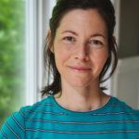
Writing Help on Campus
Bethune Writing Centre with Kathryn
https://www.yorku.ca/colleges/bethune/writing/?gad_source=1&gclid=Cj0KCQjw6oi4BhD1ARIsAL6pox3Z7JSFY49ycj0Cjs1s0rZOvepC6TPkQ88dl2KYqMy4A7IQQOCUHeIaAs3fEALw_wcB&gclsrc=aw.ds
  Offer help with writing: personal statements, applications , assignments, thesis, lab reports, essays, citations,
  Drop-in at Steacie, Study Room A on Wednesdays from 1:00 – 2:30, 10 mins max.
  Appointments
    In-person BC 206
    Virtual on Zoom
Writing Centre (Liberal Arts & Professional Studies)
https://www.yorku.ca/laps/writing-centre/
  Help students acquire the tools to be a strong and independent writer

Slide 36




Writing Resources Online
Purdue OWL (Online Writing Lab) https://owl.purdue.edu/
  Offers comprehensive writing guides and examples of written documents
Grammarly (Free Version) https://www.grammarly.com/
  Provides basic grammar and spell-check
Google Docs or Microsoft Word Grammar Suggestions
  Built-in grammar and spelling suggestions while writing

Slide 37
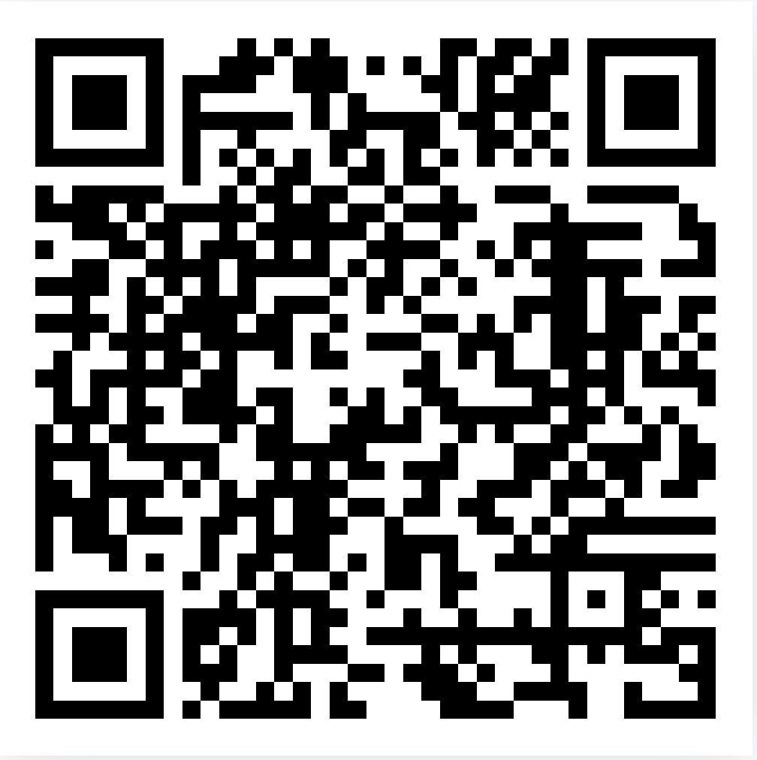
Don’t have Microsoft Apps on your Device?
For more information on how to download Microsoft 365 on your personal devices, use this website: https://www.yorku.ca/uit/faculty-and-staff-services/software-and-apps/

Slide 38

Summary
There are several kinds of components that might be part of admission requirements for different professional/graduate programs
Admissions requirements differ slightly from school to school but generally include a written component: ABS, Personal Statement, Letter of Intent, CV/Resume
Always check requirements online as they change year-to-year
Meeting minimum requirements does not guarantee admission

Slide 39
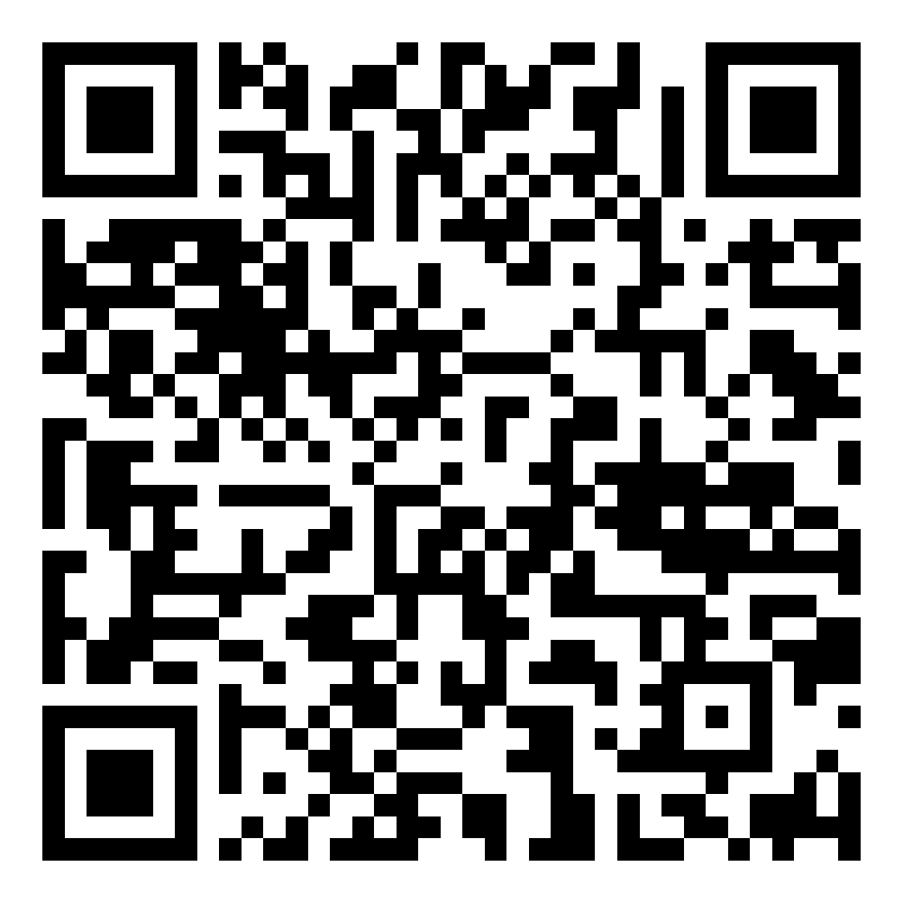
Upcoming Seminars + Slides Access
Oct 23 5:30 pm | BC203 and Zoom | How to Get into Teacher’s College
Oct 30 5:30 pm | BC320 and Zoom | Mastering the MCAT
Nov 6 5:30 pm | BC320 and Zoom | How to Get into Dental School
Nov 13 5:30 | BC 320 and Zoom | Study Tips for Exams
Slides for this seminar will be posted in the coming days!

Slide 40
Our Guest Speaker

Slide 41
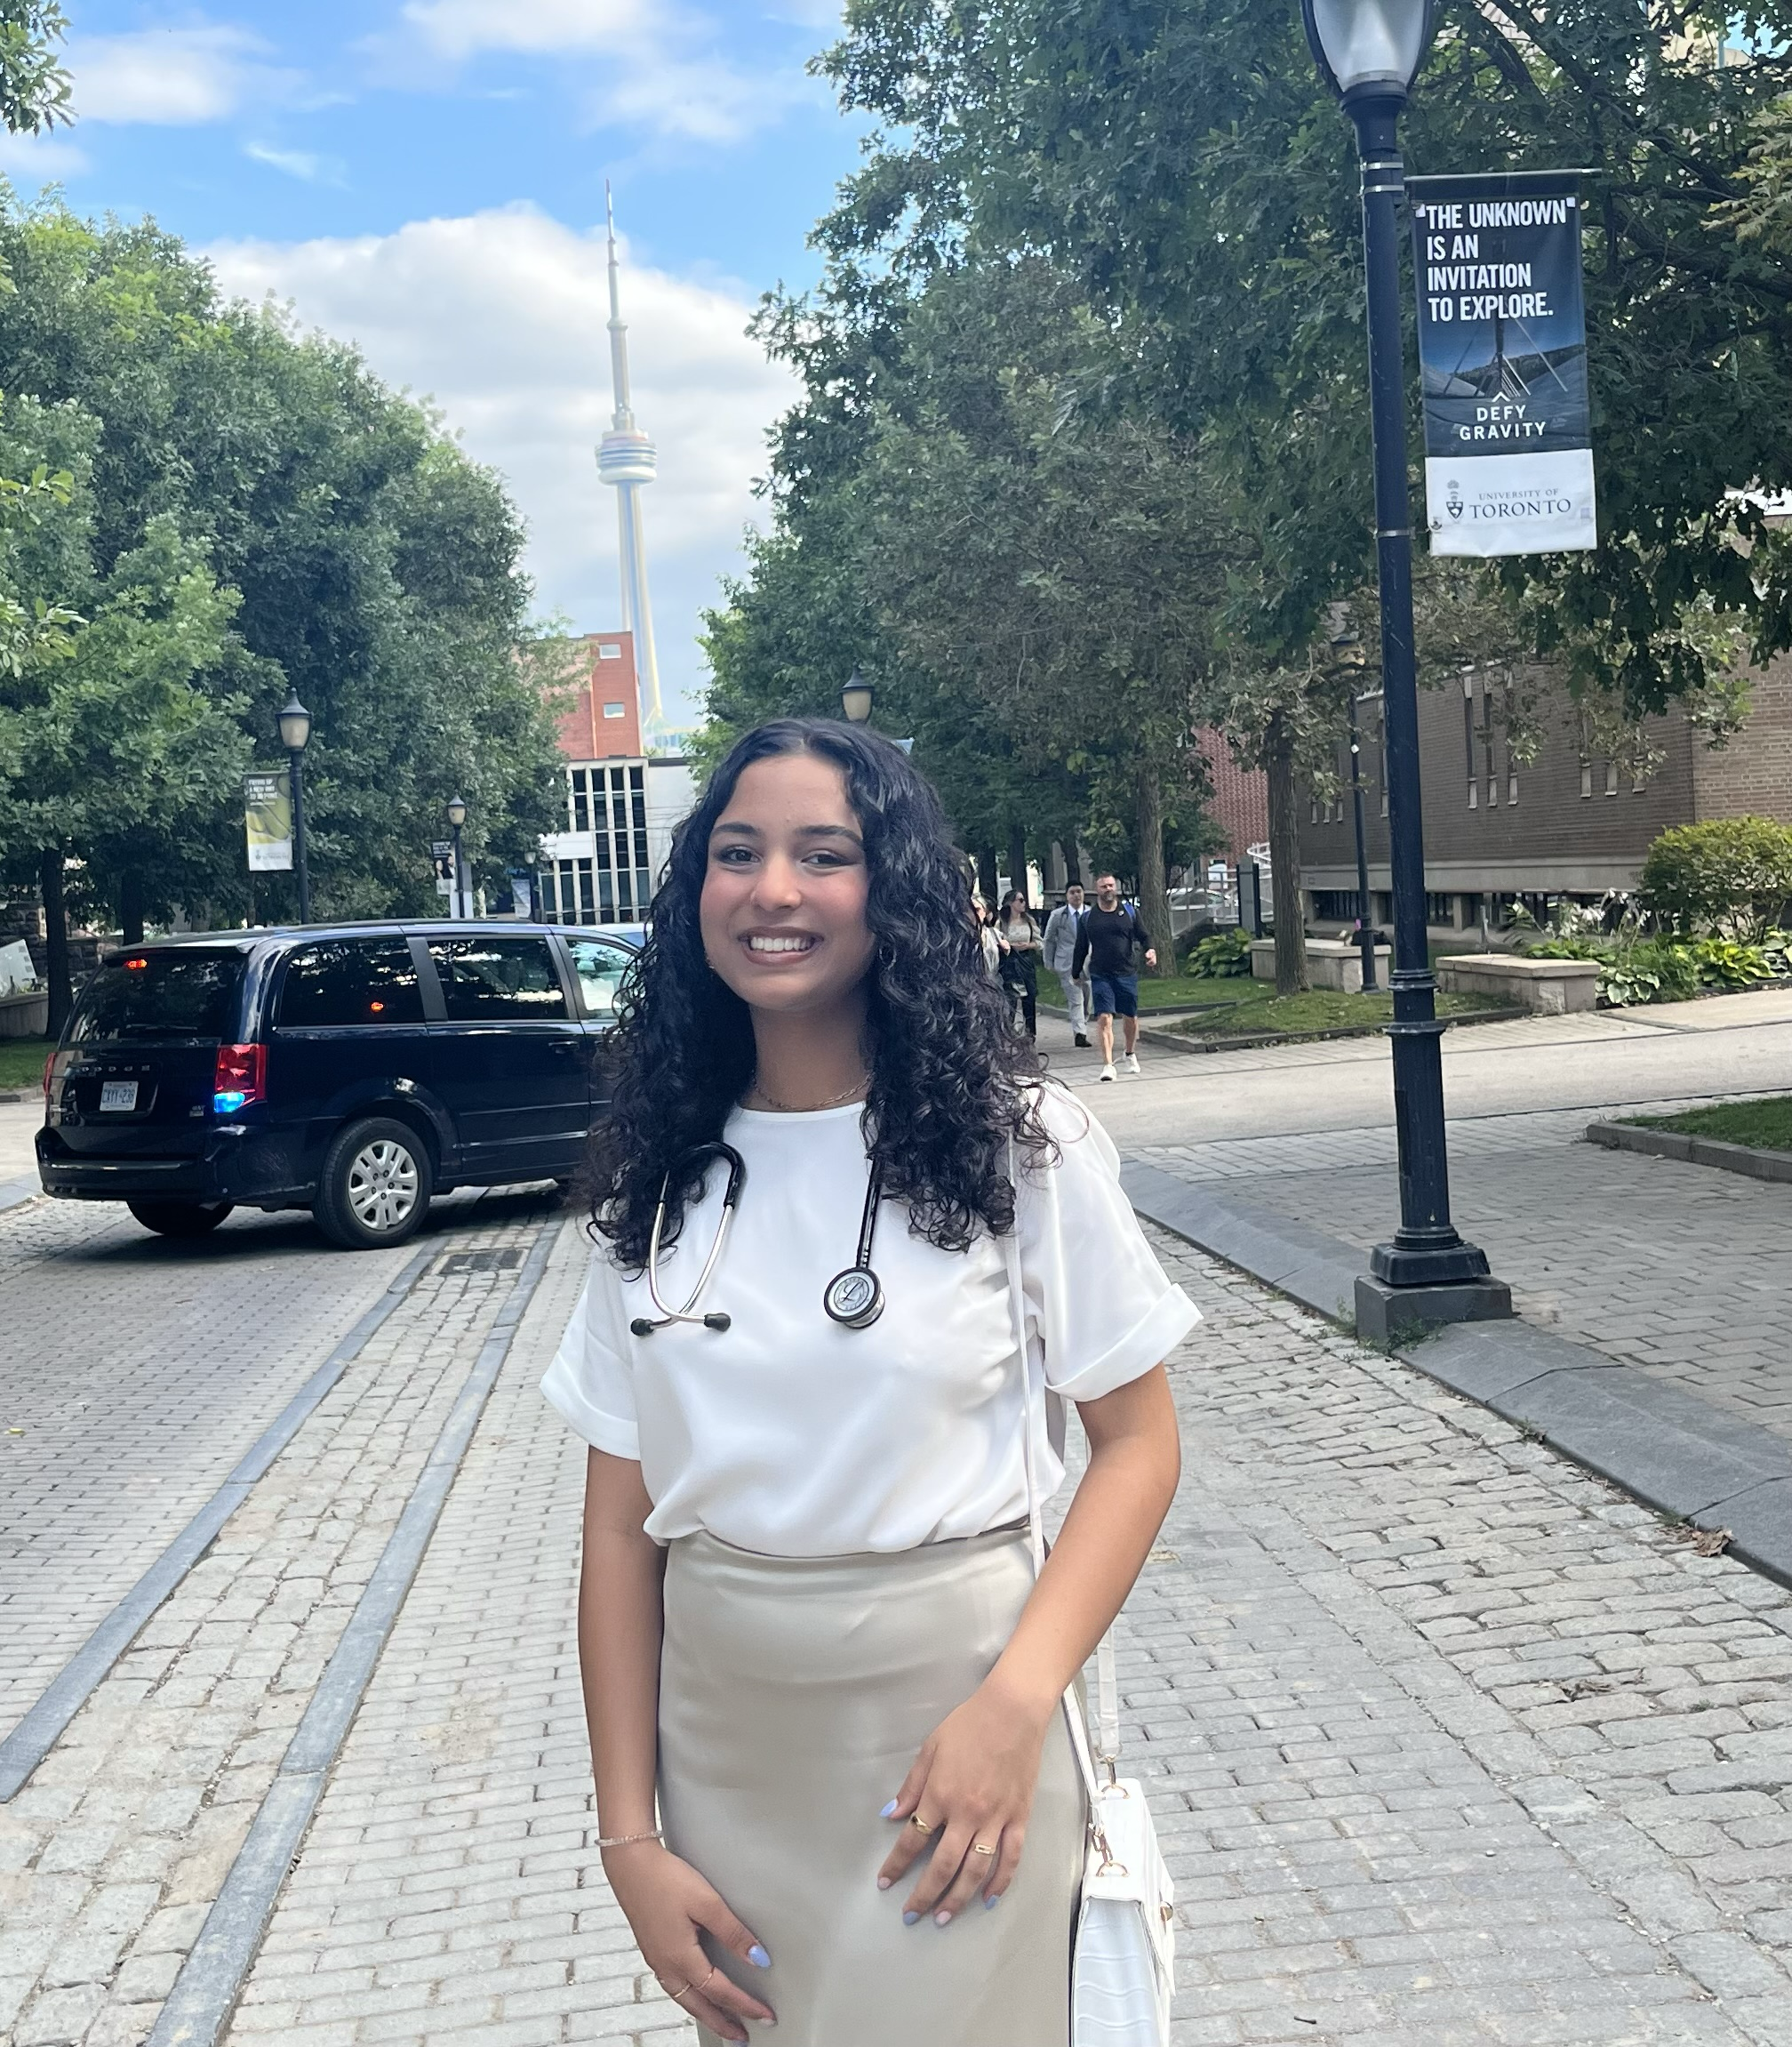
Areeba Chaudhry – 2nd Year Medical Student at UofT
York Biomedical Science Alum
Favourite York Courses: Organic Chemistry & Molecular Bio
Hobbies: pilates & spin classes, painting, digital art, reading, café hopping, and hiking
Why Med? I wanted to combine my love for science, teaching & research (+ stethoscopes make for a cute accessory!)
Key piece of advice for undergraduate students: enjoy the journey and surround yourself with supportive people!
Fun Fact: I have a list of 35+ cafes (& counting) in Toronto that are ideal for both studying and yapping

Slide 42
Questions for Areeba:

Slide 43
What is one thing you wish someone had told you before the application process?

Slide 44
When should I start working on my professional/grad school application components?

Slide 45
What was the most difficult part about the application process aside from tests (MCAT, CASPer)?

Slide 46
What should I get involved in? Are there any extracurriculars that will ‘boost’ my application?

Slide 47
HAVE ANY QUESTIONS?
Ask away OR
Send us an email: BCMENTOR@YORKU.CA
Visit:
bethune.yorku.ca

