Slide 1


How to Get Into Teacher’s College
___Bethune SOS Seminar___
Presenters: Richard, Parmeet, Kason
Date: Wednesday, October 23rd 2024
Note: This presentation contains hyperlinks to websites. The presentation will be posted online under the Bethune College Workshops webpage: https://www.yorku.ca/colleges/bethune/events-workshops/workshops/

Slide 2
MEET OUR MENTORS
Richard H.
Parmeet D.
Kason N.
Notes:
Share your year, program and a fun fact about yourself

Slide 3

Overview
Researching programs
Teaching Pathway
Consecutive VS. Concurrent
Teaching Levels and Teachables
Ontario Schools offering Teacher’s Education + School-Specific Requirements
  York University
  Western
  Brock
  OISE (UofT) – Master’s VS. Bachelor’s
Summary
Q&A

Slide 4
Disclaimer
The information provided in this seminar gives some background information about Teacher’s College . This is based on information provided by the websites of these programs. Any experiences given by the presenters or guest speaker may not reflect experiences shared by others. They are here to deliver the presentation, answer any questions, and provide support.
We do our best to provide you the most updated information. Please ensure you obtain the latest information by conducting your own research.

Slide 5

Start your Research
If you are considering Teacher’s College, you should first look into the profession, schooling, requirements etc… by doing your research!
Some good places to start to start include:
Ontario College of Teachers site
  https://www.oct.ca/becoming-a-teacher/requirements
OUAC TEAS (Ontario Universities’ Application Centre Teacher Application Service)
  https://www.ouac.on.ca/guide/teas-guide/
School specific sites
  Search up “SCHOOL NAME + teacher’s college” or “SCHOOL NAME + bachelor’s of education”
Friends, family, this seminar!

Slide 6
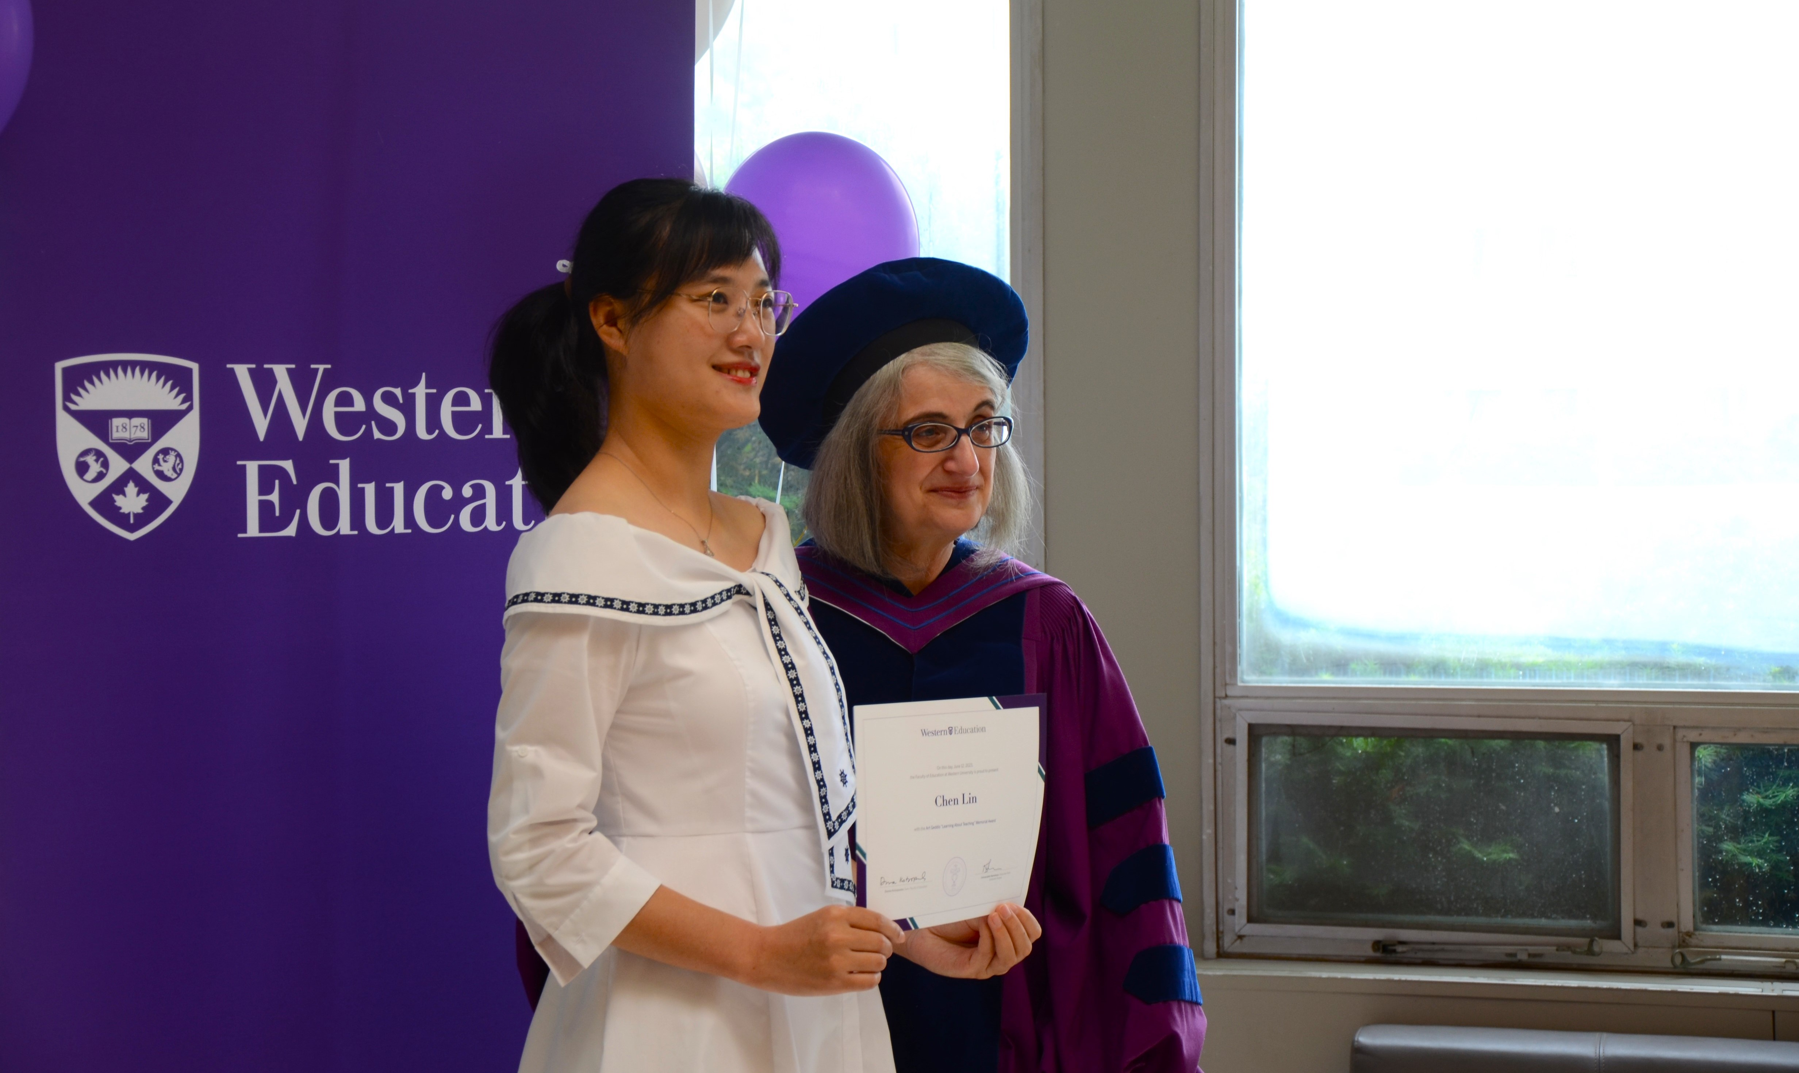
General Pathway
Undergraduate program (3 or 4 years depending on specific school requirements)
4-semester teacher education program (BEd or MT) with practicums in schools and community organizations
Apply to the Ontario College of Teacher’s for certification
Sometimes, points 1 and 2 are done at the same time = concurrent
From: https://www.oct.ca/becoming-a-teacher/requirements

Slide 7
Bachelor’s of Education Streams
WHAT’S THE DIFFERENCE?
Concurrent (5-6 years)
  Direct Entry from high school / upper year entry
  Pursue 2 degrees at the same time
Consecutive (3-4 years +2 years)
  Already completed another degree
  Apply through (Teacher Education Application Service) TEAS: https://www.ouac.on.ca/guide/teas-guide/
** In general, students cannot switch into concurrent education programs**

Slide 8
Teaching Levels
Graduates of the YorkU BEd program can be certified to teach in Ontario in 2 of the following grade levels:
  Primary (JK – Grade 3)
  Junior (Grade 4 – 6)
  Intermediate (Grade 7-10)
  Senior (Grade 11-12)
So, you would be qualified to teach:
  Primary/Junior
  Junior/Intermediate
  Intermediate/Senior
Some programs may have specialized versions of these combinations:
  Primary/Junior FSL (French as a Second Language) → TyndaleU
  Primary Junior Aboriginal (focused on delivering a culturally responsive curriculum) → BrockU

Slide 9
Teachable Subjects
Will differ depending on the school
Typically:
  No teachables required for primary-junior stream
  1 teachable is required for junior/intermediate stream
  2 teachables are required for intermediate/senior stream (1st and 2nd teachable)
May have different requirements for different programs
  French as a Second Language (1st teaching subject) at York requires 6 full-year courses in French including 3 full-year courses in language
  French as a Second Language (2nd teaching subject) at York requires 3 full-year courses in French including 2 full-year courses in language
  French as a Second Language (1st OR 2nd teaching subject ) at UofT requires 6 full-year courses in French and demonstrated written and oral proficiency
Some teachable combinations are not permitted depending on the school

Slide 10
Schools in Ontario
There are 17 Schools that offer Teaching programs:
York University
Brock University
Lakehead University
Nipissing University
Queen’s University
Trent University
Ontario Tech University
University of Ottawa
Western University
University of Windsor
Wilfred Laurier University
Redeemer University
Tyndale University
Laurentian University (Programs offered in French only)
Université de l’Ontario français (Programs offered in French only)
OISE/University of Toronto (application not through OUAC)
**Keep in mind, each school has different requirements**

Slide 11
York University

Slide 12

York University Education
Faculty of Education
Winters College
4700 Keele Street
Toronto, ON M3J 1P3
Email: OSP@edu.yorku.ca
Phone: 416-736-5001

Slide 13
YorkU – Consecutive Program Stats + Admissions
Statistics:
Typically, 3400 applicants compete for approximately 300 spaces
Admissions Requirements:
Approved undergraduate degree with a minimum overall GPA of B (6), based on the final two years (60 credits at York or equivalent)
Online Supplemental Information Form
  Experience Summary and Profile
  Personal Statement
  2 Online Reference Letters – you would provide the name and email of 2 referees
From: https://www.yorku.ca/edu/wp-content/uploads/sites/28/2024/06/Website_Consecutive-BEd-How-to-apply-2025-26.pdf

Slide 14
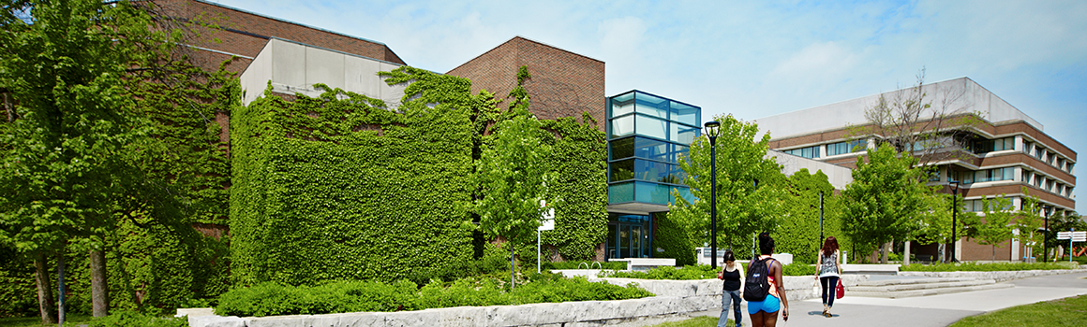
YorkU – Consecutive Program Selection
Selection:
Based on GPA, experience, personal statement and 2 online reference letters
** Each school/program has its own selection method**
From: https://www.yorku.ca/edu/wp-content/uploads/sites/28/2024/06/Website_Consecutive-BEd-How-to-apply-2025-26.pdf

Slide 15
YorkU – Teaching Streams
Primary/Junior (JK – 6)
  No subject specialization required
Junior/Intermediate (4 – 10)
  Choose to specialize in one Junior-Intermediate teaching subject
Intermediate/Senior (7 – 12)
  Choose to specialize in two Junior-Intermediate teaching subjects
For a full list of teachable subjects:
https://www.yorku.ca/edu/students/bed-consecutive/bed-teaching-subjects/
** Pay attention to ineligible teaching subject combination and restricted courses**
From: https://www.yorku.ca/edu/students/bed-consecutive/

Slide 16
YorkU – Consecutive Program Important Deadlines
Deadline to apply: December 2, 2024 (TEAS application)
Deadline to submit online supplemental form: December 18, 2024
For more information: https://www.yorku.ca/edu/students/bed-consecutive/bed-consecutive-how-to-apply/
From: https://www.yorku.ca/edu/wp-content/uploads/sites/28/2024/06/Website_Consecutive-BEd-How-to-apply-2025-26.pdf

Slide 17
How About Other Schools?
Western University
Brock University
OISE (University of Toronto)

Slide 18
Western University
Consecutive Education

Slide 19

Western University Education
Faculty of Education
John George Althouse Faculty of Education Building
1137 Western Road
London, ON
Canada N6G 1G7
Email: edrecruit@uwo.ca
Phone: 519-661-2111 ext.82745

Slide 20
Western – Consecutive Program Admissions
Admissions Requirements:
Approved undergraduate degree with a minimum of 70% in your best 10 full undergraduate courses and 70% minimum average in courses supporting teachables for Junior/Intermediate or Intermediate/Senior stream
CASPer (Computer-Based Assessment for Sampling Personal Characteristics)
Optional: Equity Admission Form
From: https://www.edu.uwo.ca/teacher-education/apply.html

Slide 21

CASPer Test
Computer-Based Assessment for Sampling Personal Characteristics
  Online, scenario-based test assessing non-academic qualities like empathy, ethics, and decision-making.
Format
  12 scenarios (video or word-based prompts)
  3 open-ended questions each (5 mins/section)
  Can only be taken once per application cycle
Preparation Tips:
  Practice responding to ethical dilemmas.
  Stay calm under time pressure.
  Focus on empathy, ethical reasoning, and clarity in responses.
Next Testing Dates
  November 07, 2024 - 8:00PM EST
  December 05, 2024 - 8:00PM EST
From: https://www.caspertest.com + https://www.edu.uwo.ca/teacher-education/_docs/teacher-education-program-faqs.pdf

Slide 22
CASPer Example
Prompt: You are a university student and you haven’t seen one of your closest friends, who also happens to be in many of your classes, all week. This is unusual for them. You attempt to call them, but they don’t answer your calls. Their roommate bumps into you in the hallway and mentions that your friend hasn’t been looking so good lately.
Questions
  How do you handle the situation?
  What factors do you consider in deciding whether or not to show up at your friend’s dorm room?
  How do you decide if/when to involve the help of other individuals (professionals, parents etc.) in this situation?
From: https://www.caspertest.com/casper-sample-questions/#sample-question-card-3

Slide 23
Western – Specialty Areas
Teaching Specialty Areas
International Education (P/J, J/I, I/S)
Early Childhood Education (P/J)
Urban Education (P/J, J/I, I/S)
French (Elementary) (P/J, J/I)
French (Secondary) (I/S)
Advanced Studies in the Psychology of Achievement, Inclusion and Mental Health (P/J, J/I, I/S)
Mathematics through the Arts (P/J, J/I)
STEM Education (I/S)
Legend:
P/J = Primary/Junior
J/I = Junior/Intermediate
I/S – Intermediate/Senior
From: https://www.edu.uwo.ca/teacher-education/apply.html

Slide 24
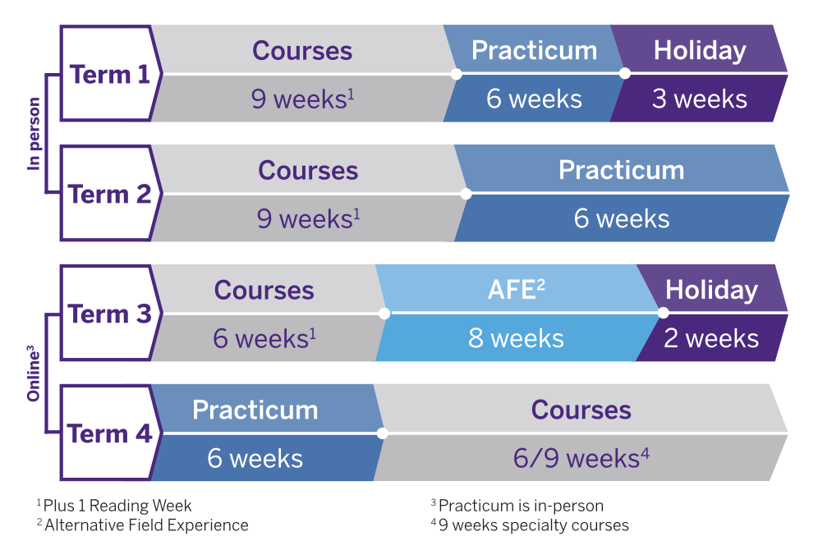
Western – Program Structure
16-month program
First 8 months are on-campus
Second 8 months are online
Practicum positions are in-person
From: https://www.edu.uwo.ca/teacher-education/index.html

Slide 25
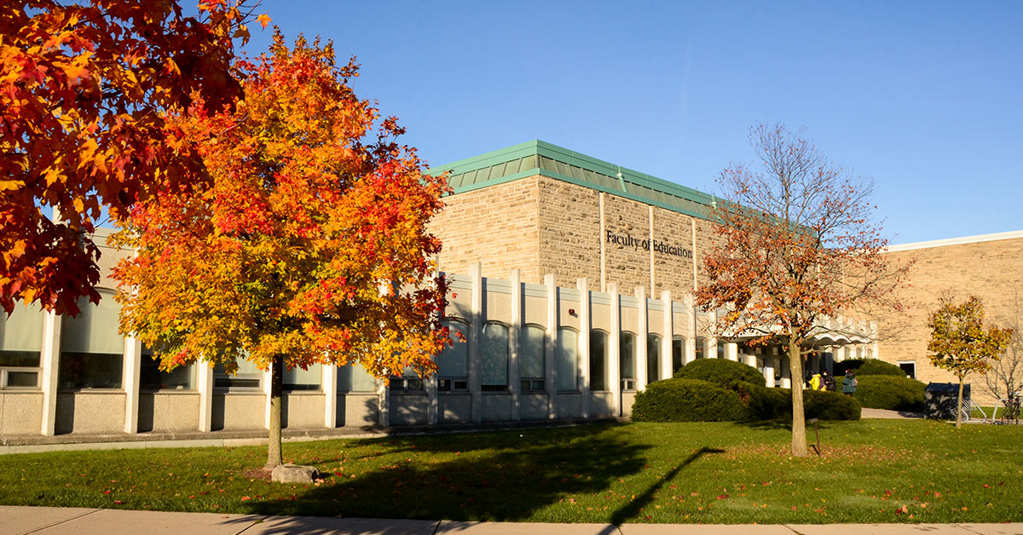
Western – Important Deadlines
Deadline to apply: December 2, 2024 (TEAS application)
For more information: https://www.edu.uwo.ca/teacher-education/index.html
From: https://www.edu.uwo.ca/teacher-education/_docs/teacher-education-program-faqs.pdf

Slide 26
Brock University

Slide 27

Western University Education
Faculty of Education
St. Catharines (Main) Campus
500 Glenridge Avenue
St. Catharines, ON
L2S 3A1
Burlington Campus (Program is here!)
1433 Headon Rd.
Burlington, ON
L7M 1V7
Email: futurestudent@brocku.ca

Slide 28
Brock – Consecutive Program Admissions
Admissions Requirements:
Approved undergraduate degree with a minimum of 70% in your best 10 full undergraduate courses and 70% minimum average in courses supporting teachables for Junior/Intermediate or Intermediate/Senior stream
CASPer (Computer-Based Assessment for Sampling Personal Characteristics)
From: https://brocku.ca/admissions/consecutive/

Slide 29
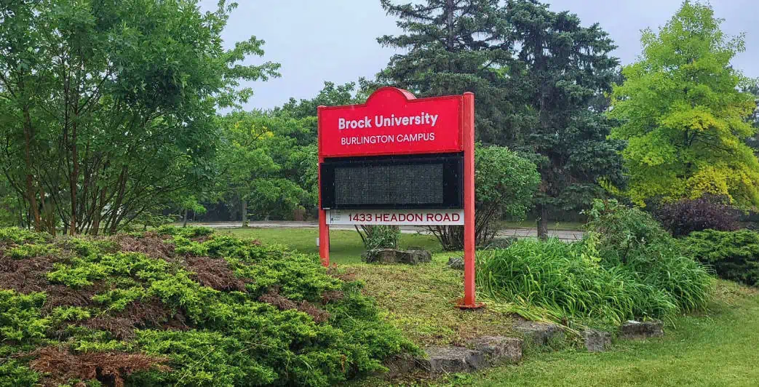
Brock – Consecutive Program Selection
Selection:
Based on academic requirements (70%) and CASPer test (30%)
** Each school/program has its own selection method**
From: https://brocku.ca/admissions/consecutive/

Slide 30
Brock – Division Requirements
Primary/Junior
In addition to the minimum admissions requirements, those applying to the Primary – Junior program are encouraged to have an area of concentration related to school curriculum.
Additionally, some preference is given to Primary/Junior applicants with:
  a major/degree in Child and Youth Studies or Early Childhood Education
  completed university degree level courses (half or full credit) in one or more of Mathematics, Science and/or English
  completed university degree level courses (half or full credit) in Indigenous Studies
From: https://brocku.ca/admissions/academic-requirements-primary-junior/

Slide 31
Brock – Division Requirements
Junior/Intermediate
In addition to the minimum admissions requirements, those applying to the Junior – Intermediate division must have the equivalent of at least 3.0 full undergraduate credits (18 York Credits) , averaging 70%, in one teaching subject area where:
  At least 1.0 full undergraduate credit (equivalent of 6 York credits – 1 Y course) must be at the second year level or above.
  At a minimum, 2.0 out of 3.0 teaching subject credits must be complete at the time of application.
Some preference is given to applicants who present
  Completed university degree-level courses (half or full credit) in one or more of Mathematics, Science and/or English.
  Completed university degree-level courses (half or full credit) in Indigenous Studies
From: https://brocku.ca/admissions/academic-requirements-junior-intermediate/

Slide 32
Brock – Division Requirements
Junior/Intermediate Teachable Subjects
Dramatic Arts
English
French as a Second Language
Geography
Health and Physical Education
History
Mathematics
Music, Vocal
Science, General
Visual Arts
** Each teachable subject has specific requirements/restrictions. For more information visit the page linked at the bottom of this slide **
From: https://brocku.ca/admissions/academic-requirements-junior-intermediate/

Slide 33
Brock – Division Requirements
Intermediate/Senior
In addition to the minimum admissions requirements, those applying to the Intermediate-Senior division must have two teachable subject areas.
For the first teachable area, you must have:
  At least 5.0 credits (30 York Credits) , averaging 70% in this subject area,
  At least 3.0 (18 York) of the 5.0 (30 York) credits must be at the year two level or above, and
  At a minimum, 3.0 (18 York) out of 5.0 (30 York) first teaching subject credits must be complete at the time of application.
For the second teachable area, you must have:
  At least 3.0 (18 York) credits, averaging 70%, in a second teaching subject area,
  At least 1.0 (6 York) of the 3.0 (18 York) credits must be at the year two level or above, and
  At a minimum, 2.0 (12 York) out of 3.0 (18 York) second teaching subject credits must be complete at the time of application.
Some preference is given to applicants who present
  Completed university degree-level courses (half or full credit) in Indigenous Studies
From: https://brocku.ca/admissions/academic-requirements-intermediate-senior/

Slide 34
Brock – Division Requirements
Intermediate/Senior Teachable Subjects
Dramatic Arts
English
French as a Second Language
Geography
Health and Physical Education
History
Mathematics
Science, Biology
Science, Chemistry
Science, General
Science, Physics
Visual Arts
** Each teachable subject has specific requirements/restrictions. For more information visit the page linked at the bottom of this slide **
From: https://brocku.ca/admissions/academic-requirements-intermediate-senior/

Slide 35
Brock – Important Deadlines
Deadline to apply: December 2, 2024 (TEAS application)
Deadline to submit all documents: December 10, 2024
For more information: https://brocku.ca/admissions/consecutive/
From: https://brocku.ca/admissions/wp-content/uploads/sites/18/Step-by-Step-Application-Guide-FA25-Final.pdf

Slide 36
Ontario Institute for Studies in Education (OISE)
University of Toronto

Slide 37

OISE – University of Toronto Education
Faculty of Education
Ontario Institute for Studies in Education
University of Toronto
252 Bloor St W
Toronto, ON
M5S 1V6
Admissions:
Office of the Registrar & Student Services, 8th Floor
Email: admissions.oise@utoronto.ca
Phone: 416-978-4300

Slide 38
OISE – Master’s of Teaching
The University of Toronto’s pathway to teaching is different from all other programs in Ontario
Where all other programs offer a Bachelor’s of Education, the UofT equivalent that will allow you to move onto the certification process is the Master’s of Teaching program (NOT the Master’s of Education)
What’s the difference?
The Master’s program:
  Is a research-based degree
  Has higher fees
From: https://www.oise.utoronto.ca/ctl/masters-degrees/master-teaching#:~:text=An%20appropriate%20honours%20bachelor's%20degree,SGS%20calendar%20for%20more%20details.

Slide 39
OISE – Program Admissions
Admissions Requirements:
Honours bachelor’s degree (4-year) or equivalent with a mid-B or better average in the final year or over senior courses
Prerequisite courses for J/I or I/S streams:
  J/I: the required number of prerequisite courses for ONE teachable
  I/S: the required number of prerequisite courses for TWO teachables (1st and 2nd)
Faculty Questions: CTL
Resumé/CV
Reference Letters
Instructional Experience Chart
From: https://www.oise.utoronto.ca/ctl/masters-degrees/master-teaching#:~:text=An%20appropriate%20honours%20bachelor's%20degree,SGS%20calendar%20for%20more%20details.

Slide 40
OISE – MT Admissions, Faculty Questions
Faculty Questions: CTL (3 Questions)
Describe significant teaching and/or teaching-related experiences (up to a maximum of three experiences, at least one with a group) you have had with learners in school, work, or community settings. Reflecting on the insights that you have gained; how can you contribute to supporting and teaching students in school? How does this relate to what you can bring to the teaching profession? (max. 500 words)
Describe a challenging situation you had with a learner or group of learners during one of the experiences mentioned in Question 1 above. How did the challenging situation impact the learner(s)? What did you learn about teaching and learning from this specific situation? (max. 500 words)
Describe an experience that deepened your understanding of equity and social justice (you may wish to reference your own identities). How might this knowledge enable you to support the growth and success of diverse classrooms, schools, communities and/or learners? (max. 500 words)
From: https://www.oise.utoronto.ca/ctl/masters-degrees/master-teaching#:~:text=An%20appropriate%20honours%20bachelor's%20degree,SGS%20calendar%20for%20more%20details.

Slide 41
OISE – MT Admissions, References + Instructional Experience Chart
2 Reference Letters (1 professional and 1 academic)
The professional reference should be a person who supervised you during one of the teaching-related experiences described in the responses to the questions above.
The academic letter should come from a a University professor who has taught you in the past.
Instructional Experience chart
A MS Word document that described your past formal/informal instructional experiences.
Include dates, number of hours working with learners, locations of experience and role.
Ideally, you should have experience working with groups of learners at the age level you wish to teach.
From: https://www.oise.utoronto.ca/ctl/masters-degrees/master-teaching#:~:text=An%20appropriate%20honours%20bachelor's%20degree,SGS%20calendar%20for%20more%20details.

Slide 42
OISE – Teachable Subjects
Junior/Intermediate Teachable Subjects (need 1)
Dramatic Arts
English (First Language)
French (Second Language)
Geography
Health and Physical Education
History
Mathematics
Music, Instrumental
Music, Vocal
Science, General
Visual Arts
Each teachable subject has specific requirements/restrictions. For more information visit the page linked at the bottom of this slide
Each subject, with the exception of French requires 3 full-year university courses in that subject
French requires 5 full-year university courses in French and demonstrated written and oral proficiency
From: https://www.oise.utoronto.ca/ctl/masters-degrees/master-teaching/juniorintermediate-teaching-subject-prerequisites

Slide 43
OISE – Teachable Subjects
Intermediate/Senior Teachable Subjects (need 2)
Business Studies, General
Business Studies, Accounting
Dramatic Arts
English (First Language)
French (Second Language)
Geography
Health and Physical Education
History
Mathematics
Music, Instrumental
Music, Vocal
Religious Education in Catholic Schools
Science, Biology
Science, Chemistry
Science, General
Science, Physics
Social Science, General
Visual Arts
** Each teachable subject has specific requirements/restrictions. For more information visit: https://www.oise.utoronto.ca/ctl/masters-degrees/master-teaching/intermediatesenior-teaching-subject-prerequisites

Slide 44
OISE – Important Deadlines
Deadline to apply: November 4, 2024 5:00PM ET
Deadline to submit all documents: within 10 days after an application is officially submitted
For more information: https://www.oise.utoronto.ca/registrar-students/admissions/deadlines-closing-dates
From: https://www.oise.utoronto.ca/registrar-students/admissions/deadlines-closing-dates

Slide 45
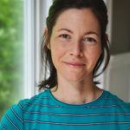
Need Application Writing Help?
Bethune Writing Centre with Kathryn
https://www.yorku.ca/colleges/bethune/writing/?gad_source=1&gclid=Cj0KCQjw6oi4BhD1ARIsAL6pox3Z7JSFY49ycj0Cjs1s0rZOvepC6TPkQ88dl2KYqMy4A7IQQOCUHeIaAs3fEALw_wcB&gclsrc=aw.ds
  Offer help with writing: personal statements, applications, assignments, thesis, lab reports, essays, citations,
  Drop-in at Steacie, Study Room A (Wed 1:00 – 2:30, 10 mins max.)
  Appointments
    In-person BC 206
    Virtual on Zoom

Slide 46

Summary
Consecutive teacher pathways are typically Bachelor’s programs, except OISE (MT)
Admissions requirements differ slightly from school to school but generally include completion of an undergraduate degree, with a ~70% average
Always check requirements online as they may change year-to-year
Meeting minimum requirements does not guarantee admission

Slide 47
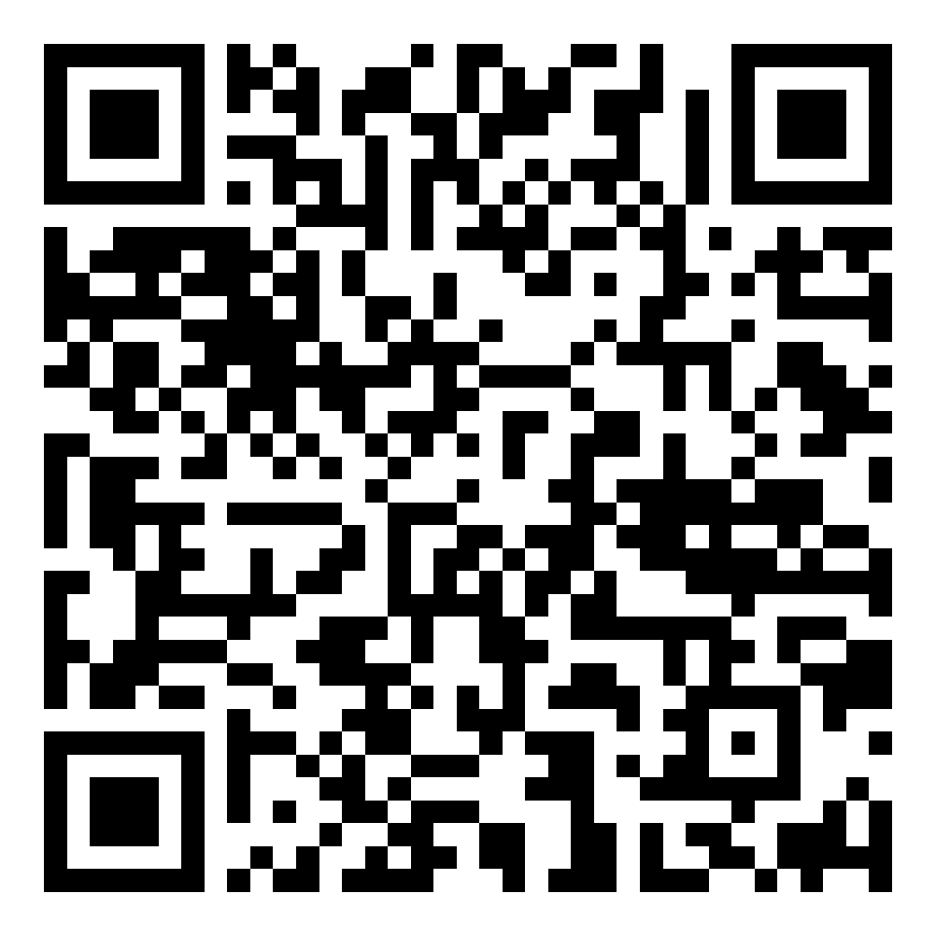
Upcoming Seminars + Slides Access
Oct 30 5:30 pm | BC320 and Zoom | Mastering the MCAT
Nov 6 5:30 pm | BC320 and Zoom | How to Get into Dental School
Nov 13 5:30 pm | BC 320 and Zoom | Study Tips for Exams
Nov 20 5:30 pm | BC 320 and Zoom | Make your Degree International
Slides for this seminar will be posted in the coming days!

Slide 48
Our Guest Speaker

Slide 49
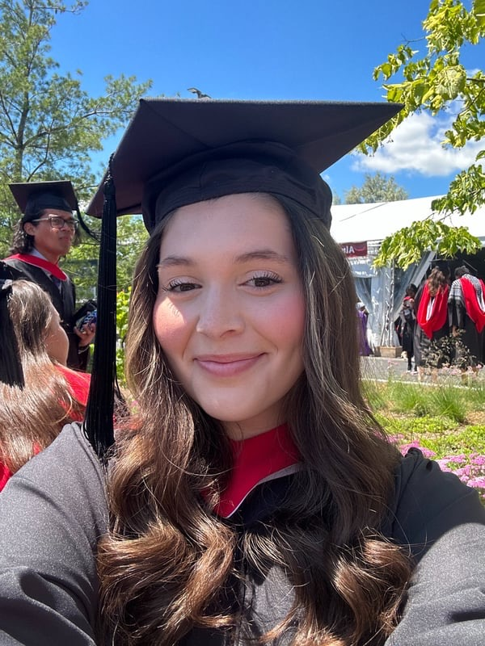
Simona Coletti – 1st Year Teacher’s Ed at Brock
York Mathematics for Education (Major) and Chemistry (Minor) Alum
Favourite York Courses: Organic Chem (CHEM3020!!) and Topics in Math Education (MATH4100!!)
Hobbies: Swimming, Baking, Scrapbooking
Why Teacher’s College? I have always wanted to be a teacher to help others and share my knowledge. Sadly I made a mistake not applying correctly to concurrent so I had to apply to teacher’s college during my undergrad.
Key piece of advice for undergraduate students: There is so much time to change your mind, find a path and make it your own. A professor once said your major is the depth of your undergrad and your electives are the width, so enjoy trying a bunch of different things to expand that!
Fun Fact: I was a Peer Mentor for my last 2 years at York and loved it!!
Also applied to: York, Western, Lakehead, OntarioTech and UofT

Slide 50
Questions for Simona:

Slide 51
What is one thing you wish someone had told you before Teacher’s College or the application process?

Slide 52
The requirements for schools are so different… do I need experience teaching? What are some non-traditional teaching experiences?

Slide 53
What is the difference between MEd and MT? Can I become a teacher with MEd?

Slide 54
What are community placements like?

Slide 55
HAVE ANY QUESTIONS?
Ask away OR
Send us an email: BCMENTOR@YORKU.CA
Visit:
bethune.yorku.ca

