Slide 1


How to Get Into Medical School
___Bethune SOS Seminar___
Presenters: Shayan, Jeyany, Nandini
Date: Wednesday, October 2nd 2024
Note: This presentation contains hyperlinks to websites. The presentation will be posted online under the Bethune College Workshops webpage: https://www.yorku.ca/colleges/bethune/events-workshops/workshops/

Slide 2
MEET OUR MENTORS
Shayan J. Jeyany J. Nandini B.
Notes:
Share your year, program and a fun fact about yourself

Slide 3






Overview
Introduction
  Different type of physicians
  Education & Fees
  Lifestyle
What you need to get into Medical School
  Extra-curricular involvement
  Medical College Admissions Test (MCAT)
  CASPer
  OMSAS Application Requirements (Ontario)
  Interviews
Summary
Q&A

Slide 4
Disclaimer
The information provided in this seminar gives some background information about the medical school application process. This is based on information provided by medical school websites, OMSAS, and the AAMC. Any experiences given by the presenters or guest speaker may not reflect experiences shared by others. They are here to deliver the presentation, answer any questions, and provide support.
We do our best to provide you the most updated information. Please ensure you obtain the latest information by conducting your own research.

Slide 5
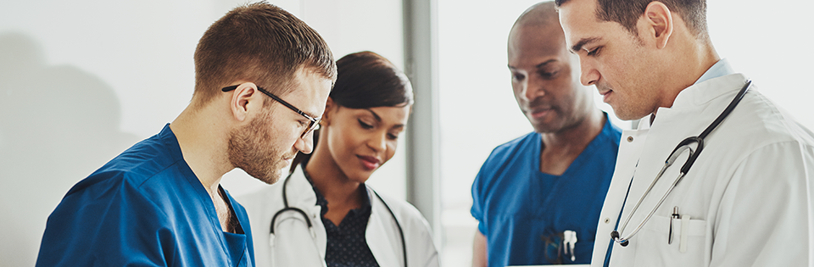
Different Types of Physicians
Primary Care (Pediatrician, Family Practitioner and Internal Medicine, etc)
Surgeons (Neurosurgeon, Plastic Surgeon, General Surgeon, ENT, OBGYN etc)
Specialists (Dermatologist, Cardiologist, Psychiatrist, Neurologist, Nephrologist, etc)

Slide 6
How Much Education Does it Take to Become a Doctor?
Typically takes 10-16 years:
Undergraduate studies 3-4 years
Medical School 3-4 years
Residency Training 3-7 years
Fellowship* 1-2 years
*Fellowship is optional in the case you need to sub-specialize in a certain field.
Resources: https://careersinmedicine.aamc.org/explore-options/specialty-profiles

Slide 7
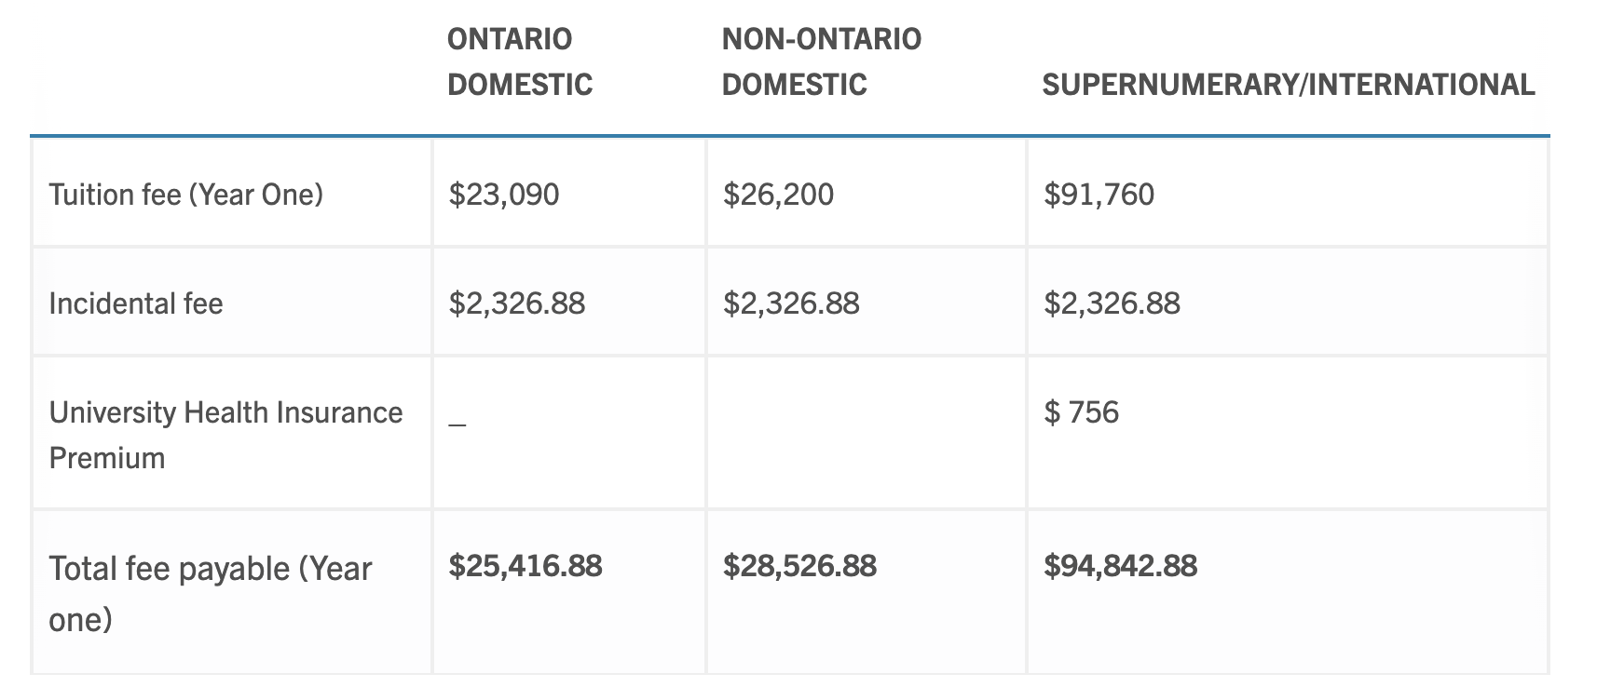
What is the cost of attending Medical School in Canada?
From University of Toronto’s Website:
Resources: https://md.utoronto.ca/current-fees

Slide 8

What is the Lifestyle Like?
Work hours vary between specialities
Common to work 35 to 60 hours a week
Lifestyle varies depending on specialty:
  Surgical specialties are typically “on call”
  Some have fixed hours
Requires determination, sacrifice, and dedication

Slide 9

What Will You Need?
Key Competencies (CanMEDS)
Extra-curricular Involvement
Medical College Admissions Test (MCAT)
CASPer Test
OMSAS Application System
Admission Requirements (Ontario)
Interviews

Slide 10
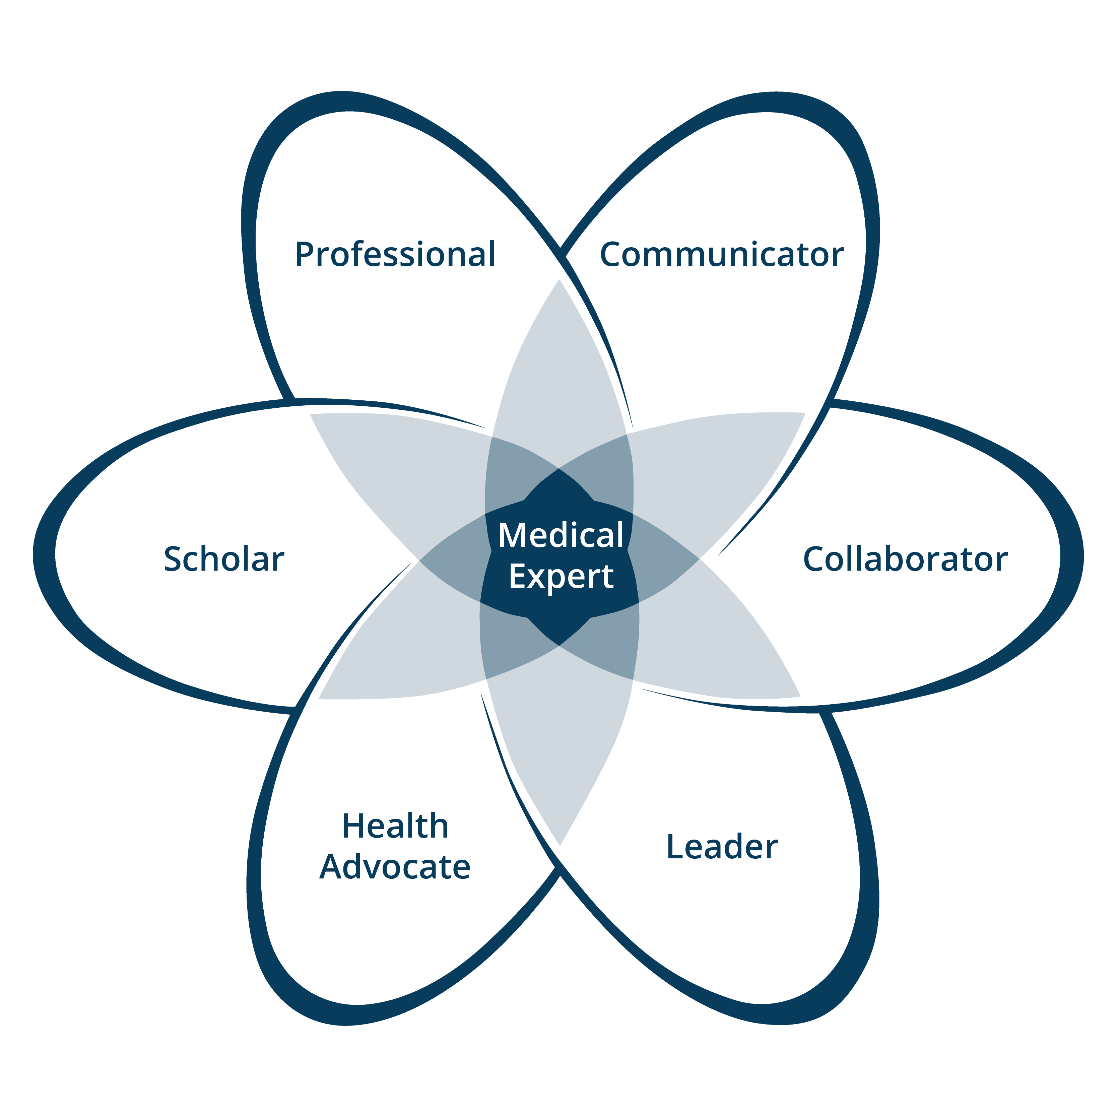
CanMEDS (Physician Competency Framework) https://www.royalcollege.ca/en/standards-and-accreditation/canmeds.html
‘Is a physician competency framework that identifies and describes the abilities physicians require to effectively meet the health care needs of the people they serve’
Keep the following characteristics in mind when considering Medical School:
  Communicator
  Collaborator
  Leader
  Health Advocate
  Scholar
  Professional

Slide 11

Extra-curricular Involvement
Research Positions
  RAY (Research @ York)
  Work-study positions with professors
  Research at Hospitals
Volunteer Opportunities
  Volunteering at Hospitals
  Joining Clubs and Organizations at York
  Community Involvement
Leadership Positions
  Executive member on clubs/organizations
Sports and Hobbies
  Varsity, intramurals

Slide 12


OMSAS Application System (through OUAC)
ONTARIO MEDICAL SCHOOL APPLICATION SERVICE (OMSAS)
Standard Application Service Fee: $220
Additional institutional fees apply
DEADLINES (For Current 2024-2025 Cycle):
Ontario Medical School Fee Waiter Program: Aug 22, 2024 11:59PM
OMSAS application: Oct 1, 2024 4:30PM
  Transcripts, References, All payments
MCAT Scores: Oct 21, 2024
Interview Invites: Jan/Feb
Interviews: Late Feb to Early April
First round of admission offers: May 13, 2025
Final transcripts: June 30, 2025

Slide 13
OMSAS Application System (through OUAC)
DEADLINES (For Current 2024-2025 Cycle):
Toronto Metropolitan University has different deadlines as they just received accreditation!
“Due to the accreditation process, the TMU School of Medicine’s application period for 2025 entry is off cycle. Applications to our program will be accepted via OMSAS from October 9 – December 2, 2024, for a September 2025 start.”
From: https://www.torontomu.ca/school-of-medicine/programs/md/how-to-apply/#:~:text=Applications%20to%20our%20program%20will,dates%20as%20of%20January%202025.

Slide 14

OMSAS Components
AUTOBIOGRAPHICAL SKETCH (ABS)
Need to write about
  Type of activity (Up to 32 activities)
  Number of hours invested
  150-character explanation
  Verifier
This might include:
  Employment
  Volunteer activities
  Extracurricular activities
  Awards and accomplishments
  Research
  Other
*Note: Only activities from age 16+

Slide 15
OMSAS Components
3 REFERENCES + CONFIDENTIAL ASSESSMENT FORMS (CAFs)
They typically ask that the 3 references be each one of the following:
  Academic or Employment related
  Non-academic or personal
  Additional referee of your choosing
SCHOOL-SPECIFIC QUESTIONS
E.g. UofT and TMU have their own essay questions that are answered through the OMSAS portal

Slide 16

So, what’s the deal about OMSAS GPA?
It may be perceived as unequitable
E.g. York has no equivalent to a 3.9
  York: 85% = 3.8
  UofT: 85% = 3.9
This may make your OMSAS GPA lower than your York GPA!
Let’s take a look at the OMSAS Grade Conversion Table on the next slide:

Slide 17
OMSAS GPA
Type | Numeric |  | Percentage |  |  |  | Alpha
Scale | 1 | 2 | 3 | 4 | 5 | 6 | 7 | 8 | 9
OUAC value
4.00 | 9 | 8 | 90–100 | 93–100 | 94–100 | 94–100 | A+ | A | A+
3.90 |  |  | 85–89 | 84–92 | 87–93 | 85–93 | A
3.80 |  |  |  |  |  |  |  |  | A
3.70 | 8 | 7 | 80–84 | 75–83 | 80–86 | 80–84 | A- | A-
3.30 | 7 | 6 | 77–79 | 72–74 | 75–79 | 75–79 | B+ | B+ | B+
3.00 |  |  | 73–76 | 69–71 | 70–74 | 70–74 | B | B | B
2.70 | 6 | 5 | 70–72 | 66–68 | 65–69 | 65–69 | B- | B-
2.30 | 5 | 4 | 67–69 | 64–65 | 60–64 | 60–64 | C+ | C+ | C+
2.00 |  |  | 63–66 | 62–63 | 55–59 | 55–59 | C | C | C
1.70 | 4 | 3 | 60–62 | 60–61 | 50–54 |  | C- | C-
1.30 |  | 2 | 57–59 | 56–59 |  |  | D+ | D+ | D+
1.00 |  |  | 53–56 | 53–55 |  | 50–54 | D | D | D
0.70 |  |  | 50–52 | 50–52 |  |  | D- | D-
0.00 | 3 | 1 | ≤ 49 | ≤ 49 | ≤ 49 | ≤ 49 | E/F | E/F | E/F

Slide 18

Medical College Admission Test (MCAT) - Overview
Standardized exam, required for admission to most medical schools in Canada
Computer-based exam (no calculator)
230 Multiple Choice Questions
7.5 hours total (including 50 minutes of breaks)
  Two 10-minute breaks and 30-minute lunch break
Tests knowledge in these 4 sections
Biological and Biochemical Foundations of Living Systems
Chemical and Physical Foundations of Biological Systems
Psychological, Social and Biological Foundations of Behavior
Critical Analysis and Reasoning Skills (CARS)

Slide 19
Psychological, Social and Biological Foundations of Behaviour
Critical Analysis and Reasoning Skills (CARS)
95 MINS
59 Qs
10 passages with 44 passage-based Qs + 15 discrete questions
95 MINS
59 Qs
10 passages with 44 passage-based Qs + 15 discrete questions
90 MINS
53 Qs
9 Qs, all passage-based
General Chemistry 30%
Biochemistry 25%
Physics 25%
Organic Chemistry 15%
Biology 5%
Psychology 65%
Sociology 30%
Biology 5%
Humanities 50%
Social Science 50%
*Passage (reading and analysis) based!
95 MINS
59 Qs
10 passages with 44 passage-based Qs + 15 discrete questions
Biology 65%
Biochemistry 25%
General Chemistry 5%
Organic Chemistry 5%
Biological and Chemical Foundations of Living Systems
MCAT
Chemical and Physical Foundations of Biological Systems
From: https://www.mcat-prep.com/what-is-the-mcat/

Slide 20

MCAT - Scoring
https://youtu.be/bziZbnitaMI?si=90ZgJZwZ4Sd1rjj7&t=30

Slide 21
MCAT – Resources
Getting Started
Social Media (YouTube, blogs, Reddit)* Tons of people share their experiences, check out some videos/blogs r/MCAT has many links to legitimate free resources, Anki decks, mnemonics, and study plan spreadsheets AAMC Website Carefully reach all information they have online and use their practice materials Friends, peers and mentors! Reach out to anyone you know who has the written the MCAT for advice!
Content Review
Khan Academy YouTube videos Exam prep books (ExamKrackers, Kaplan, Princeton) Preparation Courses (Kaplan, Princeton) Flash cards (Anki decks, quizlet, etc…)
Practice Questions
AAMC practice questions/passages Free online practice (Khan academy, Jack Westin) Question Banks (Bemo, Uworld)
Practice Exams
AAMC Full Length practice exams Exam prep company Full Length practice exams
* Be mindful that some people are breaking their MCAT agreement on these sites!

Slide 22
MCAT - FAQ
When can I register?
  The week of Feb 15 for April, May and June dates
  In May for July, August and September dates
How much does it cost to write the MCAT?
  Currently $335 USD + tax to register and write (in Canada), $$$ to reschedule or cancel
How many times can I write the MCAT?
  The MCAT can be written:
    Up to 3 times in a single testing year
    Up to 7 times in a lifetime
How long does it take to get my score?
  ~1 month following your test date
What does voiding an exam mean?
  Writing the exam, but do not want it to be marked
  Option is given at the end of the exam (3 minutes to decide)
  No refunds! Counts as an attempt (out of the 7 lifetime attempts)

Slide 23
Have more questions about the MCAT?
Join our MCAT Seminar, October 30th!

Slide 24
Schools in Ontario
Program | Fees
University of Toronto | $130
McMaster University | $130
University of Ottawa | $130
University of Western Ontario | $125
Queen’s University + Queens-Lakeridge Family MD program | $125
Northern Ontario School of Medicine | $125
Toronto Metropolitan University | $125
From: https://www.ouac.on.ca/guide/omsas-fees/

Slide 25

Computer-based Assessment for Sampling Personal Characteristics - CASPer
Online, scenario-based test assessing non-academic qualities like empathy, ethics, and decision-making.
Ontario Schools Requiring CASPer:
  McMaster, University of Ottawa, Queen's University, NOSM
Format
  12 scenarios (video or word-based prompts)
  3 open-ended questions each (5 mins/section)
Preparation Tips:
  Practice responding to ethical dilemmas.
  Stay calm under time pressure.
  Focus on empathy, ethical reasoning, and clarity in responses.

Slide 26
CASPer Example
Prompt: COVID-19 is an infectious disease that has quickly taken over our world. Many people feel that we will not be able to return to our “normal” lives until a vaccine is developed. It is likely that when the vaccine is developed, there will not be enough vaccines for everyone to receive it right away.
Questions
  How should priority be determined for the COVID-19 vaccine?
  What are the ethical concerns to consider in any priority or ranking system?
  Discuss a time where you had to choose one person over another in a personal situation and how you came to your decisions.
From: https://www.caspertest.com/casper-sample-questions/#sample-question-card-7

Slide 27
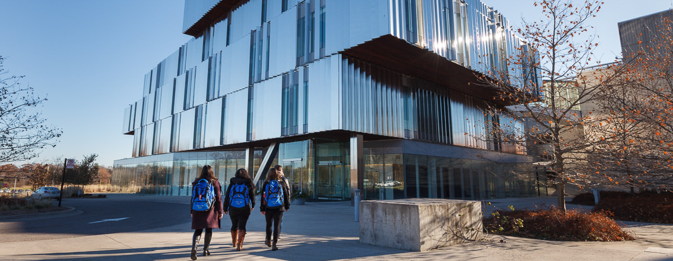
University of Toronto

Slide 28
University of Toronto – Academic Requirements
Minimum of 3 years of undergraduate work
  90 credits (weighting formula for full course load)
  28 credits is a full course load
GPA cutoff:
  3.6/4 (Full-time summer courses count )
  Average accepted GPA 3.95 (2024)
MCAT cutoff: 125 in each section (allowance of 124 in one section) *not scored
640/4290 students interviewed in 2024
From: https://applymd.utoronto.ca/admission-stats

Slide 29
University of Toronto – Course Prerequisites
Required
2 full course equivalents (FCEs) in Life Sciences
  Examples: Biology, Anatomy, Biochemistry, etc
1 full course equivalent in humanities/social science/language
1 FCE = 6 credits
No minimum required grade for prerequisite courses
Recommended
Course in Statistics
At least 2 full courses in expository writing
From: https://applymd.utoronto.ca/academic-requirements & https://applymd.utoronto.ca/prerequisite-courses

Slide 30
University of Toronto – Non-Academic Requirements
Brief Personal Essays
2 statements answering questions (outlined on their website each year)
  Question 1 (2024/25): In what way(s) are you a product of the world around you? How has it, or how will it, impact your journey in medicine?
  Question 2 (2024/25): Investor and philanthropist Charlie Munger is known for saying: “We all are learning, modifying, or destroying ideas all the time. Rapid destruction of your ideas when the time is right is one of the most valuable qualities you can acquire. You must force yourself to consider arguments on the other side.” Explore how this may affect a career in medicine.
Autobiographical Sketch & Statements (ABS) → OMSAS
List of activities + achievements since age 16
1 statement (500 words or less) expanding on an ABS item (UofT specific)
References
3 References + their Confidential Assessment Forms
From: https://applymd.utoronto.ca/non-academic-requirements

Slide 31
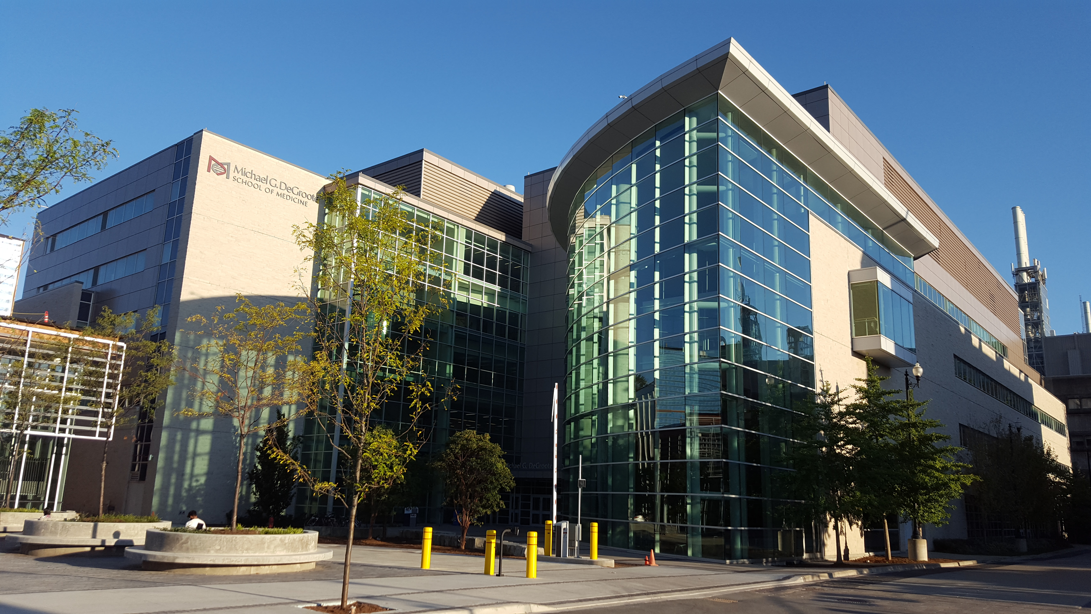
McMaster University

Slide 32
McMaster University – Academic Requirements
Minimum of 3 years of undergraduate work - ANY major
  90 credits (full course load not required)
  Prerequisites: None
GPA cutoff: 3.0 (Cumulative)
MCAT cutoff: CARS 123 (128+ is competitive)
CASPer
221/5284 applicants admitted to the Class of 2027 (569 interviewed)
  Students starting this year!
Only your CARS score, CASPer score, and GPA are used for interview consideration
From: https://ugme.healthsci.mcmaster.ca/admissions/before-you-apply/

Slide 33
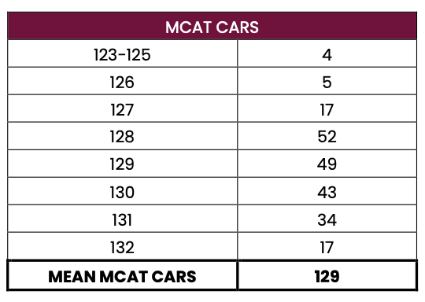
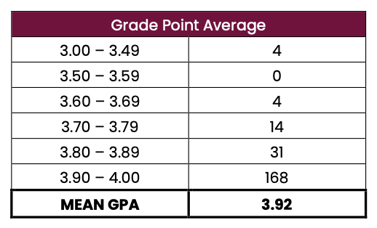
McMaster University – Stats
Medical School Admissions Stats are made available online.
Let’s take a look at the new cohort of Medical Students at McMaster:
GPA cutoff: 3.0 (Cumulative)
MCAT cutoff: CARS 123 (128+ is competitive)
From: https://ugme.healthsci.mcmaster.ca/wp-content/uploads/2024/08/Class-of-2027-Statistics.pdf

Slide 34
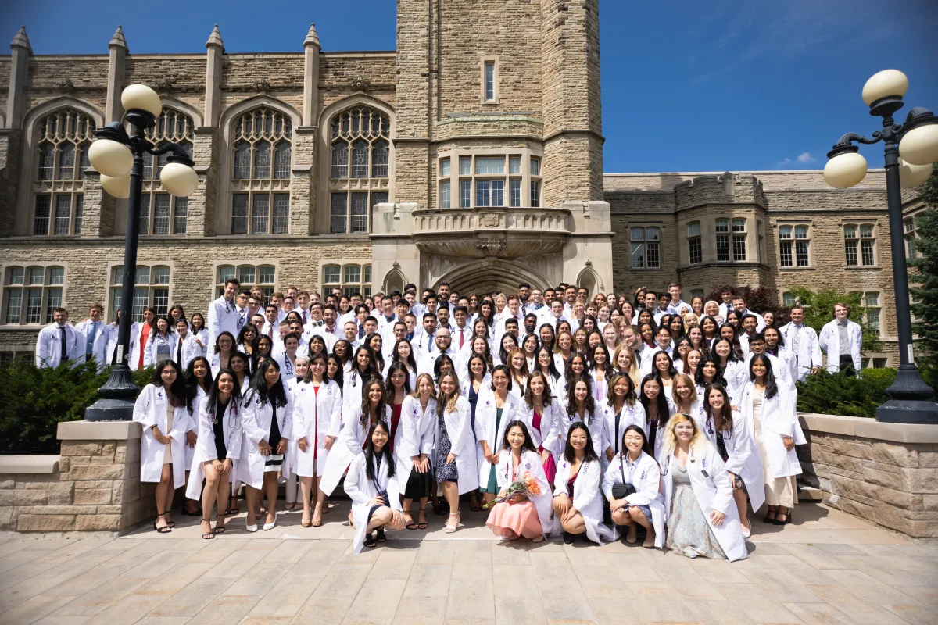
University of Western Ontario

Slide 35
Western– Academic Requirements
4 year undergraduate degree
  120 credits
  Prerequisites: none
GPA cutoff: 3.70
  Calculated from the 2 best years with full course load
  For first and second years, 60% course load should be at the level of that year of study or higher
  For the third and fourth years, 60% of the course load should be be at third level or higher.
  GPA minimum must be met in EACH of the 2 best years
  Summer Courses will not be counted
MCAT cutoff: varies annually, check this online
  For 2023/2024, a minimum score of 127 in BBFLS, CPBS and CARS + 126 in PSBB was required
From: https://www.schulich.uwo.ca/med_dent_admissions/medicine/admission_requirements.html

Slide 36
Western – Non-Academic Requirements
Western Autobiographical Sketch (ABS)
This is separate from the OMSAS ABS
Collected once OMSAS application closes
References
3 References + their Confidential Assessment Forms
  Academic or Employment related
  Non-academic or personal
  Additional refer of your choosing
From: https://www.schulich.uwo.ca/med_dent_admissions/medicine/admission_requirements.html

Slide 37
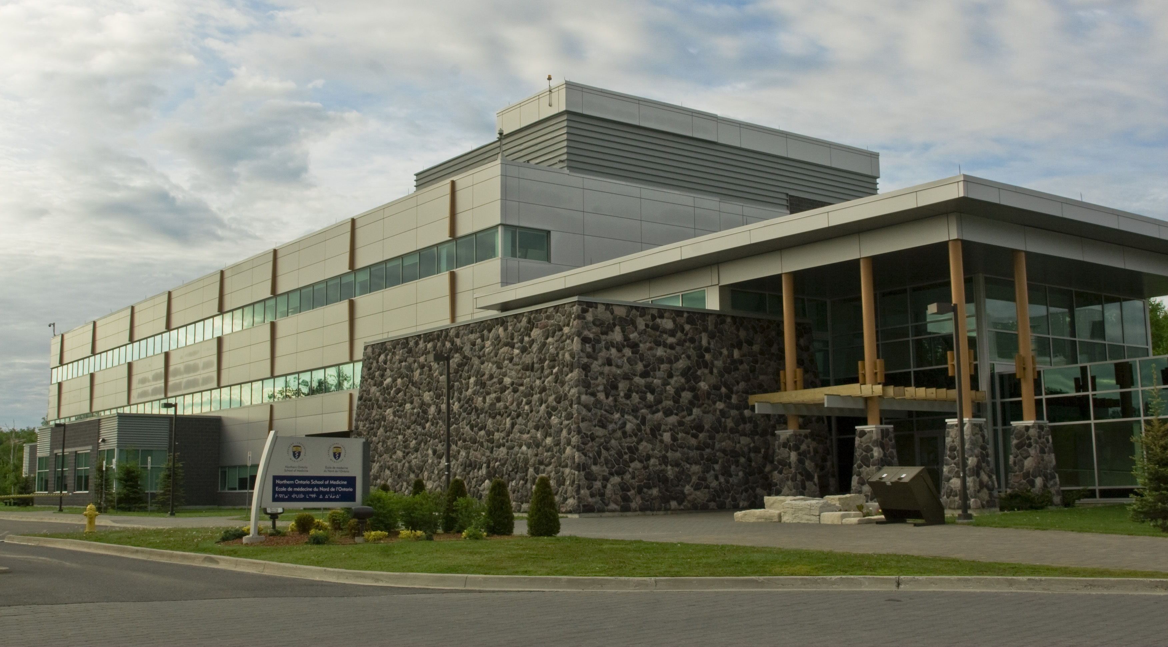
Northern Ontario School of Medicine (NOSM)

Slide 38
NOSM– Academic Requirements
4 year undergraduate degree
  120 credits
  Prerequisites: none
    Recommended:
    Science majors: 2 full course equivalents in arts/social sciences /humanities
    Art/social science/humanities majors: 2 full course equivalents in science
GPA cutoff: 3.0 on OMSAS 4.0 scale
  Cumulative
MCAT: not required
CASPer: not required
From: https://www.nosm.ca/nosm-university-admissions-learner-recruitment/ume-program-md-degree-admissions/application-information-requirements/minimum-requirements/

Slide 39
NOSM– Non-Academic Requirements
Context Score
Based on geographic/cultural criteria
  Emphasis on Northern Ontario, rural/remote areas
Employment experience may count
ABS → OMSAS
NOSM seeks applicants with a demonstrated interest and experience in Northern Ontario and/or rural/remote areas in the rest of Canada
References
3 References + their Confidential Assessment Forms
  At least one (1) referee should be a non-academic/character referee.
  It is recommended that one (1) CAF comes from a member of the community or from a community organization, and that at least one (1) be an academic reference.
  Accept CAFs written in French.
From: https://www.nosm.ca/nosm-university-admissions-learner-recruitment/ume-program-md-degree-admissions/application-information-requirements/minimum-requirements/

Slide 40
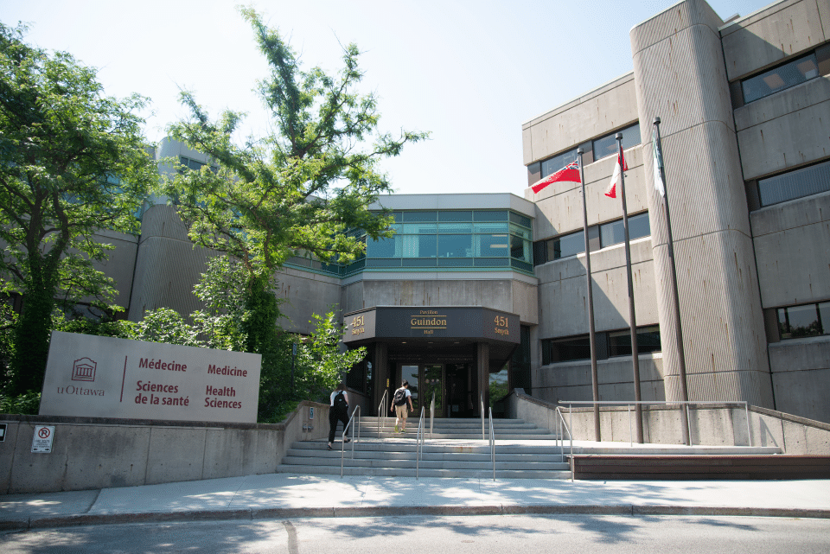
University of Ottawa

Slide 41
University of Ottawa – Academic Requirements
Minimum of 3 years of undergraduate work
  90 credits (full course load required)
  Full time undergrad studies = 5 full courses/10 half courses in regular academic year (fall + winter) OR 4 full courses/8 half courses in regular academic year and then 1 full course/2 half courses in the summer
GPA cutoff: 3.5 (WGPA* in previous years)
  New! Cumulative GPA (cGPA) for the most recent 3 years of full-time undergraduate studies including summer course grades
  cGPA cut-off increases based on the stream you apply too; to learn about the cut-off contact the admissions office
MCAT: Not required but it is encouraged to write the MCAT!
From: https://www.uottawa.ca/faculty-medicine/undergraduate/admissions/application-process

Slide 42
University of Ottawa – Academic Requirements
Prerequisites (Minimum Grade of “B” is required for prereqs)
6 units in General Biology (BIOL 1000 & 1001)
  Anatomy and Physiology courses are also accepted
6 units in Humanities/Social Science
  Any course that is not considered to be a science based
  Examples: Sociology, Psychology, Math, Religion, Administration & English ** second language courses do not count
3 units in the following courses:
  Biochemistry (BIOL 2020 or CHEM 2050)
  Chemistry (CHEM 1000 & 1001)
  Organic Chemistry (CHEM 2020 & 2021)
  Statistics (Any statistics course like bio stats or psych stats)
Lab requirement can be met by having 6 units worth of lab courses
From: https://www.uottawa.ca/faculty-medicine/undergraduate/admissions/application-process

Slide 43
University of Ottawa – Non-Academic Requirements
CASPer (Computer-based Assessment for Sampling Personal Characteristics)
Assessment of interpersonal skills and decision-making
90 minutes
Autobiographical Sketch (ABS)
References
3 References + their Confidential Assessment Forms
  Academic or Employment related
  Non-academic or personal
  Additional refer of your choosing
Language Proficiency
Choice of instruction in either French or English
Interviews conducted in the language of instruction indicated on application
From: https://www.uottawa.ca/faculty-medicine/undergraduate/admissions/application-process

Slide 44
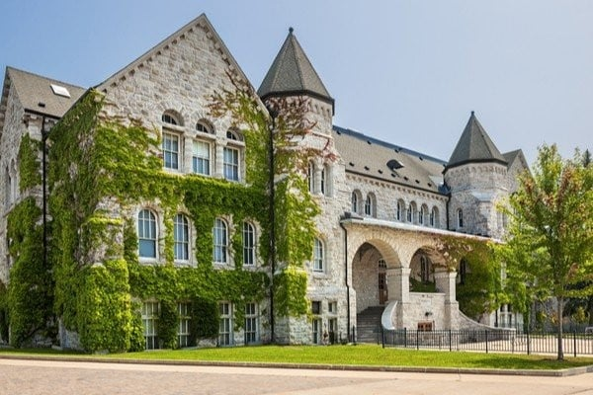
Queen’s University

Slide 45
Queen’s University – Academic Requirements
Minimum of 3 years of undergraduate work
  90 credits
  Prerequisites: none
GPA cutoff: varies from year to year
  2 GPAs are calculated
  Cumulative GPA (CGPA) *Summer Courses included
  Most recent two full -time years GPA (2YGPA) *Summer Courses do not count
    At least 3 courses per semester (considered full course load)
    Do not have to be sequential
1st cutoff: cGPA. If you do not meet this cutoff, 2YGPA is considered for the cutoff
From: https://meds.queensu.ca/academics/mdprogram/admissions/eligibility_application_process

Slide 46
Queens– Academic + Non-Academic Requirements
MCAT cutoff varies annually, check this online
  For 2024/2025, a minimum score of 125 in each section is required
References
3 References + their Confidential Assessment Forms
  Academic or Employment related
  Non-academic or personal
  Additional refer of your choosing
From: https://meds.queensu.ca/academics/mdprogram/admissions/eligibility_application_process

Slide 47
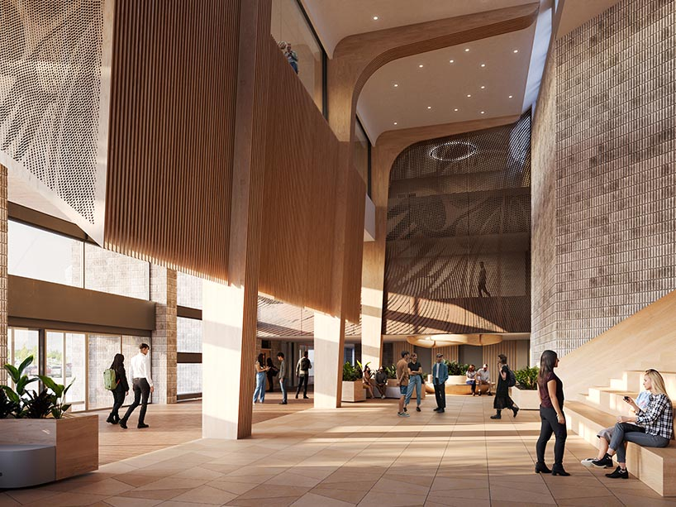
Toronto Metropolitan University (TMU) ** NEW

Slide 48
TMU – Academic Requirements
Minimum of 4 years of undergraduate work
  120 credits are required prior to the start of Year 1
  Prerequisites: none
GPA cutoff: 3.3
Answers to 4 Supplementary Questions
  More on these on the next slide!
From: https://www.torontomu.ca/school-of-medicine/programs/md/application-requirements/#!accordion-1725387950818-gpa-requirement

Slide 49
TMU – Non-Academic Requirements
4 Supplementary Questions for the 2025 Admissions Cycle:
How have your lived experiences contributed to your personal growth and desire to pursue a career in medicine?
What leadership roles and/or community engagement experiences have you undertaken within your community, particularly in efforts aimed at supporting and advocating for marginalized groups? How have these experiences prepared you to address the needs of underserved communities as a future healthcare professional?
How have your personal, professional, or extracurricular experiences with diversity, inequity, and/or marginalization influenced your efforts to create a more inclusive environment in your school, community, or workplace?
Describe your connection(s) to the Brampton/Peel Region and surrounding communities and/or your interest in practicing in culturally diverse communities such as these, that represent the future of Canada.
From: https://www.torontomu.ca/school-of-medicine/programs/md/application-requirements/#!accordion-1725387950818-gpa-requirement

Slide 50
Schools in Canada – 18 Total
Ontario
McMaster
Ottawa
Western
Queens
UofToronto
NOSM
TMU** NEW
Quebec
Laval
McGill
Montréal
Sherbrooke
Alberta
UofAlberta
UofCalgary
Newfoundland & Labrador
Memorial University of Newfoundland
Saskatchewan
UofSaskatchewan
Nova Scotia
Dalhousie
British Columbia
UBC
Manitoba
UofManitoba

Slide 51
Schools in the United States
155 accredited medical schools in the United States
School specific requirements
  Physics and English
  Some accept Humanities instead of English
Apply via AMCAS
  https://students-residents.aamc.org/applying-medical-school-amcas/applying-medical-school-amcas
BeMo’s guide on Canadian Friendly US Medical Schools (2024)
  https://bemoacademicconsulting.com/blog/canadian-friendly-us-med-schools

Slide 52

Interviews
Assessing your personal qualities
Personal qualities and traits (e.g. maturity)
Personal experiences and interests
Exposure to healthcare and medical research environments
Potential contributions to the campus and community
Ability to communicate
Getting to know you as a person

Slide 53

Interview Preparation
Plan your trip carefully
Dress accordingly to weather
Dress comfortable yet professional
Practice common questions
Know your application
Be honest and sincere
Be ready to discuss your research in layman’s terms (if you’ve done any)
Thank everyone who helped

Slide 54

Panel Interviews
More than one interviewer interviews you the same time
May be interviewed with other candidates together
Interviewers can be faculty, students, admission officers
May be open file, blind or partially blind (reviewing of applicant’s file before interviews)

Slide 55
Multiple Mini Interview (MMI) Format
10-station circuit
Each station lasts 8 minutes with a 2-minute break between stations
Topics may include:
Ethical decision making
Critical thinking
Personal questions
Communication skills
Knowledge of the healthcare system

Slide 56
MMI Possible Scenarios
Interaction with an actor
A writing station
Interaction with other candidates
Standard interview station
Ethical scenario with questions
Example question: “Should a doctor's primary aim be to change behavior to prevent disease or treat existing disease? What are your thoughts on upstream and downstream care?”
Question from: https://www.shemmassianconsulting.com/blog/mmi-interview#mmi-interview-questions

Slide 57

Summary
There are several medical schools in Canada, and even more in the United States
Admissions requirements differ slightly from school to school but generally include
  GPA (min 3.0)
  MCAT
  ABS
  References
Always check requirements online as they change year-to-year
Meeting minimum requirements does not guarantee admission

Slide 58
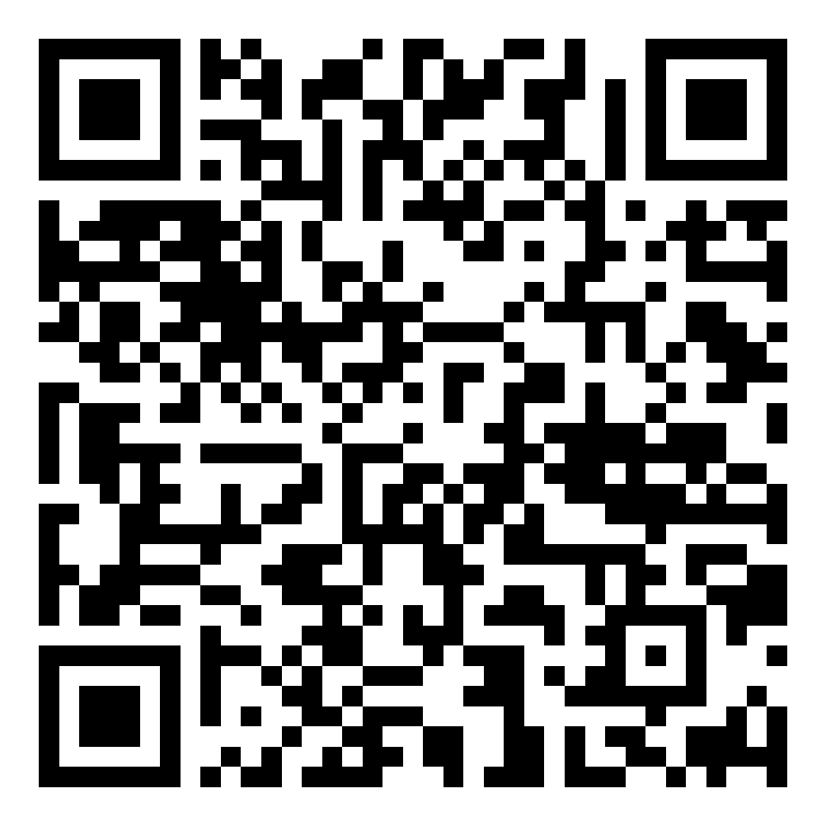
Upcoming Seminars + Slides Access
Oct 9 5:30 pm | BC320 and Zoom | Crafting Strong Professional School Applications
Oct 23 5:30 pm | BC203 and Zoom | How to Get into Teacher’s College
Oct 30 5:30 pm | BC320 and Zoom | Mastering the MCAT
Nov 6 5:30 pm | BC320 and Zoom | How to Get into Dental School

Slide 59
Our Guest Speaker

Slide 60
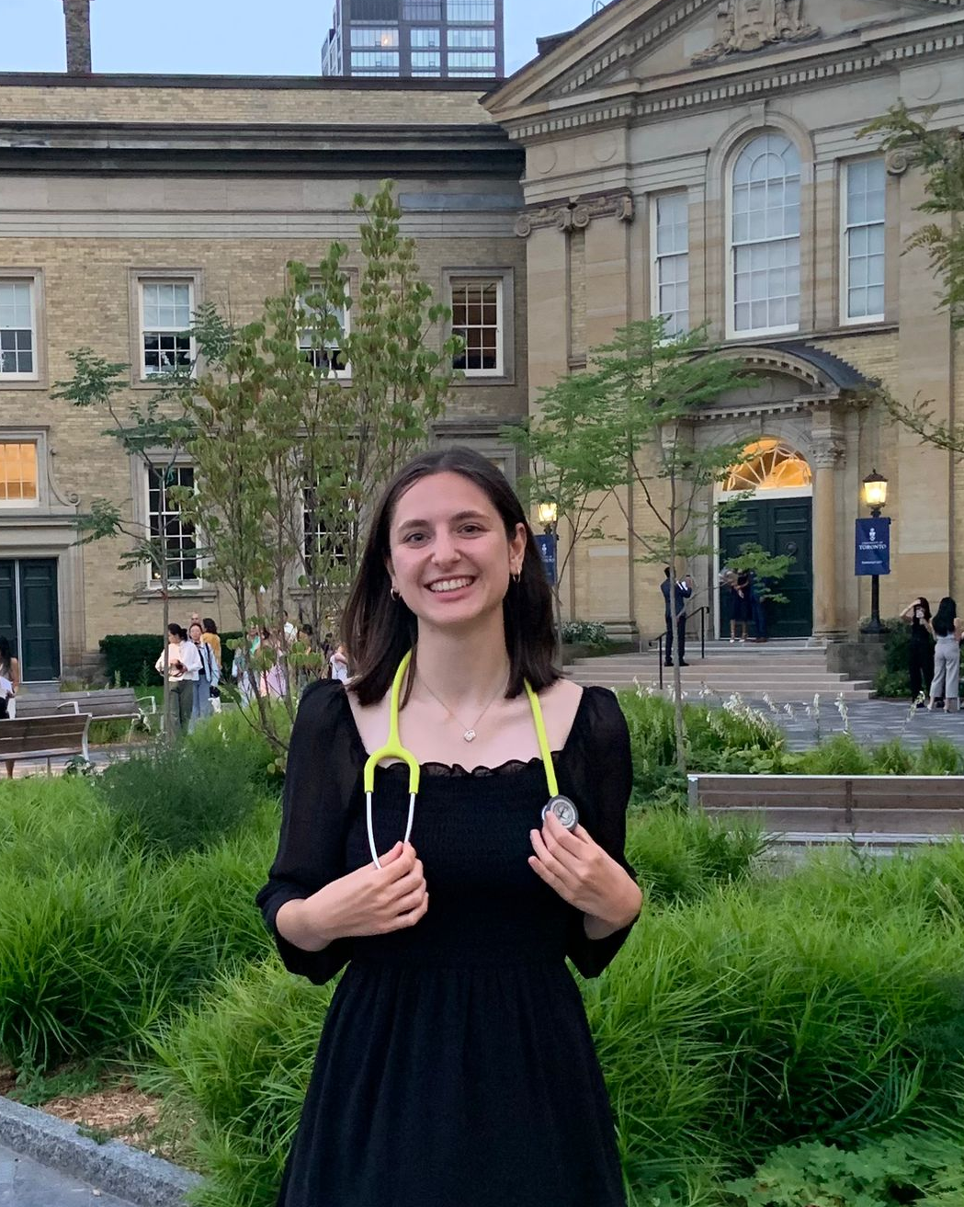
Claire Del Zotto - 1st Year Medical Student at UofT
York Biology Alum
Favourite York Courses: Anything Ecology related! (Don’t feel like you need to love cell/molecular biology to be a doctor)
Hobbies: Intramural sports, arts and crafts, hiking and nature photography
Why Med? Claire liked biology but has a minor fear of cats so could not be a vet.
Key piece of advice for undergraduate students: Don’t let your career goals stop you from having fun + enjoying the present!
Fun Fact: Claire worked in a bee research lab and she loves taking photos of bees!
Contact: cdz02@yorku.ca

Slide 61
Questions for Claire:

Slide 62
What is one thing you wish someone had told you before starting Medical School? And another?
From Claire: Don’t feel like you need to go to med school right after undergrad! So many of my classmates did amazing things in their masters/gap year/ previous careers

Slide 63
What should I get involved in? Are there any extracurriculars that will ‘boost’ my application?

Slide 64
I’m worried about my GPA not being high enough. Do I have a shot at getting into Medical School? What can I do?

Slide 65
Can I apply to Canadian Medical Schools if I am an International Student?

Slide 66
How would you go about answering this question from earlier:
“Should a doctor's primary aim be to change behavior to prevent disease or treat existing disease? What are your thoughts on upstream and downstream care?”

Slide 67
When should I start applying to Medical School?

Slide 68
What is the difference between MD, MD/PhD, DO?

Slide 69
HAVE ANY QUESTIONS?
Ask away OR
Send us an email: BCMENTOR@YORKU.CA
Visit:
bethune.yorku.ca

