Slide 1


Mastering the MCAT
___Bethune SOS Seminar___
Presenters: Lilia, Tina, Kiana
Date: Wednesday, October 30th 2024
Note: This presentation contains hyperlinks to websites. The presentation will be posted online under the Bethune College Workshops webpage: https://www.yorku.ca/colleges/bethune/events-workshops/workshops/

Slide 2
MEET OUR MENTORS
Lilia M.S.
Tina B.
Kiana B.
Notes:
Share your year, program and a fun fact about yourself

Slide 3
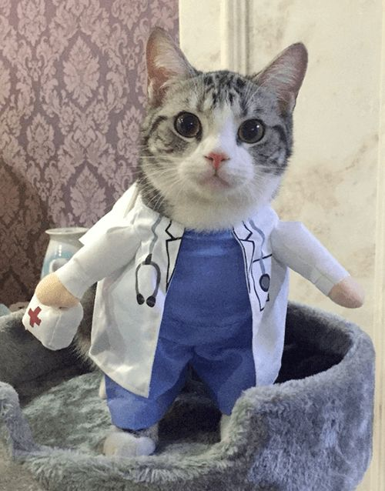
Overview
What is the MCAT?
Timelines
How to prepare and study
How to reserve a seat
Resources
Sample Questions
FAQs and Summary
Q&A

Slide 4
Disclaimer
The information provided in this seminar gives some background information about the Medical College Admissions Test. This is based on information provided by medical school websites, OMSAS, and the AAMC. Any experiences given by the presenters or guest speaker may not reflect experiences shared by others. They are here to deliver the presentation, answer any questions, and provide support.
We do our best to provide you the most updated information. Please ensure you obtain the latest information by conducting your own research.

Slide 5

What Will You Need for Medical School?
Key Competencies (CanMEDS)
Extra-curricular Involvement
Medical College Admissions Test (MCAT)
CASPer Test
OMSAS Application System
Admission Requirements (Ontario)
Interviews

Slide 6
What is the MCAT?

Slide 7


Medical College Admission Test (MCAT) - Overview
Standardized exam, required for admission to most medical schools in Canada, created by the AAMC (Association of American Medical Colleges)
Computer-based exam (no calculator)
230 Multiple Choice Questions
7.5 hours total (including 50 minutes of breaks)
  Two 10-minute breaks and 30-minute lunch break
Tests knowledge in these 4 sections
Biological and Biochemical Foundations of Living Systems
Chemical and Physical Foundations of Biological Systems
Psychological, Social and Biological Foundations of Behavior
Critical Analysis and Reasoning Skills (CARS)

Slide 8
Sections and Questions
4 sections:
  Chemistry and physics, 59 Qs
  CARS (Critical Analysis and Reasoning Skills), 53 Qs
  Biology and biochemistry, 59 Qs
  Psychology and sociology, 59 Qs
Passage-based exam
  Answer 5-7 Qs based on the passage or similar concepts
230 questions total
90-95 minutes per section
7.5 hours total (including breaks and introduction)
  Two 10-minute breaks and 30-minute lunch break
  3 minutes to decide if you want to score or void the attempt
Qs = Questions

Slide 9
Psychological, Social and Biological Foundations of Behaviour
Critical Analysis and Reasoning Skills (CARS)
95 MINS
59 Qs
10 passages with 44 passage-based Qs + 15 discrete questions
95 MINS
59 Qs
10 passages with 44 passage-based Qs + 15 discrete questions
90 MINS
53 Qs
9 Qs, all passage-based
General Chemistry 30%
Biochemistry 25%
Physics 25%
Organic Chemistry 15%
Biology 5%
Psychology 65%
Sociology 30%
Biology 5%
Humanities 50%
Social Science 50%
*Passage (reading and analysis) based!
95 MINS
59 Qs
10 passages with 44 passage-based Qs + 15 discrete questions
Biology 65%
Biochemistry 25%
General Chemistry 5%
Organic Chemistry 5%
Biological and Chemical Foundations of Living Systems
MCAT
Chemical and Physical Foundations of Biological Systems
From: https://www.mcat-prep.com/what-is-the-mcat/

Slide 10
Aids and Scores
No calculators, formula sheets or other aids allowed besides a provided periodic table + white boards.
  White boards can not be erased but they can be exchanged for a new white board.
  Review some math for chemistry and physics (logs, trig, ratios, etc.)
  Must memorize all necessary equations, pathways, definitions, etc.
Scaled scoring, rather than percentage grading
  Perfect score overall is 528
  Perfect score per section is 132
  500 is the median score
  Not a bell curve
To score or to void? That is the question.
  Consider voiding if you left many questions blank, felt ill on test day

Slide 11
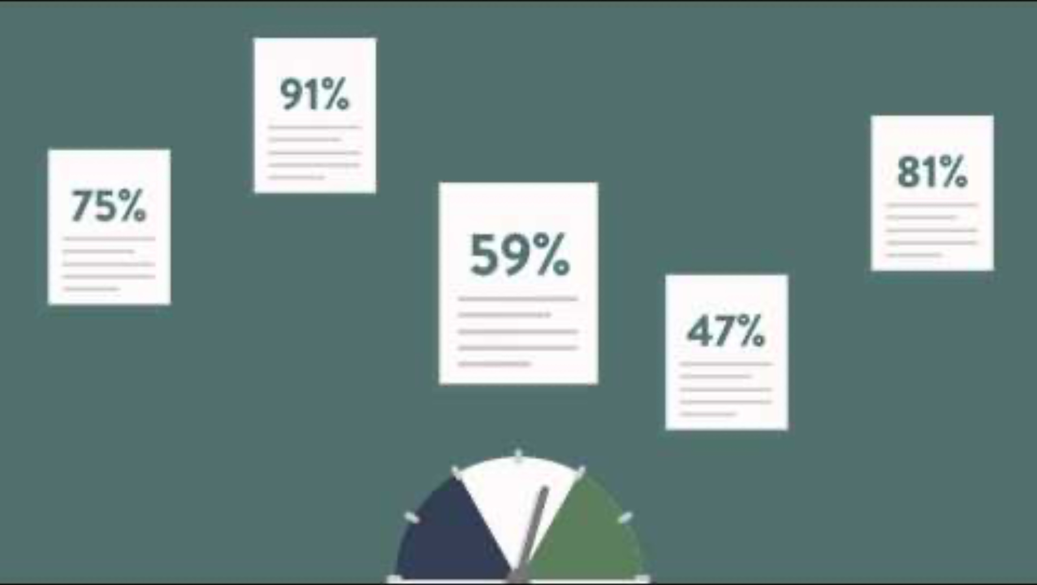
MCAT - Scoring
https://youtu.be/bziZbnitaMI?si=90ZgJZwZ4Sd1rjj7&t=30

Slide 12
Ontario Schools MCAT cutoff scores
UofT: 125 in each section (allowance of 124 in one section) *not scored
McMaster: CARS 123 (128+ is competitive)
Western: varies annually, check this online
  For 2023/2024, a minimum score of 127 in BBFLS, CPBS and CARS + 126 in PSBB was required
Queens: varies annually, check this online
  For 2024/2025, a minimum score of 125 in each section is required
Ottawa: not required
Northern School of Medicine (NOSM): not required
Toronto Metropolitan University (TMU) : not required

Slide 13
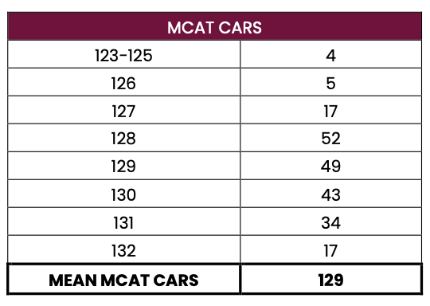
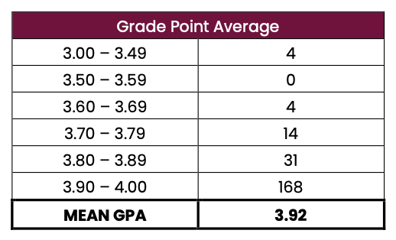
McMaster University – Stats
Medical School Admissions Stats are made available online.
Let’s take a look at the new cohort of Medical Students at McMaster:
GPA cutoff: 3.0 (Cumulative)
MCAT cutoff: CARS 123 (128+ is competitive)
From: https://ugme.healthsci.mcmaster.ca/wp-content/uploads/2024/08/Class-of-2027-Statistics.pdf

Slide 14
Suggested Timeline/Steps

Slide 15
Research
Plan
Learn what the MCAT is, testable content, registration process, and how to study for it.
Make a detailed study plan/schedule. Prioritize high yield content and tricky concepts.
1
2
3
4
Study
Gather Resources
Begin studying.
Take a mock test to get an idea of what it is like to write the test and where your weak points are.

Slide 16
Write Practice Tests
Visit Test Centre
Take practice tests under exam conditions.
Check out the test center within a week of your exam date.
5
6
7
8
Make Modifications
Write the MCAT
Make changes to your plan as necessary
Good luck!

Slide 17
Preparing & Studying for the MCAT

Slide 18
How and When can I write the MCAT?
Test dates vary each year, are usually offered on weekends January - early September
Register at least 60 days prior to your preferred exam date. However, it depends on different factors.
Keep in mind it takes ~1 month to get your score.
  You might want to know your score before applying for certain schools!
There are fees associated with signing up for and rescheduling/cancelling the exam
  Currently $335 USD + tax to register and write
  Fee assistance program is available to eligible students in need of financial assistance (Eligibility tied directly to the U. S. Department of Health and Human Services poverty level guidelines)
  Examinees testing outside the US, Canada, or US Territories will be charged a $120 International fee in addition to the initial registration fee. International fees are non-refundable upon registration cancellation

Slide 19
1. Getting Started
Social Media (YouTube, blogs, Reddit)* Tons of people share their experiences, check out some videos/blogs r/MCAT has many links to legitimate free resources, Anki decks, mnemonics, and study plan spreadsheets AAMC Website Carefully reach all information they have online and use their practice materials Friends, peers and mentors! Reach out to anyone you know who has the written the MCAT for advice!
2. Content Review
Khan Academy YouTube videos Exam prep books (ExamKrackers, Kaplan, Princeton) Preparation Courses (Kaplan, Princeton) Flash cards (Anki decks, quizlet, etc…)
3. Practice Questions
AAMC practice questions/passages Free online practice (Khan academy, Jack Westin) Question Banks (Bemo, Uworld)
4. Practice Exams
AAMC Full Length practice exams Exam prep company Full Length practice exams
* Be mindful that some people are breaking their MCAT agreement on these sites!

Slide 20
Following your plan
Stay on track
  Discipline and sustainability. Keep focused in a way that works best for you overlong periods of time.
Monitor your progress
  Use practice tests to gauge your score. Be aware that some practice tests are lot more challenging than the actual test.
Adaptability
  Be willing to alter your plan or change your resources/study methods
Make adjustments to your schedule/plan as necessary
  Life happens!
For more information: MCAT Study Schedule Tips & Template

Slide 21
Practice Tests
How should I go about doing practice tests?
MCAT morning routine
Start at the same time as your scheduled test
Scheduled exam breaks
No unnecessary materials, food, drinks, phone, etc…
No notes or practice test answers (until after you finish)
Stay focused
For more information: How to Take MCAT Practice Tests

Slide 22
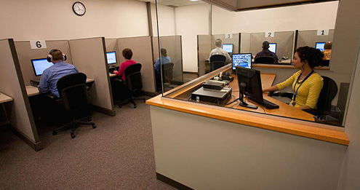
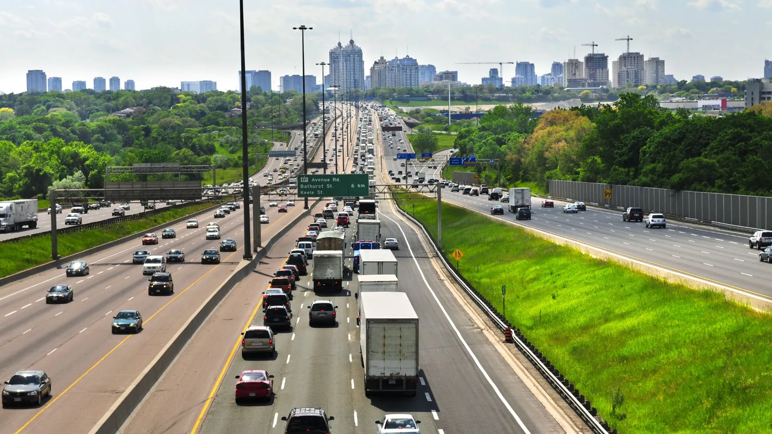
Checking out the Test Centre
Check out the test centre within a week of your exam date
  Reduce your stress the day of the exam by checking out the route and parking situation
There are 12 locations in Ontario, 6 of which are in Toronto + North York
From: https://oztrekk.com/news/where-can-i-write-the-mcat/

Slide 23
Reserving a Seat / Test Date

Slide 24
Signing up for the MCAT
You can follow the instructions from the AAMC guide to registration: https://vimeo.com/477161485
If you are signing up in the day that the registration opens, make sure to log in before 11:50 am ET. You will have 10 minutes to get back to the queue once it is your turn.
Registration for Jan-June is currently open and July-September registration will begin in February.
If you qualify for the fee assistance program, apply before you register for an exam date.
Have 3 dates that will work for you in case your first choice is not available.

Slide 25
Resources

Slide 26
York Courses with Overlapping MCAT Material
BIOLOGY
BIOL 1000, 1001
BIOL 2020, 2021
CHEMISTRY
CHEM 1000, 1001
CHEM 2020, 2021
OTHER
PSYC 1010
SOCI 1010
PHYS 1510
NRSC 2000
KINE 2021
DISCLAIMERS:
*This is NOT a comprehensive list of courses that NEED to be taken to write the MCAT
**Your final grade earned in these courses, should you be taking them, may not reflect your performance on the MCAT
***Some courses on this slide may have prerequisites, please refer to the York Courses Website to learn more about courses and their prerequisites

Slide 27
Studying Resources
Content Review
Khan Academy YouTube videos Exam prep books (ExamKrackers, Kaplan, Princeton) Preparation Courses (Kaplan, Princeton) Flash cards (Anki decks, quizlet, etc…)
Practice Questions
AAMC practice questions/passages Free online practice (Khan academy, Jack Westin) Question Banks (Bemo, Uworld)
Practice Exams
AAMC Full Length practice exams Exam prep company Full Length practice exams
Personal Support
Family, friends, peers and mentors Reach out to anyone you know how has written the MCAT Look for a tutor, start a study group, seek advice!

Slide 28
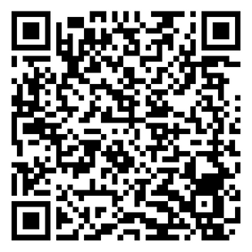
Document with Helpful Links from Peer Mentors
Scan the QR code to access a document containing helpful links!

Slide 29
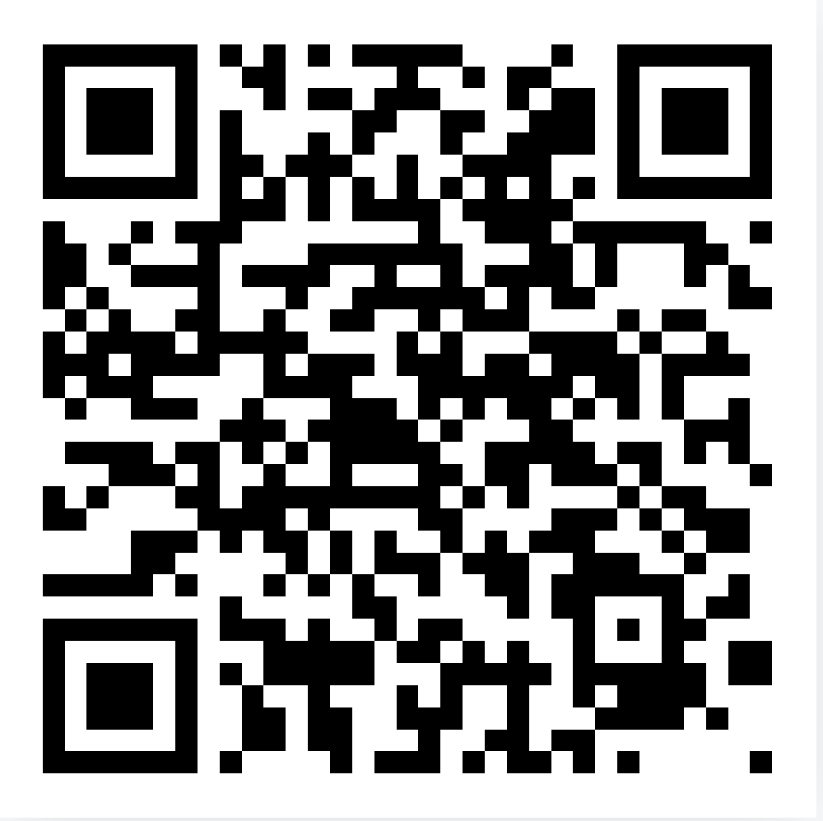
AAMC Official 2025 MCAT Booklet
Check out the official AAMC booklet for a comprehensive guide on the MCAT
From: https://students-residents.aamc.org/media/11711/download

Slide 30
Things to keep in mind…
You can follow the instructions from the AAMC guide to registration: https://vimeo.com/477161485
If you are signing up in the day that the registration opens, make sure to log in before 11:50 am ET. You will have 10 minutes to get back to the queue once it is your turn.
Registration for Jan-June is currently open and July-September registration will begin in February.
If you qualify for the fee assistance program, apply before you register for an exam date.
Have 3 dates that will work for you in case your first choice is not available.

Slide 31
MCAT – FAQs and Summary
How many times can I take the MCAT?
Attempt no more than three (3) times in a testing year
Attempt no more than four (4) times over two consecutive testing years
Attempt no more than seven (7) times in your lifetime.
When should I register for the MCAT?
At least 60 days prior to your preferred exam date. However, it depends on different factors.
February for April, May and June dates. In May for July, August and September dates.
How long does it take to get my score?
~1 month following your test date

Slide 32
MCAT – FAQs and Summary
If my score is pretty average, should I retake the MCAT?
This depends on the Med School you are applying to. Schools consider different aspects of your application differently such as your personal statement, letters of recommendation etc…
What does voiding an exam mean?
Writing the exam, but do not want it to be marked
Option is given at the end of the exam (3 minutes to decide)
No refunds! Counts as an attempt (out of the 7 lifetime attempts)

Slide 33

Summary
The MCAT is a standardized test that covers material from 4 broad categories.
The MCAT is required by most medical schools in Ontario.
The studying process looks different for everyone.
Always check requirements online as they change year-to-year. Some school’s score cutoffs vary!
Meeting minimum requirement does not guarantee admission.

Slide 34
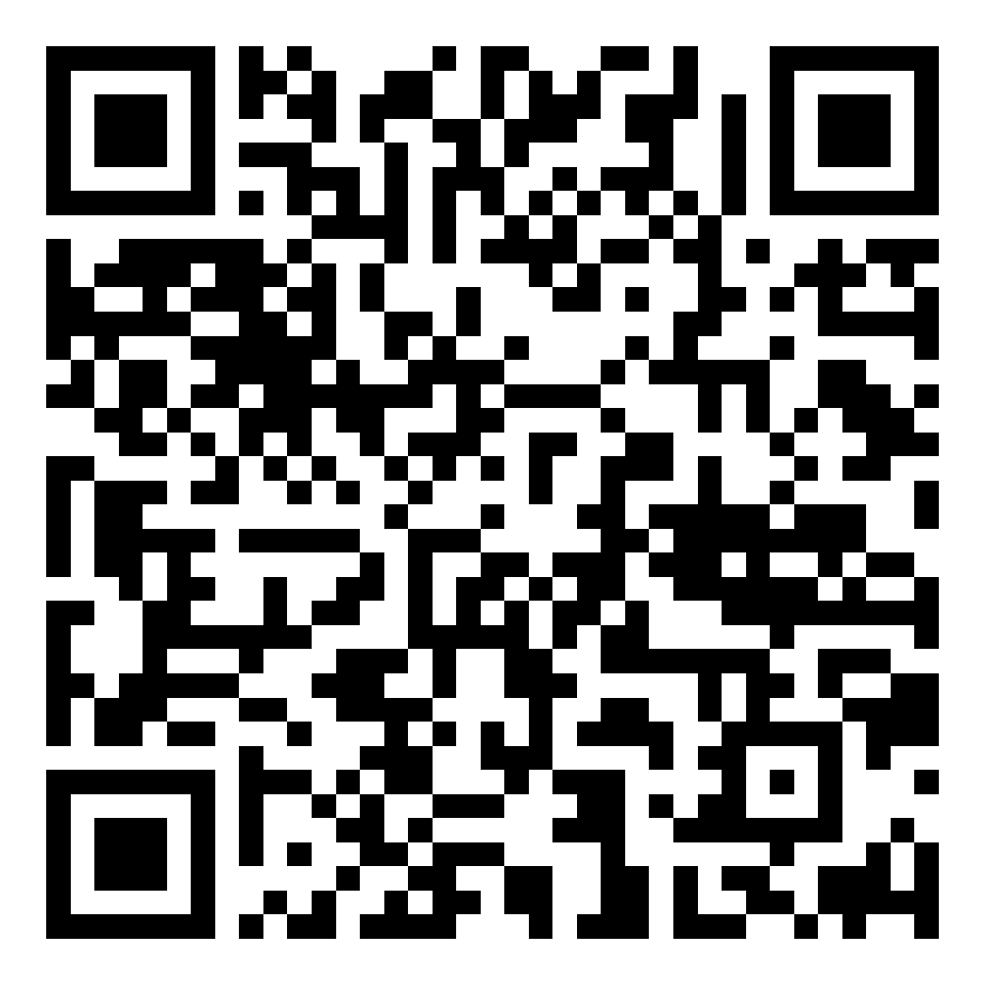
Upcoming Seminars + Slides Access
Nov 6 5:30 pm | BC320 and Zoom | How to Get into Dental School
Nov 13 5:30 pm | BC320 and Zoom | Study Tips for Exams
Nov 20 5:30 pm | BC320 and Zoom | Make your Degree International

Slide 35
Our Guest Speaker

Slide 36
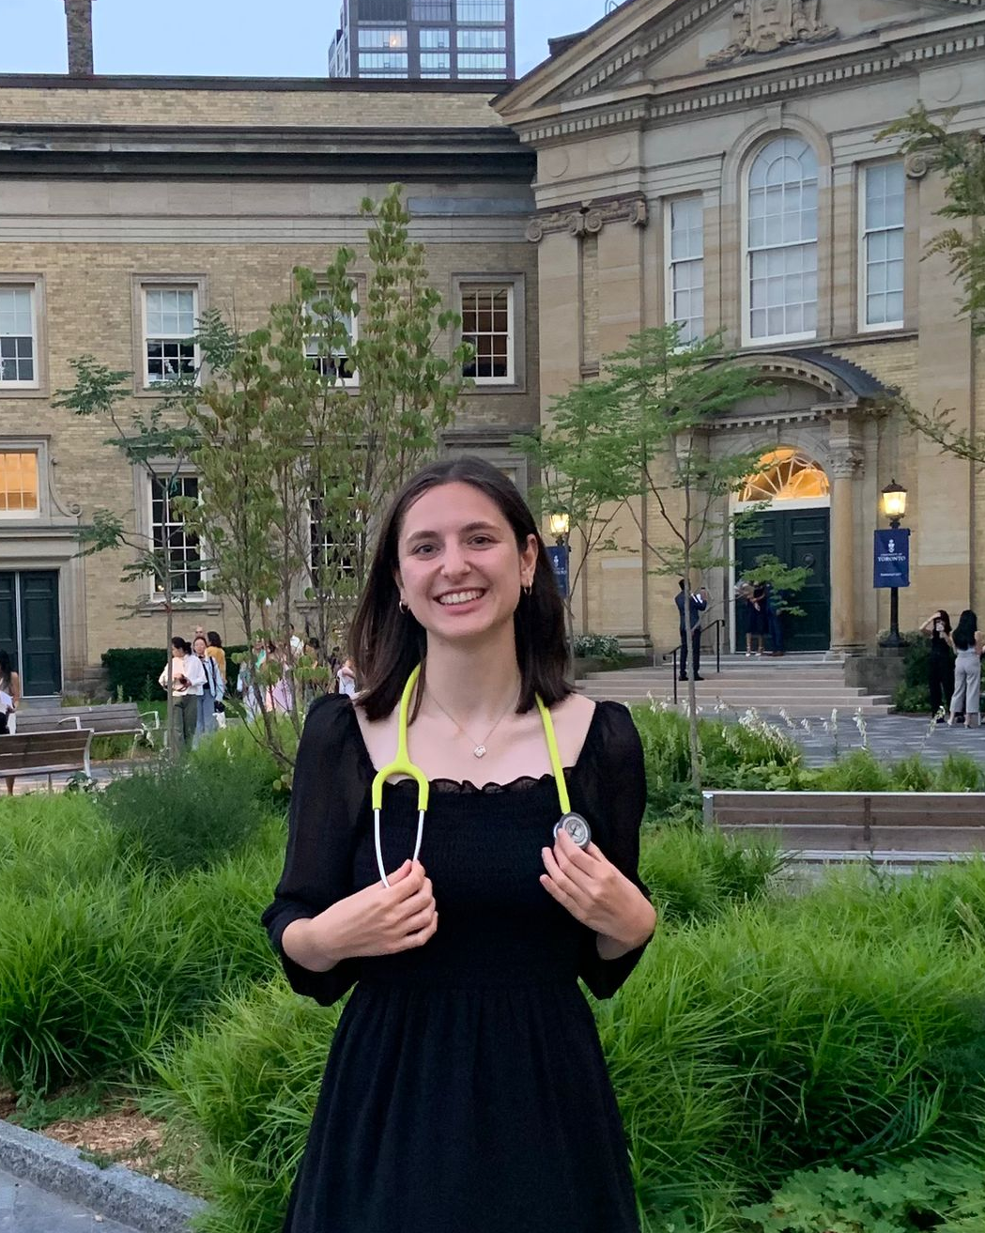
Claire Del Zotto - 1st Year Medical Student at UofT
York Biology Alum
Favourite York Courses: Anything Ecology related! (Don’t feel like you need to love cell/molecular biology to be a doctor)
Hobbies: Intramural sports, arts and crafts, hiking and nature photography
Why Med? Claire liked biology but has a minor fear of cats so could not be a vet.
Key piece of advice for undergraduate students: Don’t let your career goals stop you from having fun + enjoying the present!
Fun Fact: Claire worked in a bee research lab and she loves taking photos of bees!
Contact: cdz02@yorku.ca

Slide 37
Questions for Claire:

Slide 38
What was your MCAT timeline like? Do you have any tips for time management?

Slide 39
What is one thing you wish someone had told you before starting to study for the MCAT?

Slide 40
What would you do differently if you had to retake the MCAT?

Slide 41
HAVE ANY QUESTIONS?
Ask away OR
Send us an email: BCMENTOR@YORKU.CA
Visit:
bethune.yorku.ca

