Slide 1
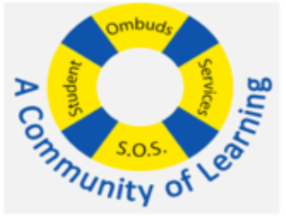

How to Get Into Dental School
___Bethune SOS Seminar___
Presenters: Raman, Danial, Andrea
Date: Wednesday, November 6th 2024
Note: This presentation contains hyperlinks to websites. The presentation will be posted online under the Bethune College Workshops webpage: https://www.yorku.ca/colleges/bethune/events-workshops/workshops/

Slide 2
MEET OUR MENTORS
Raman M.E.
Danial S.
Andrea K.
Notes:
Share your year, program and a fun fact about yourself

Slide 3

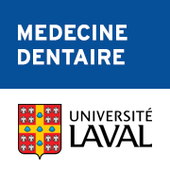








Overview
Introduction
  Education & Fees
  Lifestyle
What you need to get into Dental School
  Extra-curricular involvement
  Medical Aptitude Test (DAT)
  CASPer
  Interviews
Canadian Dental Schools
Summary
Q&A

Slide 4
Disclaimer
The information provided in this seminar gives some background information about the medical school application process. This is based on information provided by dental school websites. Any experiences given by the presenters or guest speaker may not reflect experiences shared by others. They are here to deliver the presentation, answer any questions, and provide support.
We do our best to provide you the most updated information. Please ensure you obtain the latest information by conducting your own research.

Slide 5

Route to Practise
Undergraduate Degree
  Post Undergrad? Masters? Gap Year?
Write the DAT: Gain Admission into Dental School
Write NDEB Licencing Exam
  Obtain Specialty?
Practice Dentistry
Open Clinic?

Slide 6
How Much Education Does it Take to Become a Doctor?
Typically takes ~8 years
Undergraduate studies 2-4 years (you can apply without a degree to some schools)
Dental School 4 years
Specializations/Residency* 2-4 years
*Not required, unless you would like to specialize in fields including but not limited to periodontics, endodontics, oral and maxillofacial surgery, pediatric dentistry, dental public health etc…
Resources: https://nohofamilydental.com/blog/how-long-does-it-take-to-become-a-dentist/, https://ca.prepdoctors.com/how-to-become-a-dentist-in-canada-ndeb, https://www.dentistry.utoronto.ca/prospective-students/graduate/clinical-training#HowToApply

Slide 7
What is the cost of attending Dental School in Canada?
From University of Toronto’s Website:
Domestic students: $45 000 per year x 4 years = $180 000
International students: $ 90 000 per year x 4 years = $360 000
These tuition fees include both academic , non-academic and dental instrument fees.
Resources: https://www.dentistry.utoronto.ca/node/2264

Slide 8
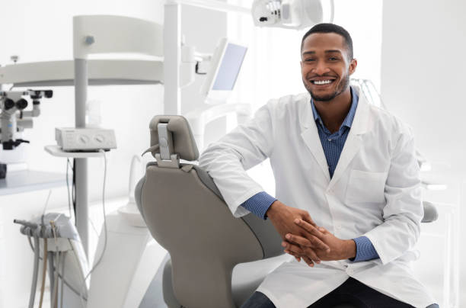
What is the Lifestyle Like?
Work hours vary between specialities
Common to work 7-10 hours a day, + additional hours for dental emergencies

Slide 9
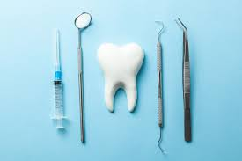
What Will You Need?
Undergraduate Studies
Extra-curricular involvement (to write about on Personal Statements, Autobiographical Sketches, etc…)
Dental Aptitude Test (DAT)
CASPer
Interviews

Slide 10

Extra-curricular Involvement
Research Positions
  RAY (Research @ York)
  Work-study positions with professors
  Research at other universities
Volunteer Opportunities
  Volunteering at Dental Clinics
  Joining Clubs and Organizations at York
  Community Involvement
Leadership Positions
  Executive member on clubs/organizations
Sports and Hobbies
  Varsity, intramurals

Slide 11
Autobiographical Sketch/Personal Statement
Different schools require different written components as part of their application package
  These components are typically autobiographical sketches, personal statements or open-ended questions for applicants to answer
They allow applicants to tell schools more about themselves, why dentistry, what singles them out from any other applicant, etc…
Some general tips include:
  Avoid vague writing, always include examples
  Check your spelling and grammar before submitting
  Have someone else look at your answers to give you feedback
  Use resources at York, such as the Bethune Writing Centre for help!
For more information on how excel on written components feel free to refer to our past slide deck on Crafting Professional School Applications.

Slide 12
Dental School Application System
Canadian Schools often have different application systems:
AADSAS: ADEA Associated American Dental Schools Application Service
  Not all schools will use this, for example, UofT does!
School-specific Application Services: to find these search up the
“School Name” + “Dental School Application System”
  UofT: University of Toronto Dental Application Service
  Western: OUAC
  Dalhousie: Dalhousie Application Portal
  McGill: McGill Application Portal
DEADLINES (For Current 2024-2025 Cycle): vary by school!

Slide 13
Dental Aptitude Test (DAT) - Overview
Standardized exam, conducted by the Canadian Dental Association (CDA)
Required for admission by all Canadian schools (except for McGill)
  Note there are American and Canadian (English and French) versions, we will be focusing on the Canadian (English) version
Computer-based exam (no calculator) + Manual Dexterity Test
210 Multiple Choice Questions
3 hours and 50 minutes (4 hour and 15 minute appointment time slot)
  A single 15 minute break is offered after the first section of the test.
  Other unscheduled breaks will ‘eat up’ your test time
Tests knowledge in these 3 sections
Survey of the Natural Sciences - Biology and General Chemistry (SNS)
Perceptual Ability Test (PAT)
Reading Comprehension Test (RCT)
From: https://www.cda-adc.ca/_files/becoming/dat/documents/DAT_Candidate_Guide.pdf

Slide 14
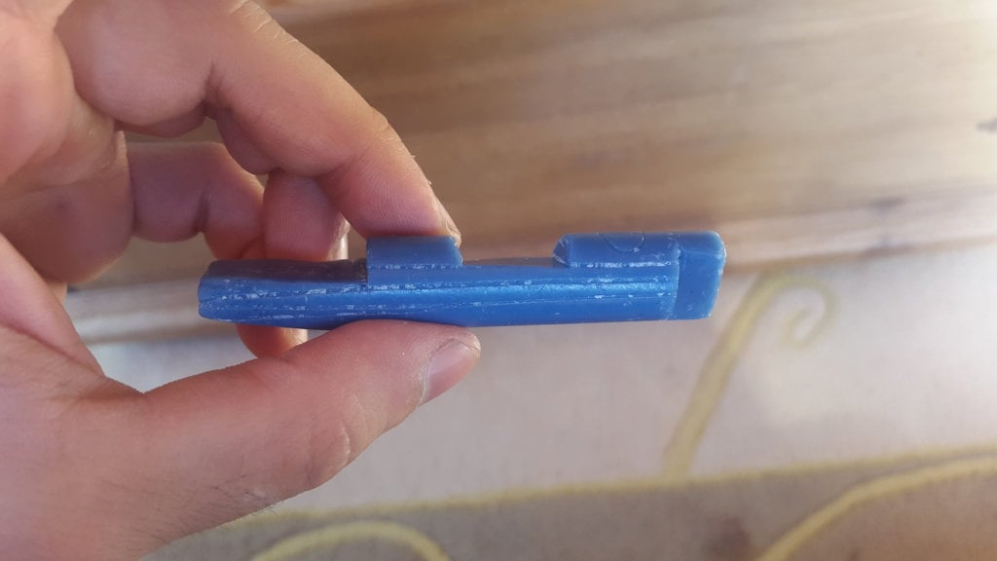
Manual Dexterity Test
Has been suspended since COVID-19.
Carving a piece of soap according to exact specifications.
From: https://www.cda-adc.ca/_files/becoming/dat/documents/DAT_Candidate_Guide.pdf

Slide 15
Dental Aptitude Test (DAT) – Sections Breakdown
Section | Duration and Questions | Sample Topics/Structure
Natural Sciences | 60 minutes 40 Biology Questions 30 Gen. Chemistry Questions | Cell Metabolism Genetics Atomic and Molecular Structure BIOL2020/2021 + CHEM1000/1001
Perceptual Ability | 60 minutes 90 Questions | Angle Discrimination 3D Form Development Apertures Paper Folding
Reading Comprehension | 60 minutes 50 Questions | No prior knowledge required 3 passages
Manual Dexterity | 30 Minutes | Carve a given model out of soap Currently suspended!
From: https://www.cda-adc.ca/en/becoming/dat/faqs/ and https://www.cda-adc.ca/_files/becoming/dat/documents/DAT_Candidate_Guide.pdf

Slide 16
DAT Scoring
DAT Scores are reported as an Academic Average (AA)
  Rounded average of your score in Natural Sciences and Reading Comprehension
  Reported as a score from 1-30, representing a percentile
  Distributions vary slightly by year
DAT Score (AA) | Percentile | Qualitative Score
17-18 | 50 | Average
19-20 | 75 | Good
22-23 | 98 | Very High

Slide 17
DAT - Fees
Fee Type | Description | Fee Amount
FEES COLLECTED DURING REGISTRATION, SUBJECT TO APPLICABLE TAXES:
DAT Test Fee | Test Administation Official Student Transcript 5 Official Transcripts to Schools | $552
Preparation Materials | DAT Preparation Manual | $30
Transcripts | Transcripts after 5 Schools | $20 per each additional transcript
FEES COLLECTED SEPARATELY FROM REGISTRATION:
DAT results audit (optional) | Within 30 days of writing, you may request an audit of your results | $80
Refunds | 1-30 days since DAT fees paid 31-90 days since DAT fees paid | $150 $250
From: https://www.cda-adc.ca/_files/becoming/dat/documents/DAT_Candidate_Guide.pdf

Slide 18
DAT - FAQ
Where can I register?
  Register via the DAT website: cda-adc.ca/dat
  Don’t wait until the last minute!
  Check with schools on when they need your scores.
When do I register?
  The CDA recommends to register 6-8 months before schools need your scores.
  Write the test at least 8 weeks before you need you scores.
How much does it cost to write the DAT?
  $552 CAD (test administration, official student transcript, up to 5 official transcripts sent to dental schools you select at registration) + additional fees… + school specific fees
How many times can I write the DAT?
  The MCAT can be written an unlimited number of times.
  For multiple DAT attempts there are certain restrictions:
    You must wait at least 60 days from your last attempt before retaking.
    If you are retesting after 3 or more times, you must provide evidence of previous applications to dental schools and you can only retest once per 12-month period
How long does it take to get my score?
  ~1 month following your test date
Can you void the exam like the MCAT?
  No, scores cannot be voided by yourself.

Slide 19
DAT – Resources
Getting Started
Social Media (YouTube, blogs, Reddit)* Tons of people share their experiences, check out some videos/blogs r/DAT (Reddit) has many links to legitimate free resources, Anki decks, mnemonics, and study plan spreadsheets CDA Website Carefully reach all information they have online and use their practice materials. Note their practice tests are for purchase only. Friends, peers and mentors! Reach out to anyone you know who has the written the DAT for advice!
Content Review and Practice Questions
Khan Academy, Jack Westin YouTube videos Exam prep books, Preparation Courses (DATBooster, DAT Destroyer Flash cards (Anki decks, quizlet, etc…) CDA Practice
* Be mindful that some people are breaking their DAT agreement on these sites!

Slide 20

Computer-based Assessment for Sampling Personal Characteristics - CASPer
Online, scenario-based test assessing non-academic qualities like empathy, ethics, and decision-making.
  What would you do in a tough situation? What are your behavioural tendencies?
Schools Requiring CASPer:
  UofT, Western, McGill, Alberta, Saskatchewan
Format
  12 scenarios (video or word-based prompts)
  3 open-ended questions each (5 mins/section)
  10 minute break hallway through test
Preparation Tips:
  Practice responding to ethical dilemmas.
  Stay calm under time pressure.
  Focus on empathy, ethical reasoning, and clarity in responses.
  Try to understand multiple perspectives in every scenario.
  Practice typing!

Slide 21
CASPer Example
Prompt: COVID-19 is an infectious disease that has quickly taken over our world. Many people feel that we will not be able to return to our “normal” lives until a vaccine is developed. It is likely that when the vaccine is developed, there will not be enough vaccines for everyone to receive it right away.
Questions
  How should priority be determined for the COVID-19 vaccine?
  What are the ethical concerns to consider in any priority or ranking system?
  Discuss a time where you had to choose one person over another in a personal situation and how you came to your decisions.
From: https://www.caspertest.com/casper-sample-questions/#sample-question-card-7

Slide 22
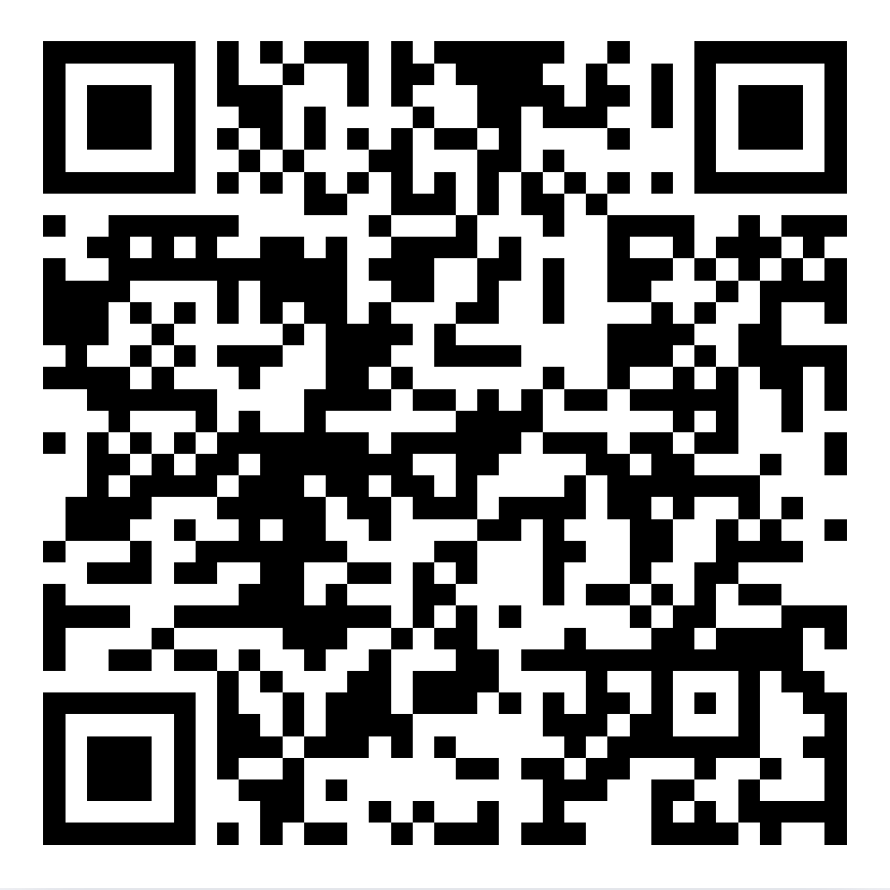
Official CDA DAT Handbook

Slide 23
Canadian Dental Schools

Slide 24
Canadian (English) Dental Schools
University of Toronto
University of Western Ontario
University of Alberta
University of British Columbia
University of Manitoba
University of Saskatchewan
Dalhousie University (Nova Scotia)
McGill University (Quebec)

Slide 25
Prerequisites – West Canada
School | Prerequisites
Alberta | Min C- in: Cell Biology (1), Microbiology (1), General Chemistry (1), Organic Chemistry (1), Biochemistry (1), English (2), Statistics (1), Human Physiology (2) 3.5 GPA cutoff DAT, CASPer
UBC | Min C- in: Biology (2), Chemistry (2), Biochemistry (2), Organic Chemistry (2), English (2) 2.8 GPA cutoff DAT
Manitoba | Biology (2), Chemistry (2), Physics (2), Organic Chemistry (2), English (2), Biochemistry (2), Humanities/Social Science (2) 3.85 GPA cutoff DAT
Saskatchewan | Biology (2), Chemistry (1), Organic Chemistry (1), Physics (1), Biochemistry (1), Metabolic Biochemistry (1), Physiology (2), Nutrition (1), Microbiology (1), Social Sciences/Humanities (2)
From: https://sssc.carleton.ca/resources-health-care-resources/dental-school-information

Slide 26
Prerequisites – East Canada
School | Prerequisites
Dalhousie | Biology (2), Chemistry (2), Physics (2), Organic Chemistry (2), Biochemistry (1), Microbiology (1), Human Physiology (2), English (2), Humanities/Social Sciences (4) DAT 3.7/4.3 GPA cutoff
Toronto | Biochemistry (2), Human/Mammalian Physiology (2), Life Sciences (4), Humanities/Social Sciences (2) 3.0 GPA cutoff DAT, CASPer
Western | Organic Chemistry (1), Biochemistry (1), Humanities/Mammalian Physiology (2) 3.7 GPA cutoff DAT, CASPer
McGill | Biology (2), Chemistry (2), Physics (2), Organic Chemistry (1), Recommended: (1) in Biochemistry, Mammalian Physiology, Cell Biology & Metabolism DAT, CASPer
From: https://sssc.carleton.ca/resources-health-care-resources/dental-school-information

Slide 27
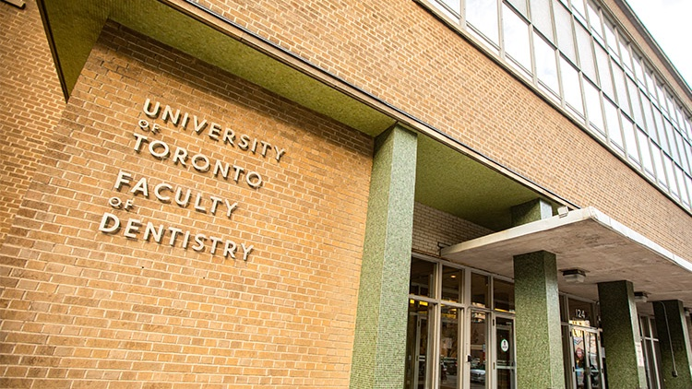
University of Toronto

Slide 28
University of Toronto – Academic Requirements
Minimum of 3 years of undergraduate work
  Biochemistry – 2 semesters
  Human/Animal Physiology – 2 semesters
  Life Sciences (biology based courses) – 4 semesters
  Humanities/Social Sciences – 2 semesters
GPA cutoff: 3.0/4.0
  Average accepted GPA 3.95 (2024), admitted students usually have a minimum GPA of 3.85
DAT average: 23
CASPer
From: https://www.dentistry.utoronto.ca/prospective-students/undergraduate/DDS, https://dat-prep.com/dat-scores-for-dental-schools.php?srsltid=AfmBOopPAu6n2emwLtPS_Y-u0W9nd9ZraNuO3pqq6uKyrHZx0XrApfbP

Slide 29
University of Toronto – Non-Academic Requirements
Personal Statement
  Explain why you want to pursue a dental career (maximum 2 pages)
Greatest Accomplishment
  Outline what you consider to be your greatest accomplishment and the reasons you have chosen to highlight it (maximum 1 page)
** There are no specific format requirements for supporting information
From: https://forms2.dentistry.utoronto.ca/201055113968048

Slide 30
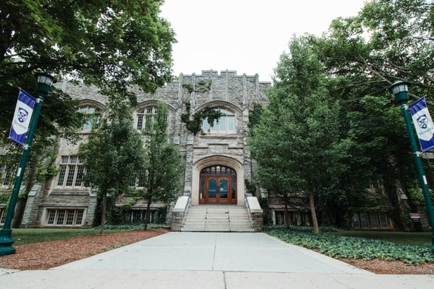
University of Western Ontario

Slide 31
Western– Academic Requirements
4 year undergraduate degree
  Organic Chemistry – 1 semester
  Biochemistry – 1 semester
  Human/Mammalian Physiology – 2 semesters
    You may be asked to complete a Physiology Challenge Exam if you apply without this course
GPA cutoff: 80% or higher in the best 2 academic years
  Calculated from the 2 best years with full course load
  At least 30 credit hours completed Sept-April = full course load
  At least 18 credit hours whose level is at or above the year of study
  A maximum of 6 pass/fail credit hours permitted per year
  Summer Courses will not be counted
DAT average: 21
CASPer
From: https://www.schulich.uwo.ca/med_dent_admissions/dentistry/admission_requirements.html, https://dat-prep.com/dat-scores-for-dental-schools.php?srsltid=AfmBOopPAu6n2emwLtPS_Y-u0W9nd9ZraNuO3pqq6uKyrHZx0XrApfbP

Slide 32
Western – Non-Academic Requirements
Western Autobiographical Sketch & Personal Statement
  Invites applicants to tell their story and share what makes them unique by linking activities/experiences. Schulich Dentistry is interested in how their activities/experiences connect with the following topics:
    Teamwork and Leadership
    Respect for Equity, Diversity, and Inclusion
    Social Accountability and Social Responsibility
    Self-directed Learning, Problem-solving and Critical Inquiry
From: https://www.schulich.uwo.ca/med_dent_admissions/dentistry/admission_requirements.html

Slide 33

Application Deadlines
Will vary from school to school! Many school’s deadlines are in November!
  UofT: Nov 1
  Western: Nov 11
  Dalhousie: May 1 (strongly recommended to apply before Feb 1)

Slide 34

Interviews
You are almost there!
  50% of interviewees are accepted
Purpose: evaluate maturity, motivation, initiative, communication, personal qualities, and social skills
Possible formats:
  MMI: multiple stations (10 minutes each) with different scenarios – given some time to prepare
    UofT – 3 stations total
  Traditional Panel Interview
    Western – 30 minute duration, 3 panelists (Faulty Member, Community Member, Current Student)

Slide 35

Interview Preparation
Before:
  Know your application
  Practice common questions
  Plan your trip carefully
  Dress comfortable yet professional
During
  Positive body language
  Listen intently
  Articulate well
  Be honest, sincere and true to yourself
After
  Reflect briefly
  Thank everyone who helped
  Continue Communication

Slide 36

Summary
There are several medical schools in Canada, and even more in the United States
Admissions requirements differ slightly from school to school but generally include
  GPA (min 80%)
  Courses in Biology, Biochemistry, Organic Chemistry, Humanities
  DAT
  CASPer
Always check requirements online as they change year-to-year
Meeting minimum requirements does not guarantee admission

Slide 37
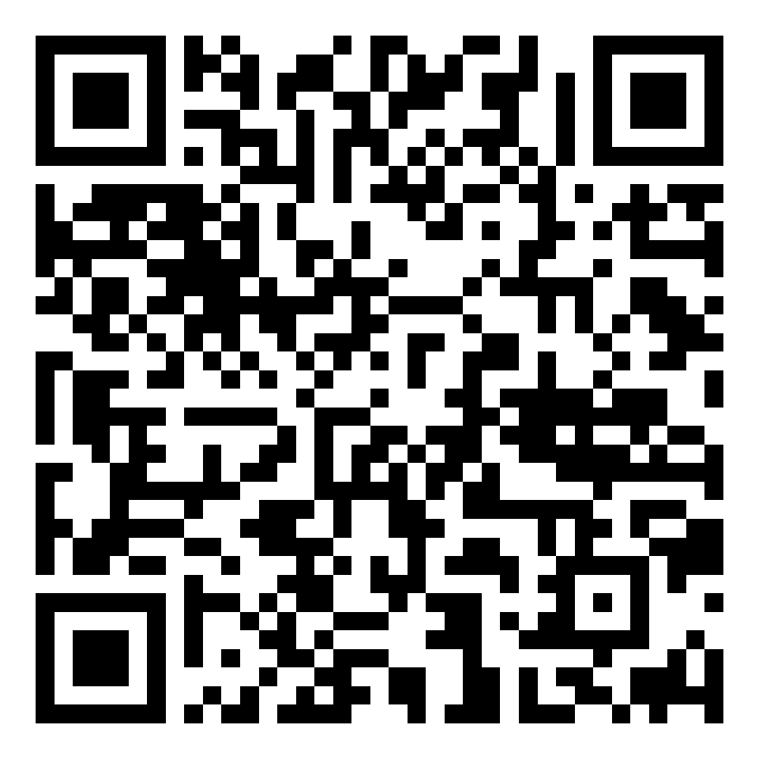
Upcoming Seminars + Slides Access
Nov 13 5:30 pm | BC320 and Zoom | Study Tips for Exams
Oct 20 5:30 pm | BC203 and Zoom | Make your Degree International
Jan 8 5:30 pm | BC320 and Zoom | Finding Research and Volunteer Opportunities
Jan 15 5:30 pm | BC320 and Zoom | Career Paths in Math

Slide 38
Our Guest Speaker

Slide 39
Sormeh Mehrabi – 2nd Year Dental Student at Dalhousie
York Biomedical Science Alum
Background: “My family and I moved from Iran to Canada in 2010 for better opportunities. Observing the transformative care my parents received from dentists inspired me to pursue dentistry”
Favourite York Courses: Persian Literature
Hobbies: Cooking and Arts + Crafts!
Why Dentistry? “I’ve always loved art, working with my hands and helping people. Watching dentists mentor me and treat my parents showed me the impact I could have in this field.”
Key piece of advice for undergraduate students: embrace your uniqueness and always practice being grateful
Fun Fact: Sormeh has a diastema

Slide 40
Sormeh’s Application Journey
Application to Australian dental school after high school: no acceptance
Attended York for its flexibility.
  Joined clubs, got involved in research.
  Founded Bright Future Dentists
Retook DAT, achieving 19 AA with a 3.85 GPA and 4th quartile CASPer score.
Applied to US schools, UofT and Dalhousie
  Drawn to Dalhousie for small class sizes and hands-on clinical experience.
Founded Luminary
  A platform to provide the mentorship and support she wished she had. Built on experiences with Bright Future Dentists, Luminary aims to help future healthcare professionals succeed.

Slide 41
Questions for Sormeh:

Slide 42
What is one thing you wish someone had told you before starting Dental School?

Slide 43
When should I start applying to Dental School?

Slide 44
What should I get involved in? Are there any extracurriculars that will ‘boost’ my application?

Slide 45
I’m worried about my GPA not being high enough. Do I have a shot at getting into Dental School? What can I do?

Slide 46
How would you go about answering this question from earlier:
“Should a doctor's primary aim be to change behavior to prevent disease or treat existing disease? What are your thoughts on upstream and downstream care?”

Slide 47
HAVE ANY QUESTIONS?
Ask away OR
Send us an email: BCMENTOR@YORKU.CA
Visit:
bethune.yorku.ca

