Slide 1


Focusing in on Socioeconomic and Health Needs of 2SLGBTQ+ Communities in Canada: Experiences with a National Study on Poverty
2SLGBTQ+ Poverty in Canada: Improving Livelihood and Social Wellbeing
CBRC Summit 2024

Slide 2
JP Armstrong, Norquest College
Presenters
  Synder Cuddahy, Community Advisory Board
  Max Ferguson, Toronto Meteropolitan University
  Marie Geoffroy, Community-Based Research Centre
  Hazal Goktas, York University
  Leonard Halladay, Carleton University
  Nick Mulé, York University
  Madison Trusolino, Dalhousie University

Slide 3
Contributors
Todd Coleman, Wilfrid Laurier University
  Roya Haghiri-Vijeh, York University
  4

Slide 4
Project Overview
Agenda
  Theoretical Framing
  Mixed Methods Approach
  Quantitative Approach & Challenges
  Qualitative Approach & Challenges
  Knowledge Mobilization
  Audience Engagement
  Questions

Slide 5
Project Overview

Slide 6
Project Overview
First national study examining prevalence & effects of poverty on 2SLGBTQ+ populations in Canada
Awarded $2.5 million by the SSHRC-funded Partnership Grant
Study Length: 6 years (2022-2028)
Project Membership: 94

Slide 7

Full Team Members
  Academics: 28
  Community Partners: 24
  Indigenous Elder: 1
  Research Assistants: 8
  Community Advisory Board: 13
  Postdoctoral Fellows: 2
  Staff: 2
  Peer Researchers: 16

Slide 8
Project Goal & Objectives
Goal
Documentation
To create evidence-based knowledge on how and why poverty affects 2SLGBTQ+ communities in Canada to inform policy and community-based action to address existing inequities
Inclusion
Objectives:
Knowledge Exchange
Action Plan

Slide 9
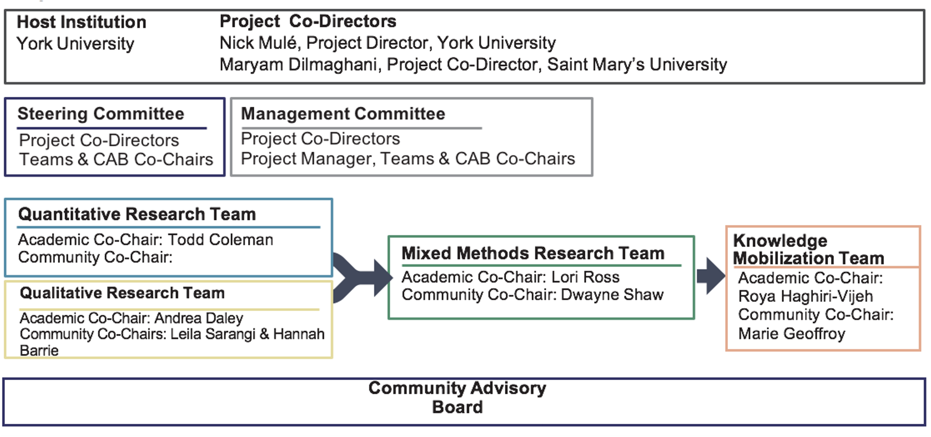
Governance Structure

Slide 10
Community-Based Participatory Action Research
Working with community organizations with anti-poverty mandates and/or advocate for 2SLGBTQ+ communities
Community Advisory Board with geographical representation of 2SLGBTQ+ individuals currently living in or with a history of poverty

Slide 11
Theoretical Framing

Slide 12

Moving from Formal to Substantive Inequality
Theoretical Framing Overview
  Landmark Developments (2SLGBTQ+ Rights in Canada)
  Critiques of 2SLGBTQ+ Rights (in Canada
Contributing Factors & Research Questions:
  Lack of Attention to 2SLGBTQ+ Poverty
  Research Questions
Theoretical Foundation - Two Frameworks:
  Poverty Trap Literature
  Social Exclusion Theory

Slide 13

Formal to Substantive Equality
2SLGBTQ+ Rights in Canada (Canada as a human rights champion)
Landmark Developments (2SLGBTQ+ Rights in Canada):
  Partial Decriminalization of Homosexuality (1969)
  Sexual Orientation added to Canadian Human Rights Act (1996).
  Same Sex marriage (2005)
  Gender Identity and Expression added to Canadian Human Rights Act (2017)
Critiques of 2SLGBTQ+ Rights (in Canada)
  Critique of Rights Doctrine v. Critique of Rights Discourse
  Homonationalism to Homohegemony

Slide 14
Formal to Substantive Equality
Homonationalism: A form of sexual exceptionalism that requires the segregation and disqualification of sexual and racial others (Puar 2007)
Homohegemony: Greater pervasiveness and entrenchment of homosexual inclusion, ideologically and institutionally (Jackson 2021)

Slide 15

Contributing Factors & Research Questions
Lack of Attention to 2SLGBTQ+ Poverty:
  Gay Affluence Myth (Badgett 2003)
  Concealment of 2SLGBTQ+ Identities
  Lack of data
  Multiple marginalities
Research Questions
  What are the salient root-causes and consequences of 2SLGBTQ+ poverty in Canada?
  How can the root-causes and negative consequences of poverty be addressed effectively by policy, programs, funding, and service provision?

Slide 16
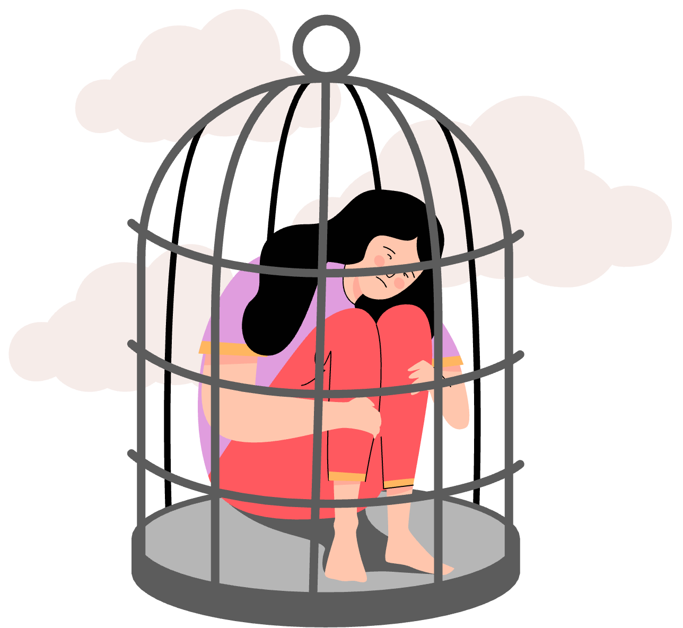
Focus: Economic and Social Determinants + Consequences of Poverty
Theoretical Foundation: Two Frameworks
Poverty Trap Literature:
  Poverty Trap: A state in which poverty engenders effects which themselves cause poverty (Azariadis & Stachurski 2005).
  Poverty understood as a constellation of forces that are cumulative and causal, reacting to one another to reproduce structural poverty.
  “Big push” policy interventions required to break the cycle of structural poverty.
Social Exclusion Theory:
  Social Exclusion: a multidimensional process that disconnects individuals and groups from economic, cultural, and political networks around them (Devicienti & Poggi 2011).
  Framework links decline in living standards to eroding welfare state, requiring policy interventions.
  2SLGBTQ+ people in Canada have a long history of social exclusion (Warner 2002) and structural exclusion in areas such as employment, housing, education, and healthcare.

Slide 17

Intersectionality within 2SLGBTQ+ Communities

Slide 18
Specific Challenges for 2SLGBTQ+ Populations
Dispelling Myths, Addressing Gaps
  Housing and Food Insecurity
  Stigmatization
  Discrimination
  Marginalization
  Poverty
  Intergenerational Trauma
  Disproportionate attention on affluence
  Not enough attention to socio-economic problems

Slide 19

Implications of
Internal/External Oppression
Internal Implications:
  Sense of self and contributions to society are diminished when struggling with poverty
  Ability to participate in the 2SLGBTQ+ communities is limited given how commercialized these communities have become
External Implications:
  2SLGBTQ+ populations rarely are considered when poverty is being examined
  Lack of policy, funding, programming, and services to address the unique needs of 2SLGBTQ+ people

Slide 20
Mixed Methods Approach

Slide 21


Multiphase Mixed Methods Design
National Survey
Focus Groups
Semi-Structured Interviews

Slide 22
Quantitative Approach & Challenges

Slide 23

Our goal was to create a survey that:
Survey Design
  Captures the multi-dimensional nature of poverty
  Measures experiences specific to 2SLGBTQ+ people
  Includes standard measures (allowing us to compare our data with other national-level datasets)
Survey design was carried out by an interdisciplinary team of scholars, our community partners, and our community advisory board.

Slide 24
Our Survey Measures:
Socio-Demographics
Housing
Education
Employment
Income
Food Security
Health & Wellness
Outness
Discrimination

Slide 25
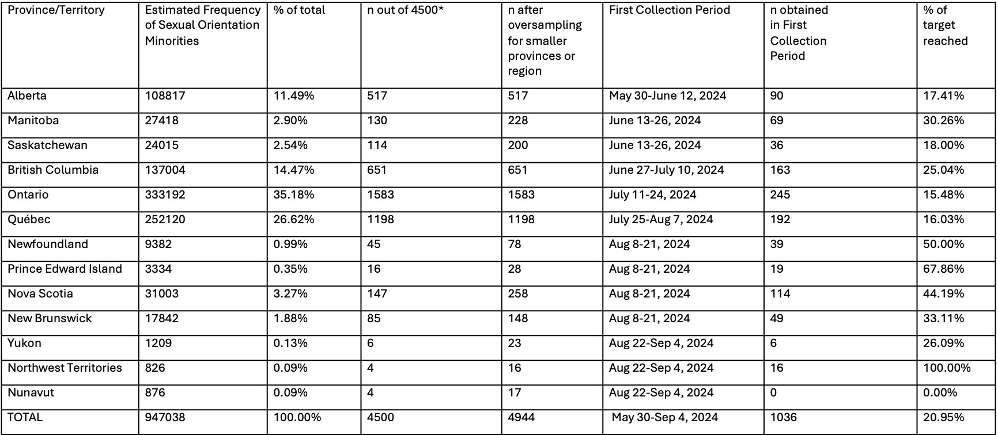
Data Collection Progress (as of October 11, 2024)

Slide 26

Survey bots and fraudulent respondents are an emerging threat to the quality of online research
Maintaing Data Integrity
  Survey bots (i.e., automated form fillers) are increasingly sophisticated computer programs that can rapidly complete online surveys
  Fraudulent respondents (i.e., professional survey takers) are individuals who misrepresent themselves to participate in online research and provide misinformation
Surveys with monetary incentives at higher risk due to financial motivation
  In addition, our study has received fraudulent responses motivated by anti-2SLGBTQ+ hate
Lack of direct contact with participants creates need for prevention strategy

Slide 27
Survey Bot and Fraudulent Respondent Prevention Strategy
Sign Up Survey
Main Survey
Response Validation
  Use of Captcha
  Use of attention checks / photo questions
  Monitor IP addresses / email addresses
  Monitor completion times
  Generate personalized links from survey sign up
  Use of hidden honeypot questions
  Compare sign up survey and main survey to ensure information matches

Slide 28
Qualitative Approach & Challenges

Slide 29

Method
130 Semi-structured interviews across Canada
  Recruited from survey respondents
  Represent diverse 2SLGBTQ+ lived experiences
  Across all 10 provinces and 3 territories.
  Urban, suburban, rural, and remote.
  Conducted by peer researchers
13 Geography-based focus groups
  Recruited from survey respondents
  Facilitated by peer researchers & the academic team

Slide 30
Semi-Structured Interview Guides
Pathway out of Poverty: For participants who have, but are no longer, experiencing poverty
Pathway to Poverty: For participants currently experiencing poverty

Slide 31

Focus Group Guide
Focus groups will build and expand on the data that we have gathered from interviews & our survey

Slide 32

Peer Researchers: Who are they and what do they do?
  Community-Based Participatory Research Approach
  People who self-identify as 2SLGBTQ+ and/or have demonstrated relationship to the community
  People with lived experience of poverty
  Essential part of Qualitative Research Team
  Individual interviews and focus groups

Slide 33
Peer Researchers: Geographical Distribution
We have Peer Researchers from:
  Ontario (3)
  Quebec (2)
  British Columbia (2)
  Alberta (2)
  Manitoba (1)
  Saskatchewan (1)
  Newfoundland and Labrador (1)
  Nova Scotia (3)
  New Brunswick (1)
We are looking for Peer Researchers from:
  Yukon
  Northwest Territories
  Nunavut
  Prince Edward Island

Slide 34

Peer Researchers: Challenges and what we learned
  Situating poverty broadly
  Outreach in the Territories
  Compensation for participants
  Interviewing participants with trauma; invoking trauma in self
  Ensuring uniformity of data
  Casual employment: compensation, work hours & time management

Slide 35
Knowledge Mobilization

Slide 36
Goals & Target Audience
2SLGBTQ+ communities and individuals
Engage Diverse Audiences
Academics & Peer Researchers
Goals
Offer Policy & Service Provider Action Plans
Frontline Workers & Service Providers
Make research findings available to front-line service providers
Policymakers & Politicians

Slide 37

What we’ve accomplished
Developing a social media presence
Social Media Accounts:
  Instagram: @lgbtq2sp
  Facebook: 2SLGBTQ+ Poverty in Canada: Improving Livelihood and Social Wellbeing
  LinkedIn: 2SLGBTQ+ Poverty in Canada: Improving Livelihood and Social Wellbeing
Decisions on Platforms:
  Implemented a “Page Like Campaign”
  Left X

Slide 38
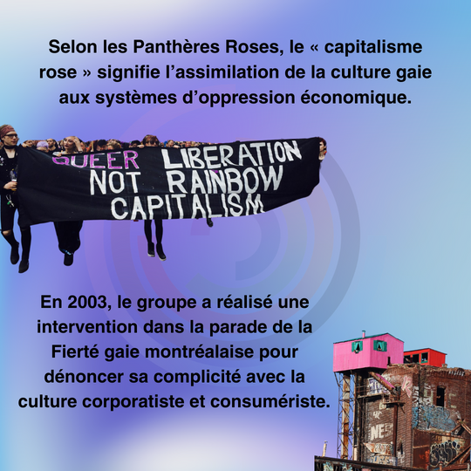
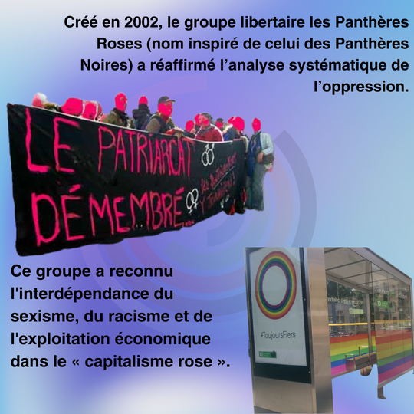
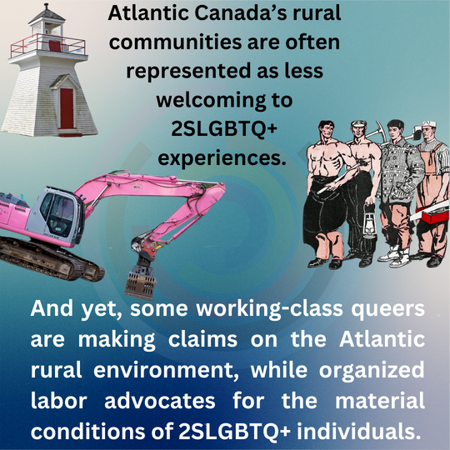
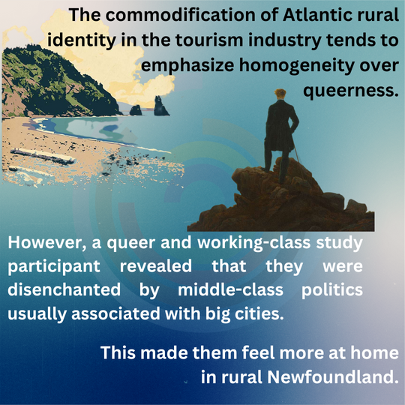
Educational Posts

Slide 39

Community Partner Appreciation Posts

Slide 40
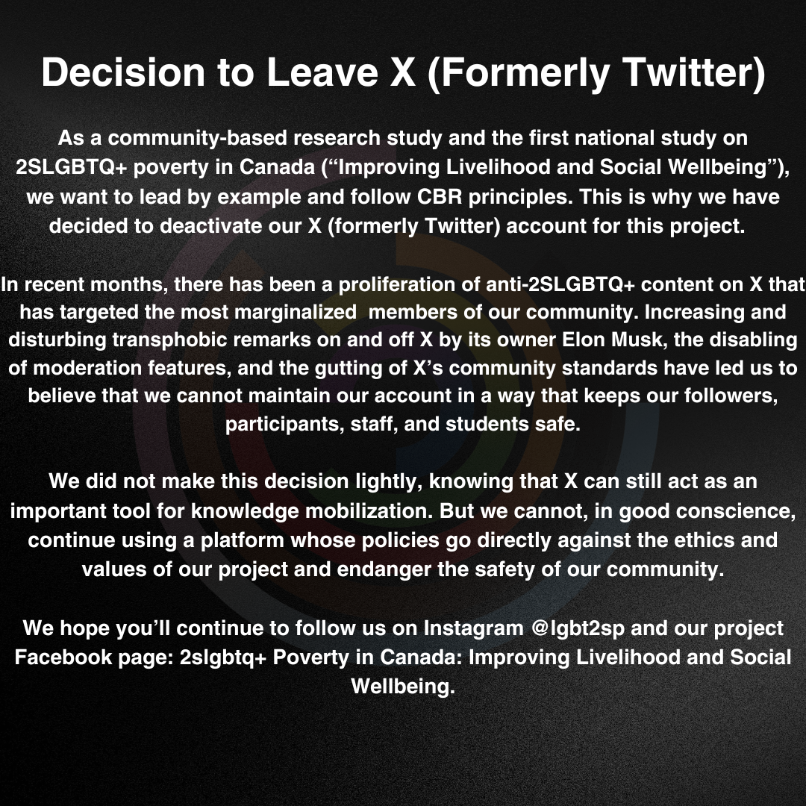
Left X (formerly Twitter)

Slide 41
Plans for the Future
Non-Profits/Community Groups
Policymakers/Advocates
The Public
Academics
  Creation of short form video content
  Creation of Zines/Infographics
  Media appearances
  Lunch-and-Learns
  Creation & Circulation of infographics, fact sheets, FAQs, pamphlets
  Policy briefs
  Policy roundtables
  Academic conferences
  Lunch-and-Learns
  Creation & Circulation of infographics, fact sheets, FAQs, pamphlets
  Lunch-and-Learns
  Attend non-academic conferences
  Frontline worker toolkits
  Creation & Circulation of infographics, fact sheets, FAQs, pamphlets

Slide 42

  What type of challenges have you been encountering with social media engagement?
  What type of products would be useful for you or your stakeholders to receive the data we’ll be collecting?

Slide 43
Audience Engagement
We want to hear what you need

Slide 44
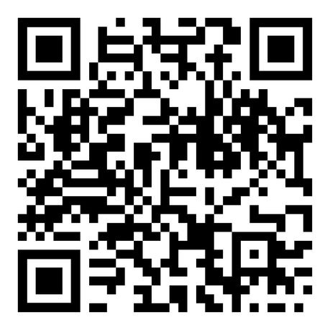

Questions?
Thank you!
lgbtq2s-p@yorku.ca

