Slide 1
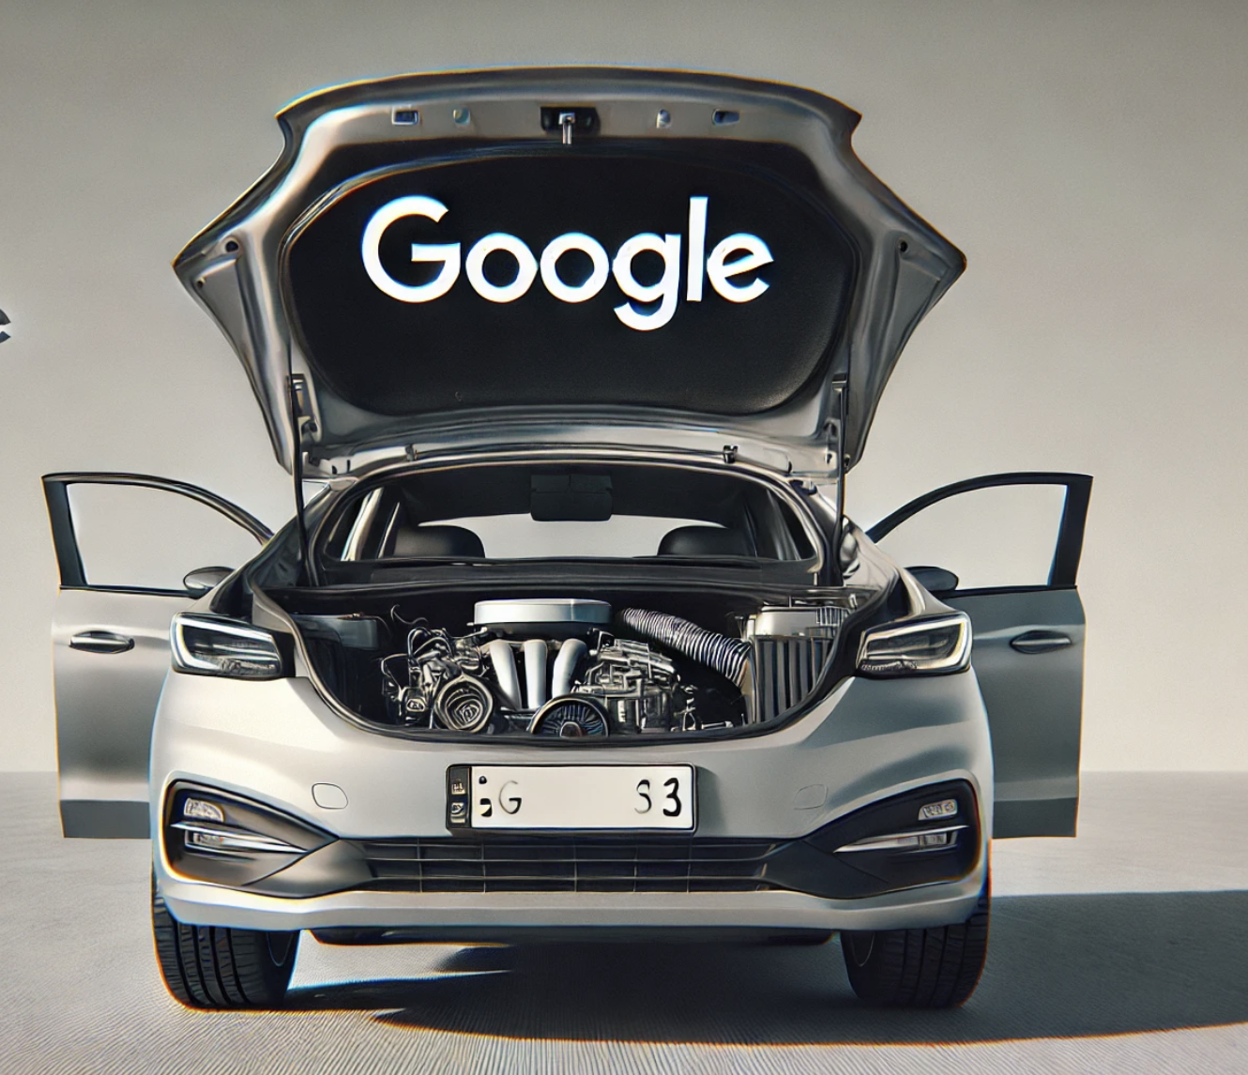
Sociology and Design:
Case Study:
Dismantling a Search Engine
Thank you Kean Birch for the invite!
Institute for Technoscience and Society Seminar Series,
York University
October 24, 2024
Koray Caliskan, The New School, koraycaliskan@newschool.edu

Slide 2
Context
93% of human online experience
90% of all searches go through Google
The most pervasive and common human experiences in world history.
400 billion digital ads are shown every day,
50 Ads per human everyday.
$600 billion annually (Kotila 2021, Lebow 2024)
Google the largest advertising corporation in world history.

Slide 3

We hear that search does/is 2 things
“Shows” “free” “information” to its “users.”
“Sells” “Ad Space” to “advertisers”.

Slide 4
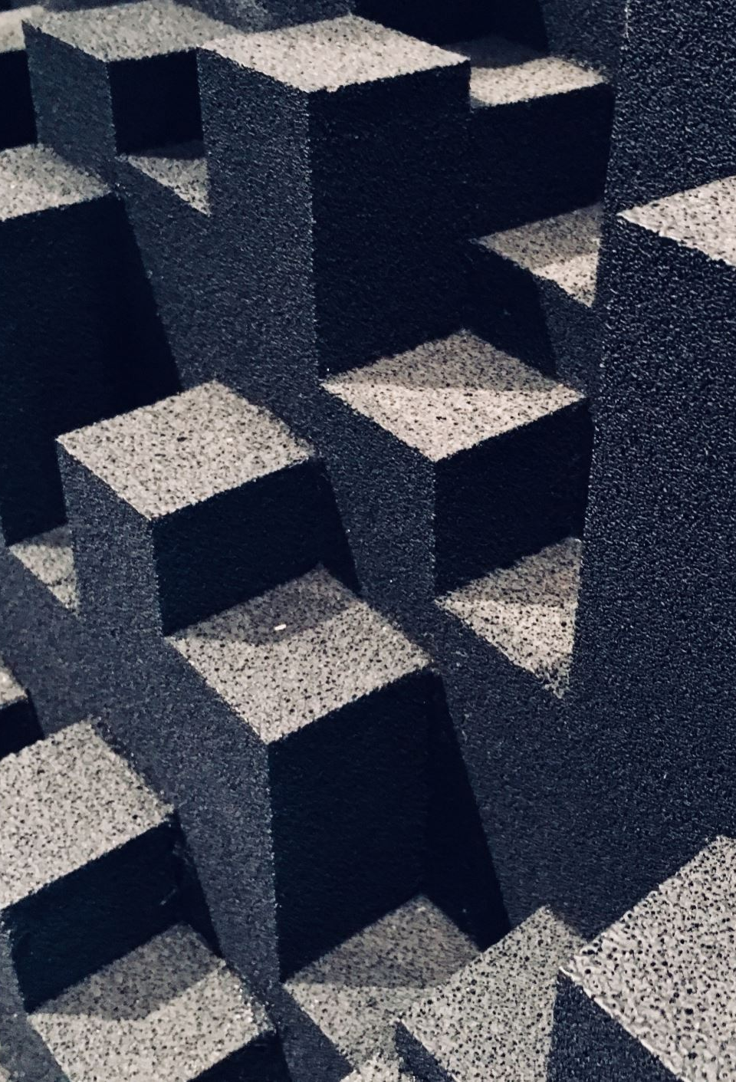
Two Strange Options
either VERY VERY SIMPLE,
or
VERY VERY COMPLEX!
→ Either no need to understand or no need to regulate regulate
Let’s take a look at these again.

Slide 5

Hendry & Efthimiadis (2008) asked how search engines work, most people assume that they search the internet with an astonishing speed and find the results the users want
Even those who are trained in Info Sys fail to explain how search works.
Example: A sketch of an IS undergrad (p. 296)

Slide 6
Common Mistakes
(less frequent as one moves from freshmen to PhD)
Google search looks at internet.
Google has all the data.
Google is free.
We know too much, and too little at the same time: None could locate main components of the engine.

Slide 7
How does it really work?
When a person types a search query, they do not search the internet.
The query asks Google to search for answers in a private index of website addresses.
Index -> a digital phone book that is constantly changing and is updated frequently.

Slide 8
Let’s Open the trunk and look at the engine

Slide 9
How to dismantle at an Intangible System
Use design.
Designers are using social science and propose evidence-based designs of organizations, systems, services, devices, networks.
How to use design as social science research?

Slide 10
But what is design?
Not industrial design (cloths or tables)
Not visual design (brands and shapes)
But Intangible Design:
Organizational Design
Strategic Design
etc.

Slide 11
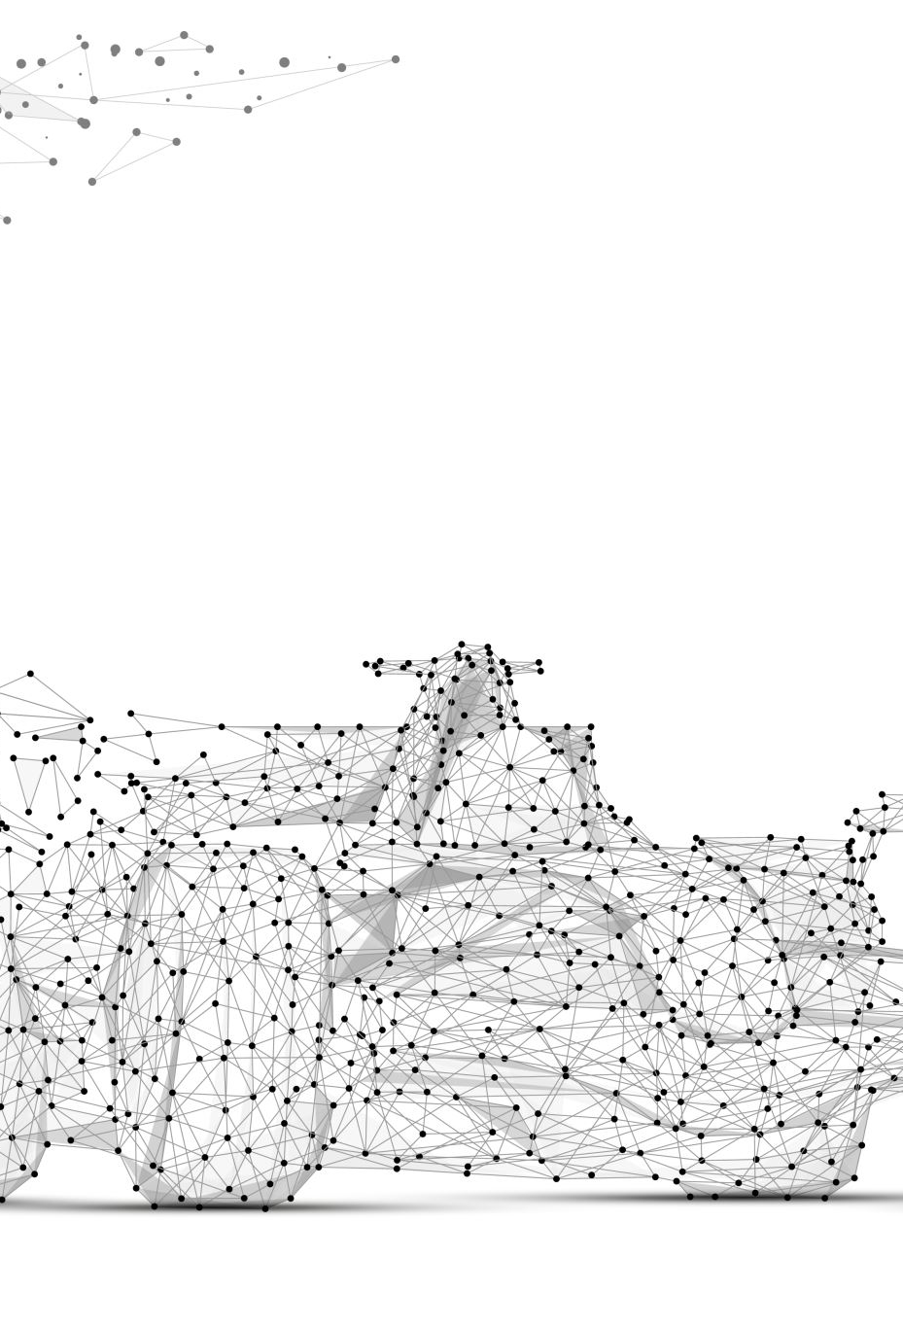
How to take Google Engine Apart and see inside?
A few ideas:
It produces something: What is it?
Is the product coming together of other products?
How can you describe production in this line of productions?
Draw charts, boxes, other shapes and processes.
Focus on Devices, Actors, Representations, Networks, to where responsibility of action is distributed.
Use A Search Engine, or Chat GPT, Gemini, Venice.Ai, or Co Pilot

