Slide 1
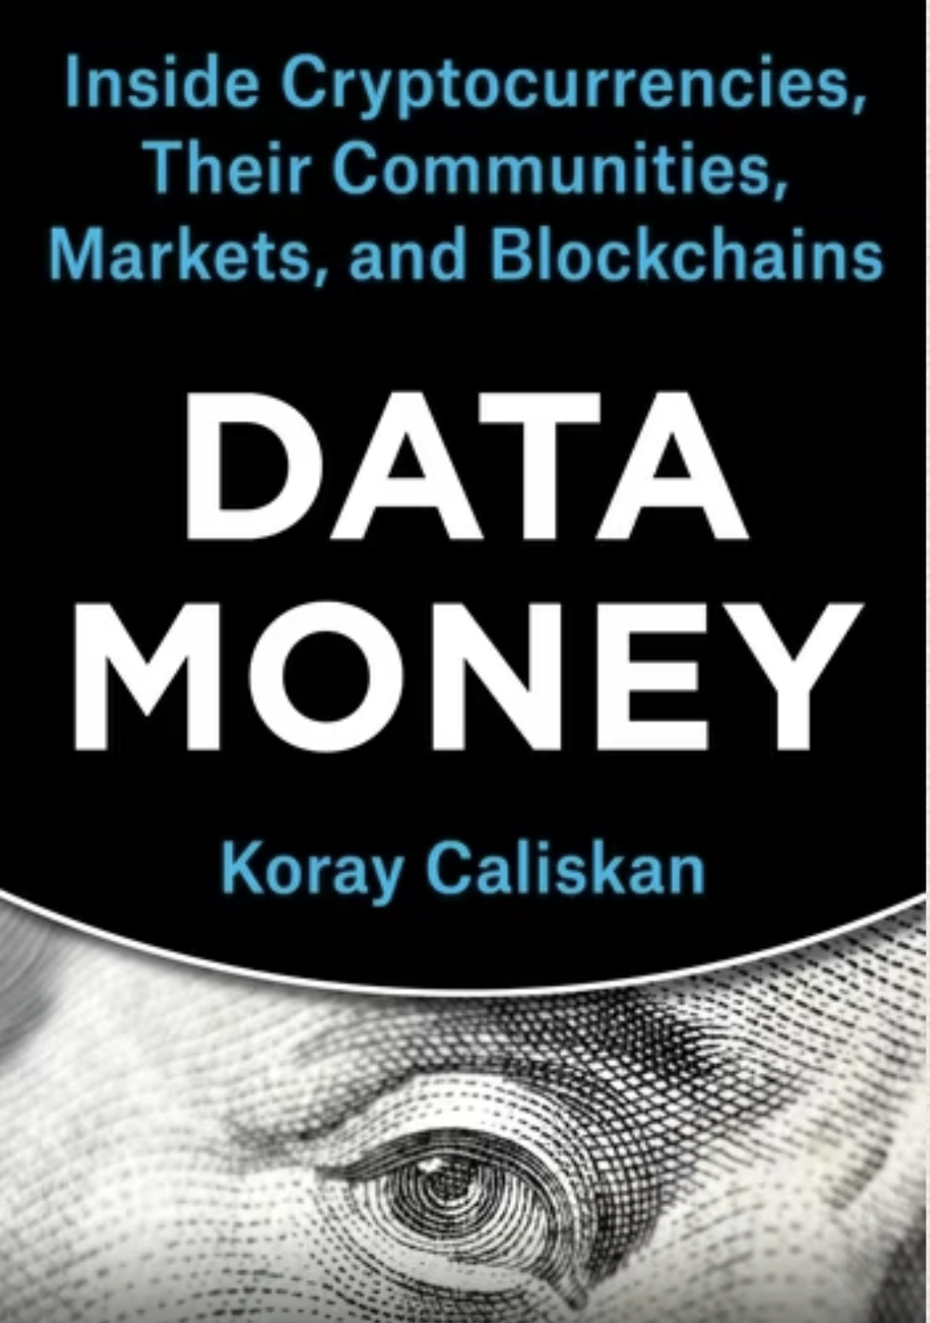
New Monies and their Materials: Cryptocurrencies, Blockchains, and their Global Communities
Thank you Kean Birch for the invite!
Institute for Technoscience and Society Seminar Series, York University
October 24, 2024
Koray Caliskan, The New School, koraycaliskan@newschool.edu

Slide 2
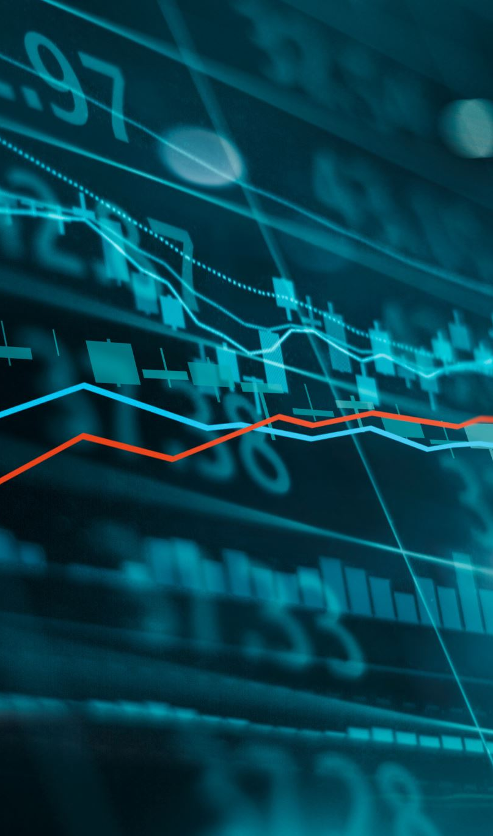
Summary
A historically new money material: Data Money
A New Accounting Infrastructure: Blockchain
Crypto Markets and Exchange Platforms
A Quick Look at Pop Finance /Global Crypto Community
New Perspective to regulate and tax Crypto Economies

Slide 3

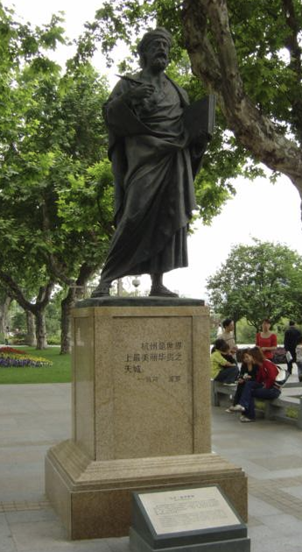
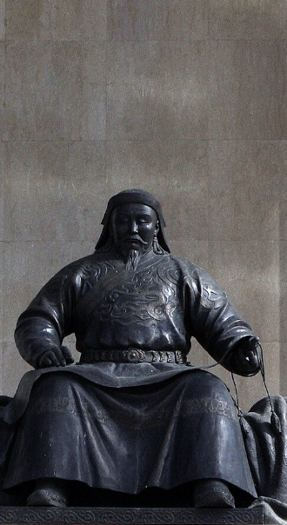
First a Story
Photo Sources:
(LEFT)Statue of Marco Polo in Hangzhou, China (https://en.wikipedia.org/wiki/Marco_Polo)
(RIGHT) Statue of Kublai Khan in Ulaanbaatar (https://en.wikipedia.org/wiki/Kublai_Khan#/media/File:Khubilai_statue.jpg)

Slide 4
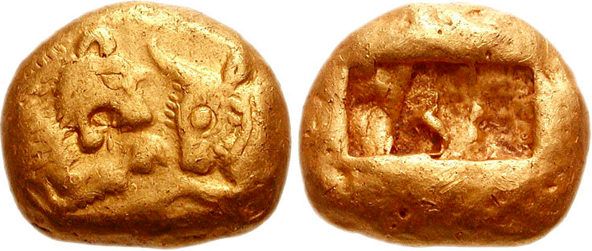
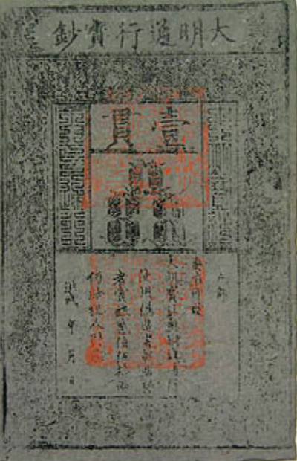
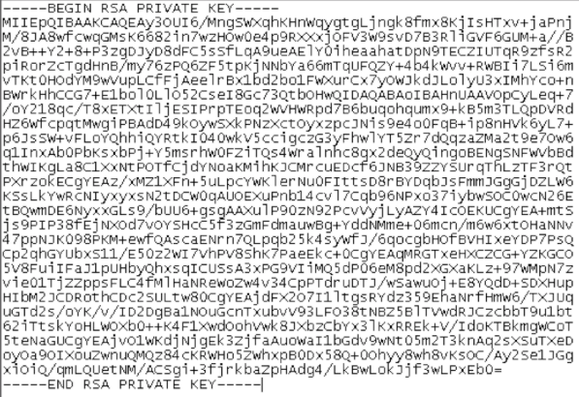
Transformation of Fiat Money: Materiality + Accounting
First Metal Money, 550 BC
First Paper Money, 1260 AD
First Data Money, 2008 AD

Slide 5
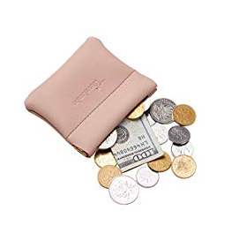
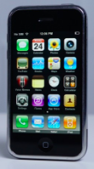
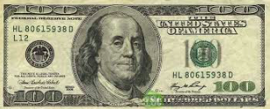
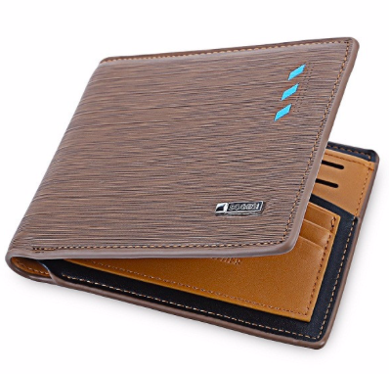
ANALOGUE EXCHANGE

Slide 6
DIGITAL EXCHANGE

Slide 7
Problem:
Digital is impossible!
Solution:
Blockchain!
  makes fraud impossible.
  operated by accountants called Miners.
  assigns incentives for accounting (Bitcoin).
  no (double-spending and reversibility).

Slide 8
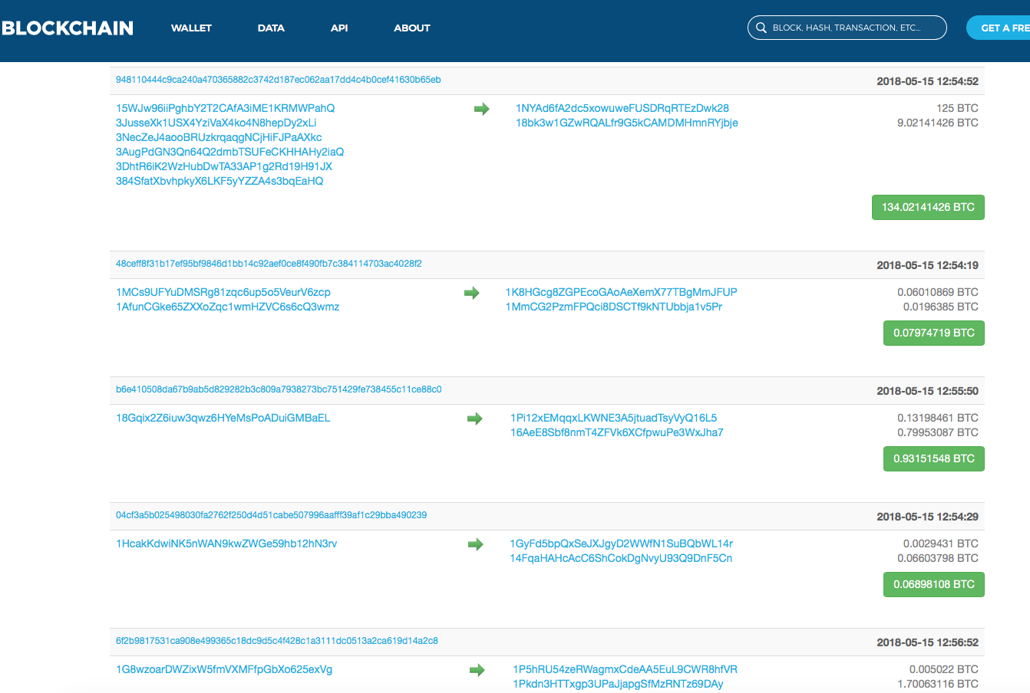
Blockchain: A Digital Accounting Ledger
Cryptocurrency: The Reward for book-keeping

Slide 9
New Money : Data Money
New Material: Monetize right to send data
New Accounting: Mining
3 Novelties

Slide 10
So:
They are
NOT Digital Currencies (Pound is)
NOT Online Monies (All money is digitally represented)
NOT Crypto currency (Your bank account is crypto too)
They are Material. Wrong to treat them as mere non-physical.
They supply actual economic service. They will replace Paper.

Slide 11
A quick look at Cryptocurrency Exchange Platforms
As of February 2024
Cryptocurrencies or Data Monies: 40.000 + (We can make one now)
Markets: 80,016
Exchange Platforms: 634+*
Market Cap: almost $2T USD
* Excluding OTC and Informal Exchanges
Notes:
The most varied money and most rapidly emerging market form in history.

Slide 12
For Social Scientists
Platforms as “cybermediary” did not picked up (Caillaud & Jullien, 2001)
Platforms as “markets” where users obtain value from interacting with other users of the opposite type. (Wright, 2003).
Platforms as “two-sided markets” that create network externalities. (Rochet & Tirole, 2003).

Slide 13
Like X Exchange all Data Money Exchange Platforms works as
as
Mints (They make Data Monies)
banks, (They lend for trading)
vaults, (They keep Monies safe)
exchanges, (They harbor markets)
ALSO: markets, data centers, information clearing houses, accounting agencies, and even in a few cases, as courts…

Slide 14
If cryptocurrency exchange platforms are simultaneously,
devices,
places,
technologies,
markets,
companies,
spaces of encounter,
and many other things…
how to describe them social scientifically and accurately?

Slide 15
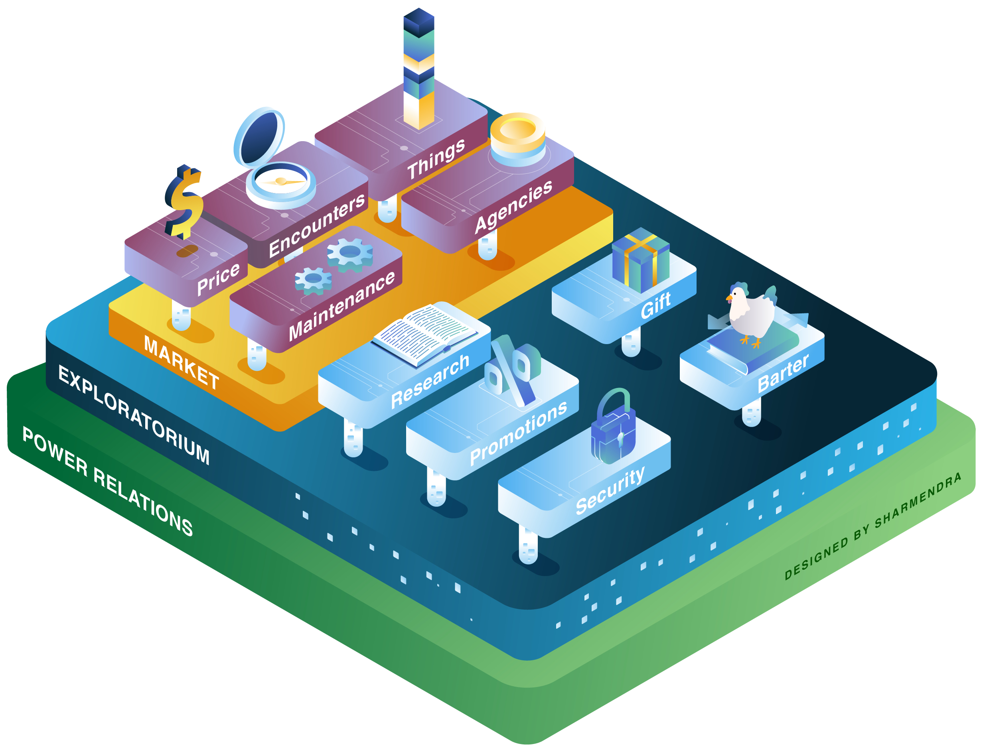
A Platform
Illustration

Slide 16
Stack Economization
Actors qualify it as economic.
They use econometric modelling in pricing and market making.
Data Money Exchanges draw on various economization processes such barter, marketization, valuation, minting, assetization processes all made possible in various layers of the stacked platform.

Slide 17
Ethnography of X Exchange
Around 200 Employees
Runs like a regular company.
Open offices.
We can talk about it in q/a.
They smell coffee and industrial carpeting.
Look like any boring office.

Slide 18
My Research about Pop Finance Communities
Fieldwork Since March 2018
Interviews Interviews with 34 members of the community, including the anonymous founder and core team member
Survey 246 Respondents
Computational Analysis : Bitcointalk Electra Pages
@ElectraProtocol 18.7K Twitter Followers’, their 340.00 followers’ Interactions Data

Slide 19
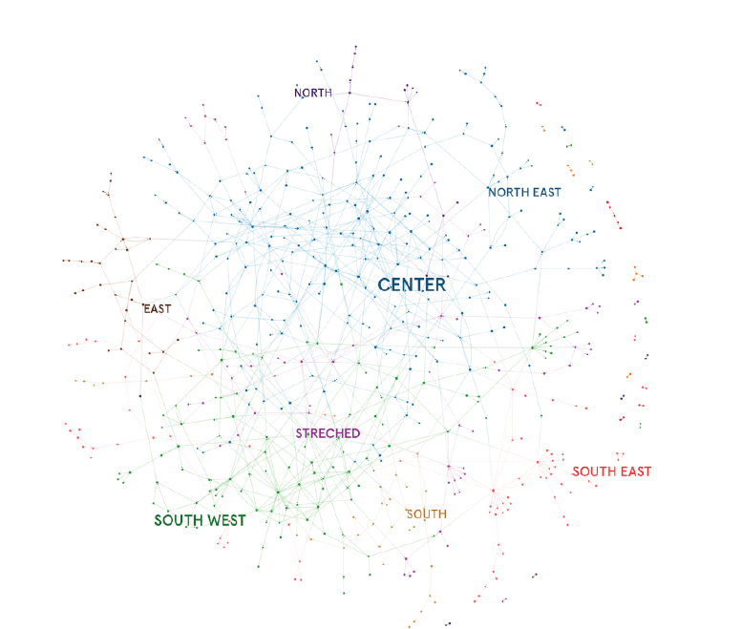
Twitter
Interaction of
Electra
Data: Twitter Inc.
Visualization: Graph Commons
Collaboration: Enis Simsar,
Burak Arikan
Data location:
Caliskan and Simsar, 2021. Twitter
Interaction Data of Electra
Cryptocurrency Community’s
Twitter Handle Followers and A Code for Follower Interaction
Analysis. GitHub Repository https://github.com/enisimsar/DataMoney https://doi.org/10.5281/zenodo.4618865
DATA available on GitHub

Slide 20
Analysis
One might think that an actor in a more central cluster would have a larger effect than one in a peripheral cluster. This is not the case.
I look at two variables:
Connectedness: the number of connections that an actor has,
Betweenness: the frequency of mentions that an actor makes or receives.

Slide 21
Most Influential Actors in Electra’s Twitter Community:
But none are influential in the Core Team…
Connectedness | Betweenness
ElectraPanther | humoalex
bitcoins_future | davidgokhshtein
PumpingAltcoin | RoyCavalera3
humoalex | LinkCrypto1
devnullius | devnullius

Slide 22
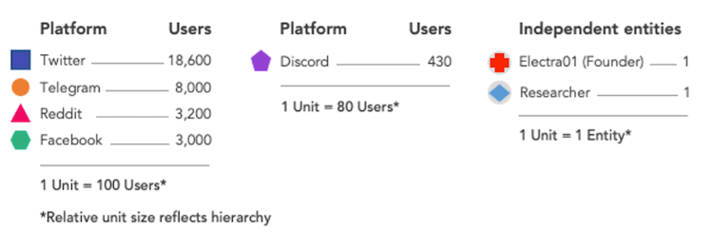
Inter-Platform Dispersion of Community Actors

Slide 23
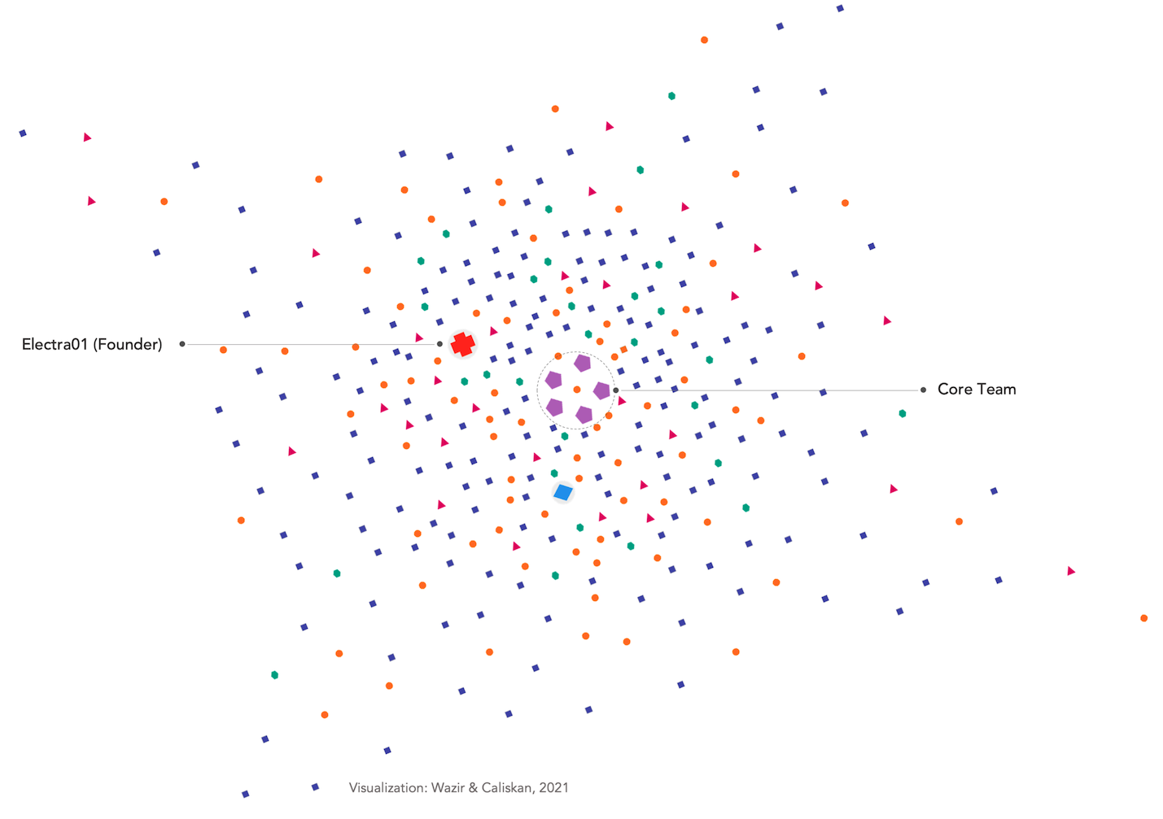
All
Platforms
Visualized
Together

Slide 24
So?
We can locate many centers of power in a decentralized community.
Question:
How do we need to calibrate our analysis of power in new economic communities, whose membership is expanding exponentially?
WE DON’T KNOW!

Slide 25
ELECTRA COMMUNITY:
The size according to members?
Very Active: 271
Moderately Active: 536
Less Active: 3.481
TOTAL 4.288
Platform with Max Membership: 18.700 (Twitter)
Discord Acceptance: 430 (Max Value)

Slide 26
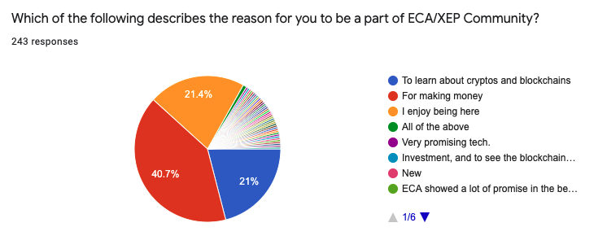

Slide 27
An “Old” and Financially Conservative Western Community
Member since:
2017 %57
2018 %35
2019 %5
2020 %3
In average %38 of all assets in Crypto.
%75 of them have only 22% in Crypto

Slide 28
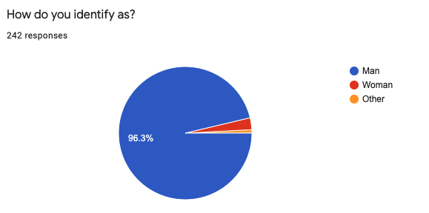
A Western, Male, Young, (White), Community
Average Age: 37.6
75% From Europe or North America,

Slide 29
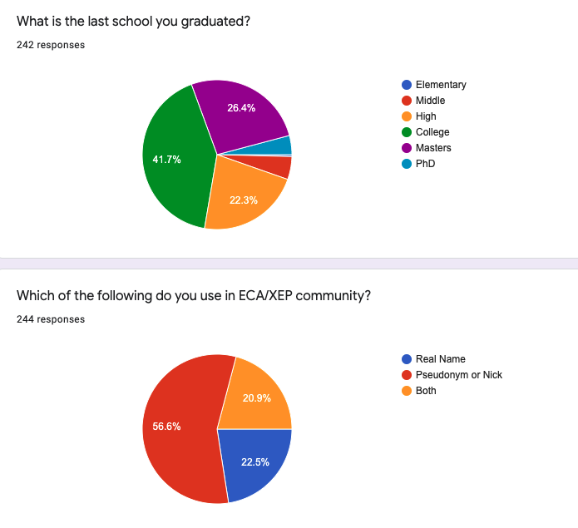

Slide 30
Conclusion
Data Money is new. We monetize the right to send data.
Platforms are not 2-sided Markets. Look at Stack Economization
Crypto communities are new. Male, Western, Educated, Not nerds.
Future?
  No revolution.
  Cambrian Explosion of Economic Devices.
  New accounting.
  Mass tokenization.

Slide 31
New Monies and their Materials: Cryptocurrencies, Blockchains, and their Global Communities
Thank you Kean Birch for the invite!
Institute for Technoscience and Society Seminar Series, York University
October 24, 2024
Koray Caliskan, The New School, koraycaliskan@newschool.edu

