Slide 1



Making AI ’ethical’:
What is data solidarity, and why do we need it?
Barbara Prainsack
Professor, Department of Political Science, and Research Plattform Governance of Digital Practices, University of Vienna
Honorary Professor, Sydney Center for Healthy Societies, University of Sydney
Chair, European Group on Ethics in Science and New Technologies (EGE)
[image: Lil Mayer @unsplash]

Slide 2
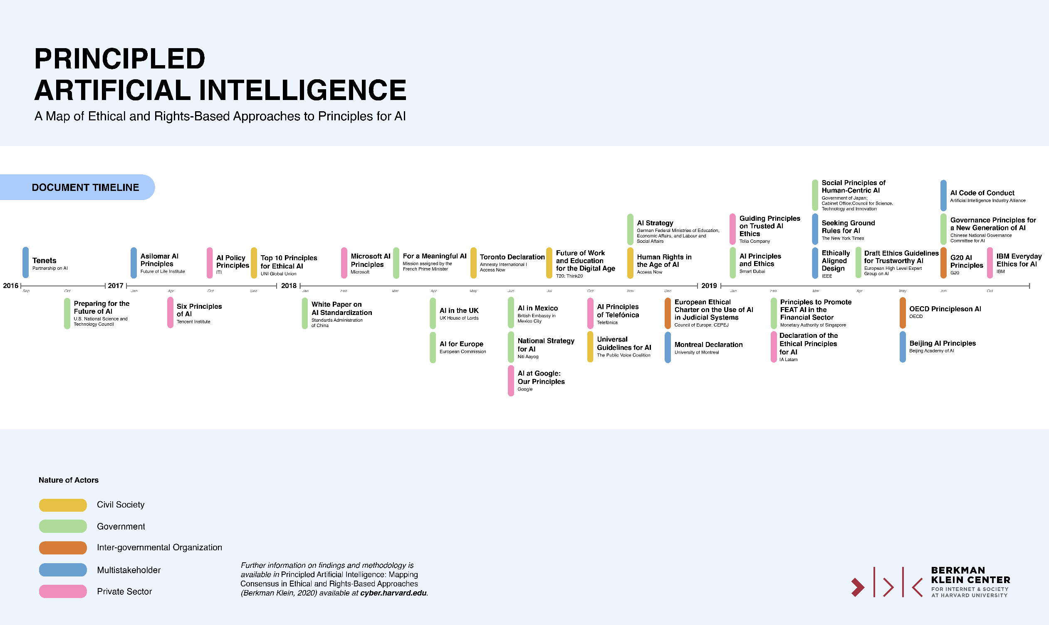

Slide 3
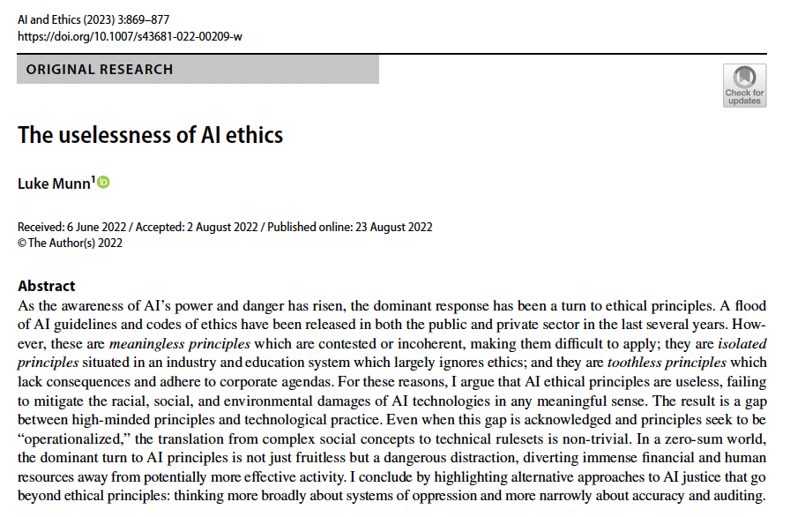

Slide 4
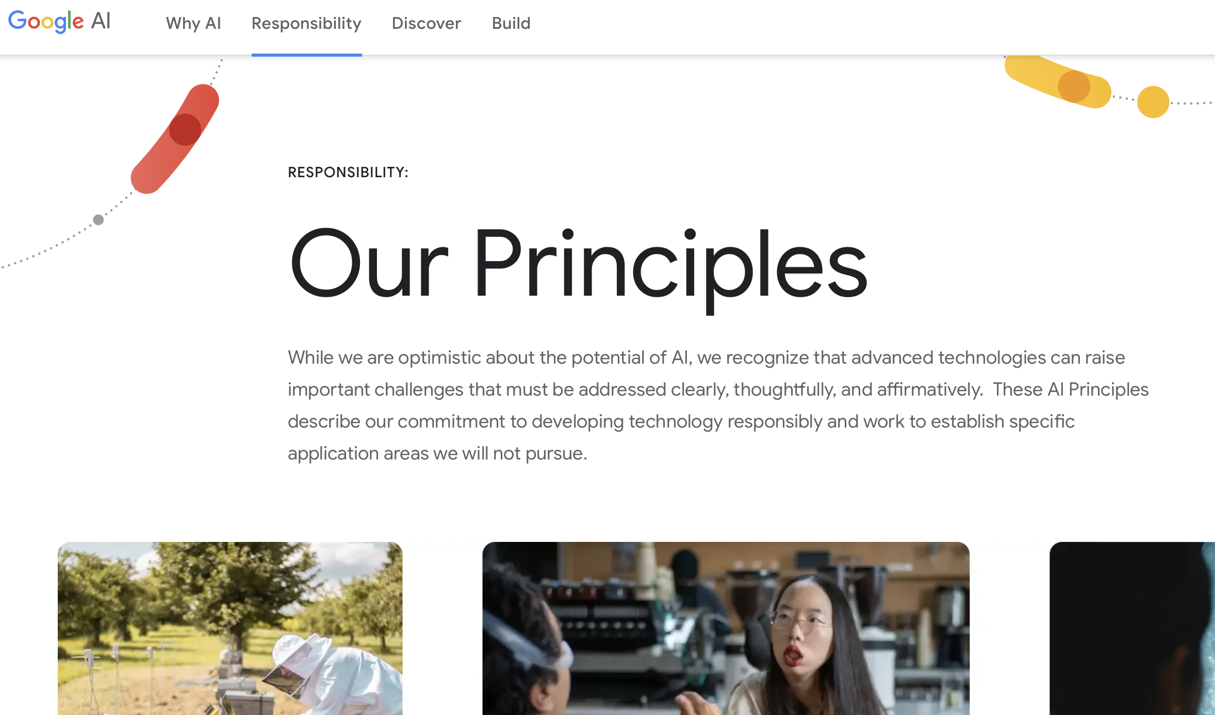
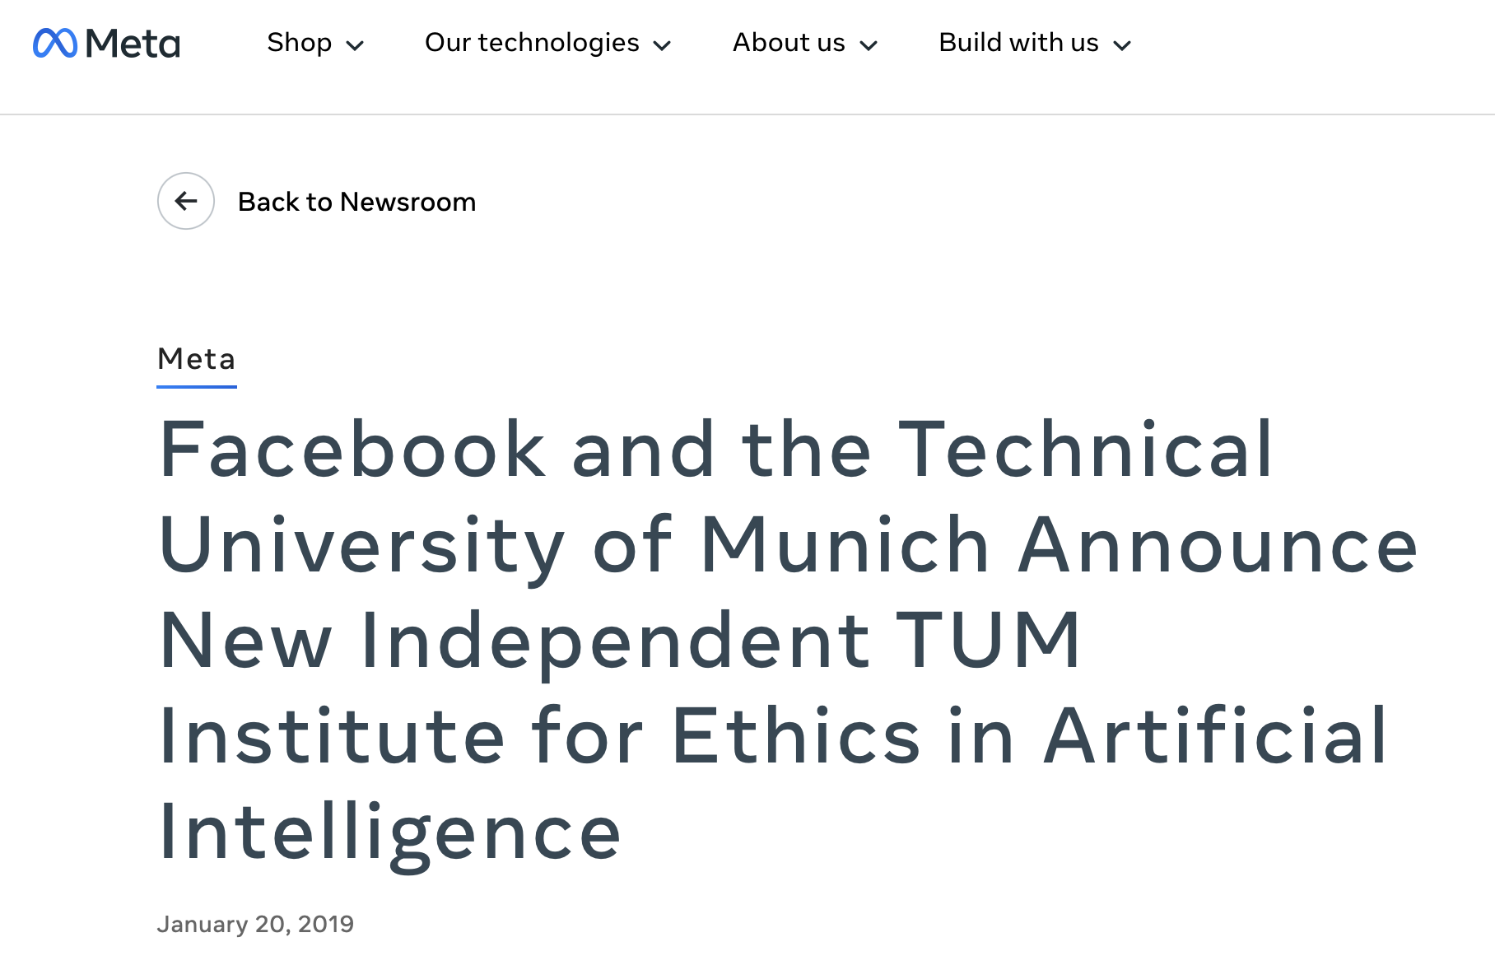
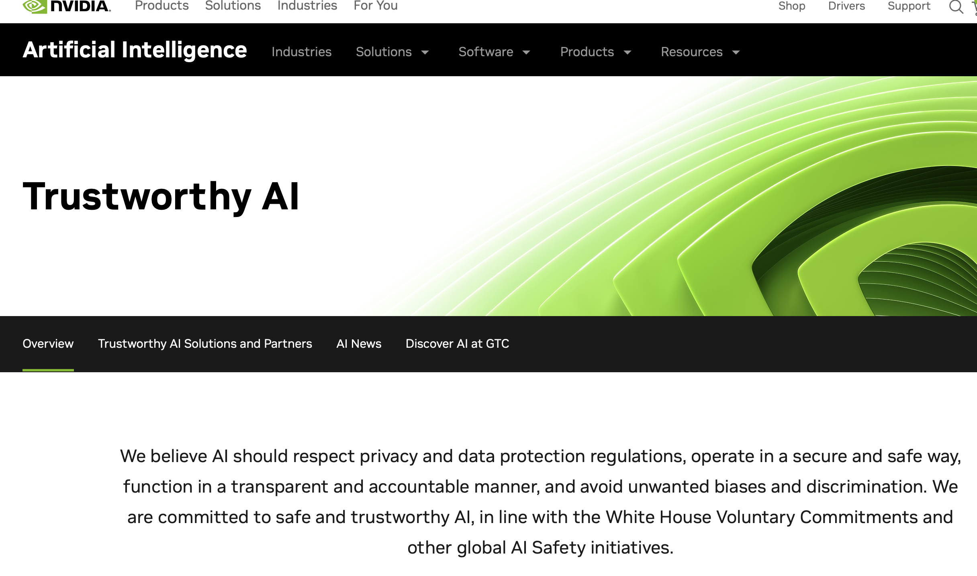

Slide 5

Data governance is stuck in the paper age
personal v. non-personal
human v. non-human
data types instead of data uses
lack of adequate protection of data from deceased people
[

Slide 6

Primary relationality: Data emerge from and out of relations
Secondary relationality: ‘Cleaned’ data represent the intentions of the data users
Tertiary relationality: data allow inferences about wider groups of people than primary data subjects
See also:
[Leonelli, S. (2016). Data-Centric Biology. A philosophical study. University of Chicago Press.]
[Viljoen, S. (2021). A relational theory of data governance. The Yale Law Journal, 131, 573-654.]
[Mhlambi, S., & Tiribelli, S. (2023). Decolonizing AI ethics: relational autonomy as a means to counter AI harms. Topoi, 42(3), 867-880.]
[image: Z. Sarpong @unsplash]

Slide 7


The invisibility of public data work
[Pinel, C. et al. (2020). Caring for data: Value creation in a data-intensive research laboratory. Social Studies of Science, 50(2), pp.175-197.]
[Birch, K. (2023). Data Enclaves. Palgrave Macmillan.]
[images: The Economist & Nathan Dumlao @unsplash]

Slide 8
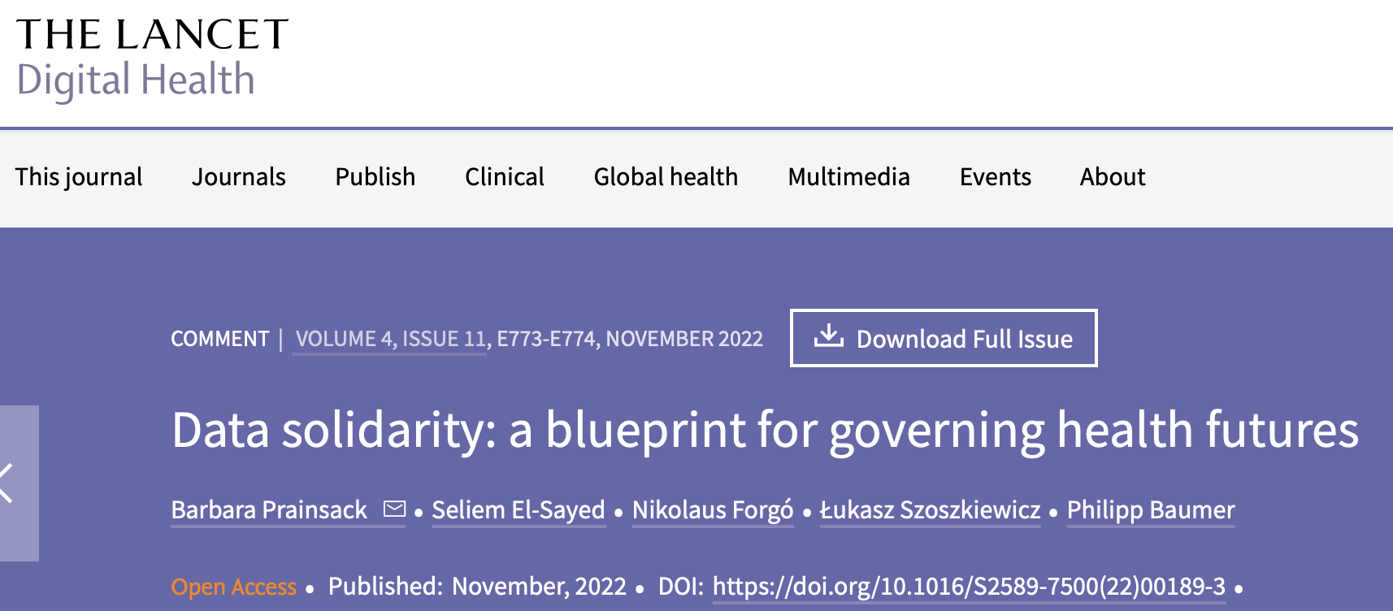

Slide 9
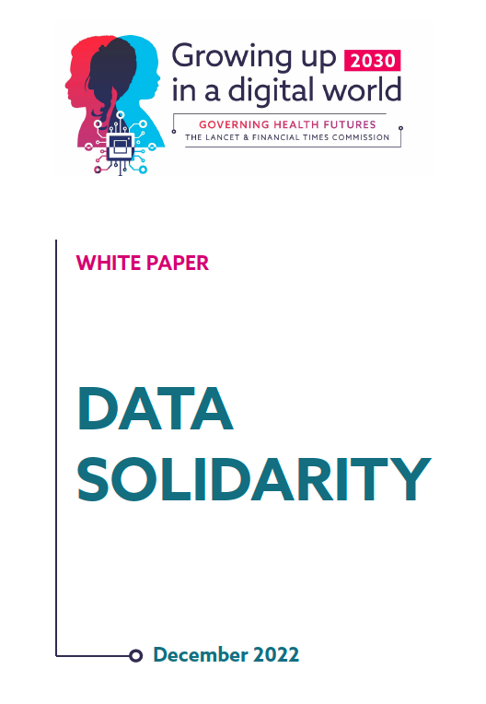
Three pillars of data solidarity
I. Facilitating data use that creates significant public value
III.
Sharing commercial profits with people and communities
II.
Harm prevention and mitigation
[Prainsack B. 2017. Research for personalised medicine: Time for solidarity. Medicine and Law 36(1): 87-98]

Slide 10

When does data use have public value?
‘if it can be plausibly assumed that the data use will have clear benefits for either many [people], for society as a whole, or for future generations, and no person or group will experience significant [and undue] harm.
[…public value] is more pronounced if the benefits are likely to materialise for underprivileged groups than for privileged people, due to the overall lower baseline, and potential size of impact’ ]
[Prainsack & Buyx. 2016. Thinking ethical and regulatory frameworks in medicine from the perspective of solidarity on both sides of the Atlantic. Theoretical Medicine and Bioethics 37(6): 489-501, 493.
See also Prainsack & Buyx. 2017. Solidarity in Biomedicine and Beyond. CUP. p 97]

Slide 11
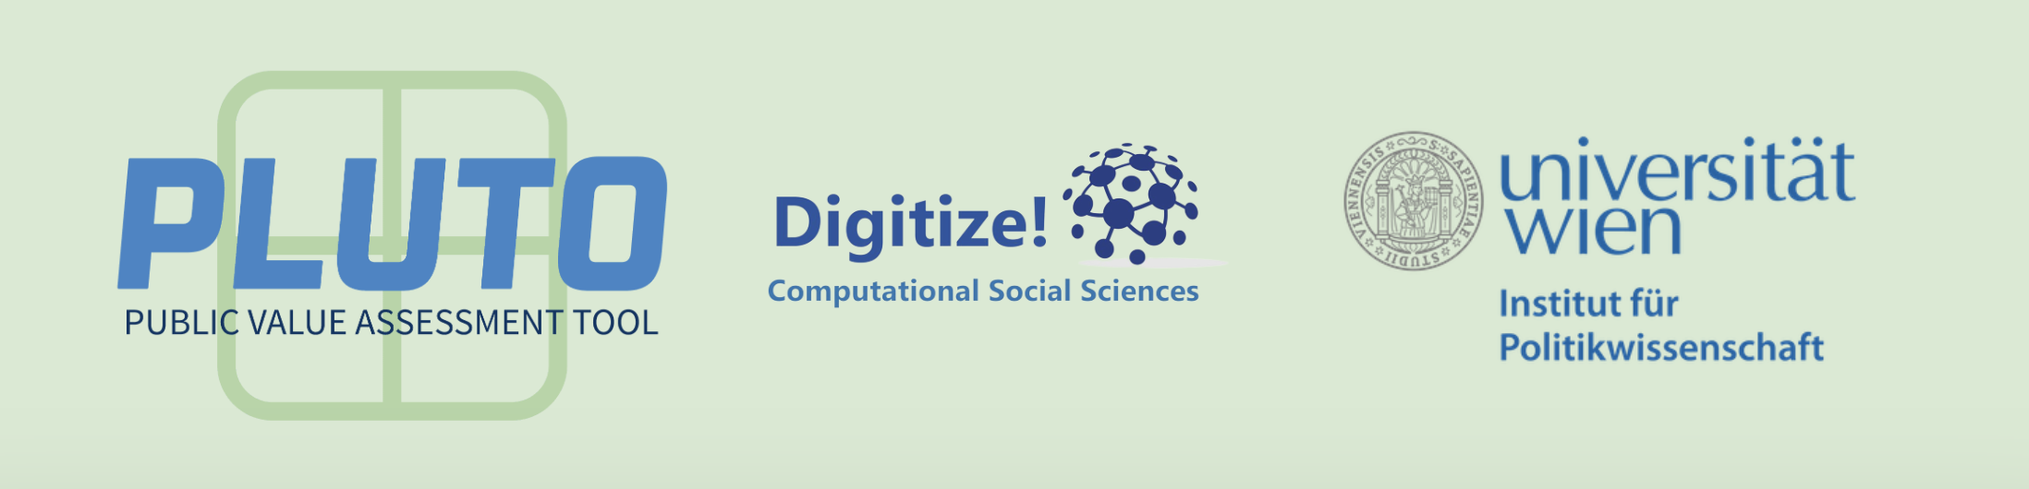






Seliem El-Sayed
Barbara Prainsack
Connor Hogan
Torsten Möller
Péter Ferenc Gyarmati

Slide 12
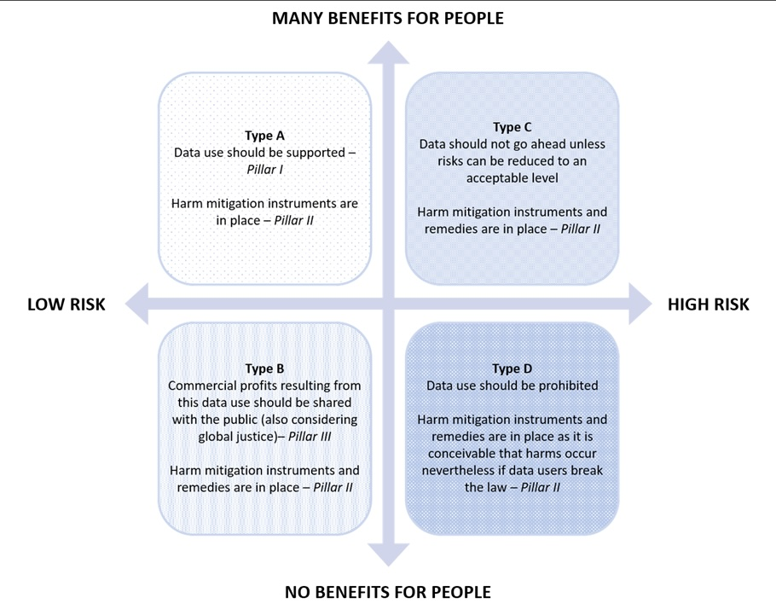

From data types to data use
[Prainsack, B., El-Sayed, S., Forgó, N., Szoszkiewicz, Ł. and Baumer, P., 2022. Data solidarity: a blueprint for governing health futures. The Lancet Digital Health, 4(11), pp.e773-e774.]

Slide 13
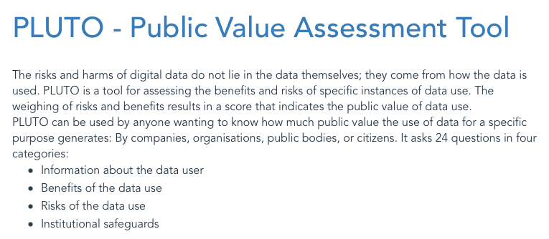
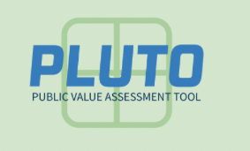
[https://pluto.univie.ac.at]

Slide 14
personal v. non-personal
human v. non-human
data types (instead of data uses)
lack of adequate protection of data from deceased people
Layers of relations

Slide 15
Layer 3: | All other information and knowledge | National-level control over infrastructures and practices
Layer 2: | Personal non-intimate stakes | Community-level control, oversight, and ownership (e.g. commons)
Layer 1: | Personal intimate stakes | Meaningful control of people over their data (e.g. individual informed consent)
Layers of relations

Slide 16

Conclusions: Moving out of the paper age: Towards a relational data ontology underpinning AI

Slide 17
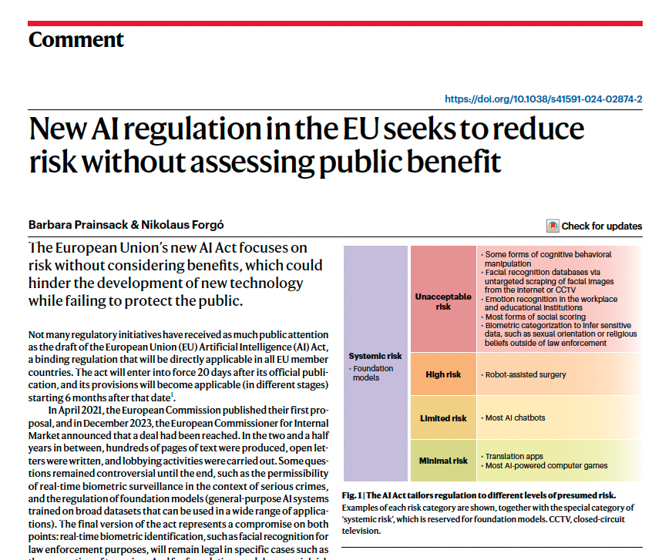

Slide 18
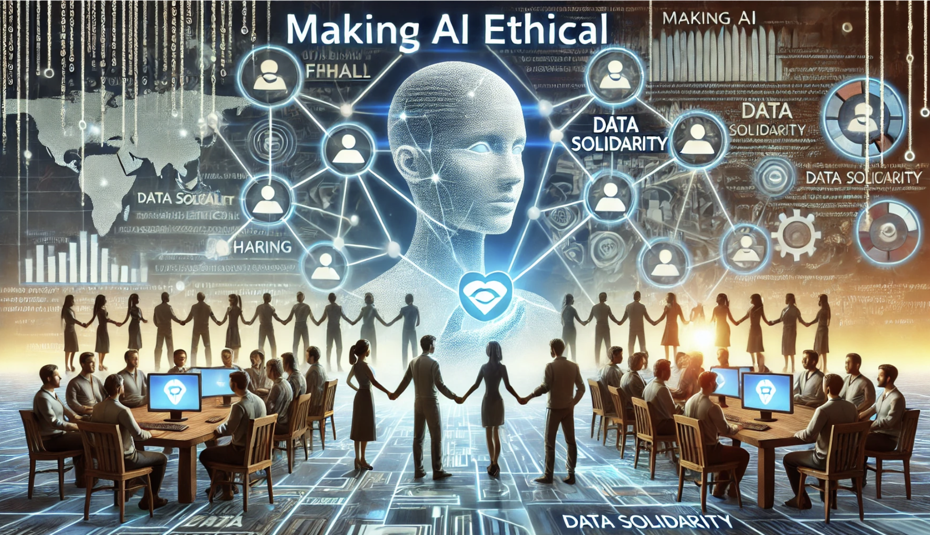
Thank you for your attention!
[👈 Dall·e ]

Slide 20
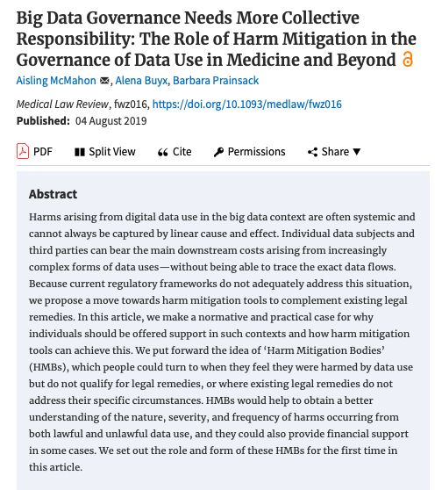
What we need: better harm mitigation
Harm mitigation Bodies (HMB) (outside of the legal domain)
Three main functions:
collect information on the types of harm occurring
relay feedback to improve data use
financial support

Slide 21
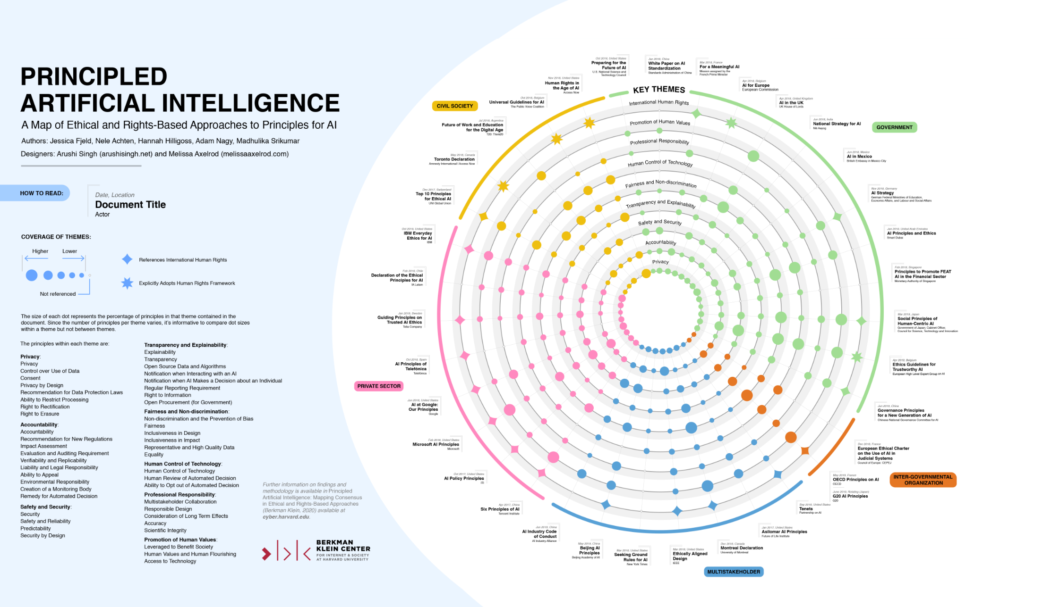
[https://wilkins.law.harvard.edu/misc/PrincipledAI_FinalGraphic.jpg]

