Slide 1
Table of Contents
Before you use this PowerPoint:
Instructions for Using This Resource
Selecting Your Course Policy on GenAI
Talking about GenAI with Students:
What Is Generative AI And What Can It Do?
Using GenAI: University and Course Policies
Critical Digital Literacies and Using GenAI
GenAI and Academic Integrity

Slide 2
For Course Directors: Instructions for Using This Resource
Welcome! This PowerPoint has been co-created by York’s Academic Integrity Specialist, Learning Skills Services, and the Teaching Commons, for instructors to use as a starting point when talking with their students about generative AI. As such, we encourage you to make this resource your own:
Mix it up: Adapt & refine slide content to suit your discipline, courses, and approach to GenAI
  Be sure to update the slides to reflect your course and assignment policies on the use of GenAI clearly and accurately. See the next slide for more support on this.
  Note that we have included a lot of options for student engagement, reflective discussion questions, and follow-up resources- feel free to keep what works for you and remove the rest.
Choose your modality: This slide deck can be used to support an in-person or synchronous online class session. You can also pre-record yourself delivering it and share with students asynchronously in eClass.
A full meal or bite-sized snippets: You can engage students with the full content of this resource in one session, or you can break it into smaller sections and deliver them throughout the course.
Use the notes: Many of the slides contain speaking and/or facilitation notes in the notes section.
Watch out for highlighted text: Sections of slides that we especially anticipate will need your input have been highlighted in yellow.
Note that this resource will not make sense to students if you simply share it with them without adding your own perspective and context!

Slide 3
For Course Directors: Selecting Your Course Policy on GenAI
Section 2 "Using GenAI: University and Course Policies" requires the instructor to make clear decisions about their course and assignment-level policy regarding GenAI use. Three options are provided as a starting point. Note: Be aware that slide numbers may change as you move, add, and delete!
Option 1
  Use of GenAI PERMITTED. Choose this option if you are open to students using GenAI in some or all course contexts, but you have not designed any assessments that require the use of GenAI
  Keep and edit as needed slides 14-16 and 20-23. Delete slides 17-20, as they will not apply.
Option 2
  Use of GenAI REQUIRED. Choose this option if you have designed your assessments and/or mandatory course activities to include GenAI. Note that best practice suggests that you provide an opt-out for students who do not wish to use AI, and that this alternative does not disadvantage their learning.
  Keep and edit as needed slides 14-15, 17-18, and 20-23. Delete slides 16 and 19, as they will not apply.
Option 3
  NO USE of AI-Based Tools. Choose this option if you want to completely exclude the use of all GenAI from your course. Note that best practice suggests that you take the time to discuss why you have made this informed decision with your students.
  If you choose this option, it is important to recognize that reliable detection tools for use of GenAI do not currently exist and the use of such tools is not recommended due to false positives, bias, and intellectual property concerns.
  Keep and edit as needed slides 14-15 and 19. Delete slides 16-18 and 20-23, as they will not apply.

Slide 4

Generative Artificial Intelligence (GenAI) for YorkU Students

Slide 5

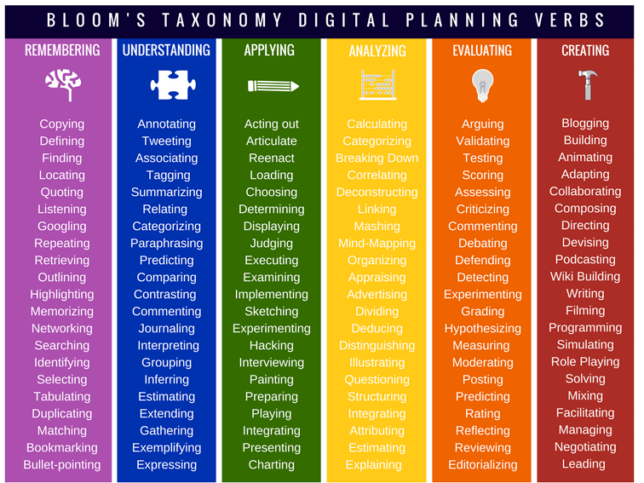
Learning Outcomes
Students will be able to:
Identify university and course policies around GenAI
Describe what GenAI is and how it works
Identify GenAI tools for learning
Examine use of GenAI using critical thinking
Distinguish when use of GenAI upholds academic integrity

Slide 6


What Is Generative AI And What Can It Do?
This Photo by Unknown author is licensed under CC BY-SA-NC.

Slide 7

What is Generative AI?
Generative AI is…
“Technology that creates content — including text, images, video and computer code — by identifying patterns in large quantities of training data, and then creating original material that has similar characteristics. Examples include ChatGPT for text and DALL-E and Midjourney for images.”
  Pasick, A. (2023, March 27). Artificial Intelligence Glossary: Neural Networks and Other Terms Explained. The New York Times. https://www.nytimes.com/article/ai-artificial-intelligence-glossary.html
POLL THE CLASS
What do you know about AI-based tools such as ChatGPT?
Do you use them? In what ways?
Notes:
Speaking notes:
Generative AI is generative, but is not really an AI in the strict sense of having true intelligence – what is broadly called GenAI right now are large language models (for text outputs) and other (non-text-based) machine learning models.
In short, GenAI responds to prompts from users to create outputs in response to those prompts. These outputs are new creations – they aren’t copied or duplicated content from elsewhere online.
Let’s unpack this definition a little.
Two alternative options:
You can anonymously survey your students to better understand their thinking. To do so, you can use/adapt the survey on Academic Integrity website:
https://www.yorku.ca/unit/vpacad/academic-integrity/wp-content/uploads/sites/576/2024/04/Questions-to-Survey-Your-Students-about-GenAI.pdf
2) Consider providing a forum for students can connect on this topic by including an artificial intelligence discussion thread where they can share information, ask questions, post articles, etc.

Slide 8


How are you currently using GenAI?
REFLECT
DISCUSS
Have you used AI-based tools in these ways?
Generating ideas
Assisting with research
Explaining concepts/topics
Providing feedback
Preparing for tests
Summarizing readings
Tutoring Support
Obtain guidance on how to approach certain tasks
Personal tasks (meal planning, scheduling, etc.)
Have you used AI-based tools in any of these ways?
What was your experience: was the tool helpful or not helpful?
Did you encounter any grey areas where you weren't sure whether using this tool was:
  undermining your learning?
  not aligned with academic integrity expectations?
8
Generative Artificial Intelligence for YorkU Students
Notes:
Tutoring support: When students struggle with assignments, GenAI can act as a virtual tutor, providing personalized support and answering their questions immediately.
Idea generation: Can use it to generate ideas as a starting point to find inspiration or to provide them with validation on pre-existing ideas
Research: Can help them to plan their research; Gather information about a topic (Literature review); summarising a vast amount of text data; can analyze data (MS CoPilot)
Language learning: Especially for non-native English-speaking students can provide conversation practice in different registers, building vocabulary, grammar, providing personalized feedback
Test Prep: Can help test themselves on course material and get real-time feedback on their performance
Accessibility support: Can generate summaries of articles for students with dyslexia; Can help break larger tasks down into smaller, more manageable ones (ADHD)

Slide 9
How does GenAI work?
Identifies patterns:
Not random! Identifies & selects statistically probably outputs
No particular adherence to the truth – beware of “hallucinations”
Is not a search engine
Based on training data:
Decides what is statistically probable based on training data
Outputs reflect biases inherent in training data & society in general
To create original material:
Technically original, but not truly innovative
The more you know about a topic, the more you can see where GenAI misses the mark
9
Generative Artificial Intelligence for YorkU Students
Notes:
Speaking notes:
Identifying patterns: Generative AI is not simply random in the way it creates content. It works by identifying and selecting statistically probably outputs - the most likely sounding/looking output in response to a given prompt. In this way you can see that there is no real THINKING behind it, as we understand it.
This impetus towards statistically probable outputs as its main goal also means that it doesn’t have any particular adherence to the truth: it will simply present what sounds right to it, and as far as it is concerned, “right” = “probable”, not “true”. This is also why we sometimes see instances of what are called “hallucinations” – when the LLM has determined a statistically probable output that it insists upon despite it not being true. One could even say that these hallucinations are ALL that Gen AI does, as they stem from the core principles behind its design.
While some GenAI tools will point you to websites that are relevant to its response, it is also important to note that these tools are not the same as search engines like Google search – they work differently, are more limited (because they are selecting what is relevant) and less comprehensive.
GenAI text can therefore often sound pretty banal and characterless – but you can also tell it to write something in the style of someone else, or you can coach it yourself to take on the voice you want it to emulate.
Training data: Exactly what the GenAI determines as the most statistically probable output depends on the data it was trained on. Development of these tools was done using vast amounts of material they’ve been “fed” and also trained on how to respond to. Human labour is an essential part of weeding out responses that may be statistically probable but not desirable during the development of GenAI tools (violent, discriminatory, nonsensical, hate-speech, otherwise undesirable (e.g. bomb-building instructions)).
The fact that AI is trained on existing data means that its probable outputs will inevitably reflect the biases inherent in that data. It is a reflection of the broad, large scale societal biases that already exist in the world, and even having people weed out the worst of the possible outputs will not mean that it doesn’t reproduce systemic inequities.
Creating original material: GenAI is not just not copy-pasting, so it is not plagiarising in that traditional sense – it is generating something new and technically original each time. It is not, however, original in terms of how it sounds/looks, but is rather pretty generic sounding most of the time. In university courses, where we’re looking for students to be able to truly think deeply and originally by the time you graduate from your program, it can sometimes be a helpful “thinking partner” but you will find that the more YOU learn about a topic/field, the more you will be able to identify the places where GenAI is missing the mark.
Further reading:
See also: Basgen, B. (2023, 08). A Generative AI Primer. EDUCAUSE Review. https://er.educause.edu/articles/2023/8/a-generative-ai-primer
And: Bender, E. M., Gebru, T., McMillan-Major, A., & Shmitchell, S. (2021). On the Dangers of Stochastic Parrots: Can Language Models Be Too Big? 🦜. Proceedings of the 2021 ACM Conference on Fairness, Accountability, and Transparency, 610–623. https://doi.org/10.1145/3442188.3445922

Slide 10

How is GenAI different from Traditional AI?
Artificial Intelligence (AI)
Generative Artificial Intelligence (GenAI)
  Involves training a computer to make predictions based on data it is provided.
  Voice assistants, search engines, and chat bots are all examples of traditional AI.
  Involves a machine generating something (text, picture, video, etc.) original, building on the data it has been trained on.
  Copilot is available with enhanced data protection to all York students. Sign in with your York email and PPY ID.
  ChatGPT, and DALL-E are other examples of generative AI tools.
  ChatGPT was released publicly in November 2022 and attracted an amazing one million users within five days. This sparked the current spotlight on GenAI.
  While GenAI creates new text and images, it does not guarantee that what it creates is factual.
Euchner, J. (2023). Generative AI. Research-Technology Management, 66(3), 71–74. https://doi.org/10.1080/08956308.2023.2188861
Lawton, G. (October 2023) What is generative AI? Everything you need to know. The TechTarget Network.
Marr, B. (July 2023). The Difference Between Generative AI And Traditional AI: An Easy Explanation For Anyone. Forbes.
10
Notes:
Video length: 2:49

Slide 11
Cognitive Offloading: When and why to use GenAI?
Consider cognitive offloading: “the use of physical action [or a tool] to alter the information processing requirements of a task so as to reduce cognitive demand.”
For example – counting on fingers, or using a GPS while driving
Cognitive offloading can be helpful or unhelpful for learning.
Where do we “waste” mental energy when we’re trying to learn something? Can GenAI help?
Where do we need to go through the “work” of learning ourselves in order to truly get it? Would GenAI compromise our learning?
REFLECT
  Risko, E. F., & Gilbert, S. J. (2016). Cognitive Offloading. Trends in Cognitive Sciences, 20(9), 676–688. https://doi.org/10.1016/j.tics.2016.07.002
  See also: Grinschgl, S., & Neubauer, A. C. (2022). Supporting Cognition With Modern Technology: Distributed Cognition Today and in an AI-Enhanced Future. Frontiers in Artificial Intelligence, 5, 908261. https://doi.org/10.3389/frai.2022.908261
Notes:
Cognitive offloading: Two easy examples are counting using fingers (makes it easier to keep track of where you are in a noisy or distracting environment), using GPS while driving (allows us to listen to podcasts instead of thinking about route-finding)
Cognitive offloading is essentially any strategy or tool used to reduce cognitive load – the amount of working memory resources used in your brain as you are completing a task. Ideally, in educational context, this is a positive thing, and makes it easier for our minds to focus on the germane cognitive load – the work of creating long-term permanent knowledge organised into a schema. Basically, cognitive offloading is helpful when and where it lets us spend more of our mental resources paying attention to what is important for our learning, and less on irrelevant and distracting things.
GenAI offers another means of cognitive offloading. It can be helpful or not, depending on whether it is doing work that frees us up to focus our attention on the meaningful parts of learning, or we are using it as an unnecessary support so that we don’t have to do that learning and thinking ourselves.
E.g. As a tool for quickly summarizing research articles and streamlining process of finding relevant sources when working on a research paper – GenAI could mean spending a lot less frustrating time mucking around in library databases and reading dead-end papers. BUT for every example of how it can be a helpful way to free up mental resources, there are also counter examples of it being an unhelpful use of cognitive offloading – a tech that potentially compromises learning. E.g. you might use it to polish draft version of a paper – in some courses, where focus is on use of evidence, argumentation, deep analysis of sources or data, having students use ChatGPT to polish the flow, grammar, etc. of the paper could be no problem, and could help students who struggled with academic writing focus more on the essential learning. But in another course, perhaps a course explicitly on academic writing in English, this would be a huge misuse of the tool, and would offload very critical aspects of course learning.
Cognitive offloading can be a useful concept in helping us to think about where and how best to use GenAI in specific contexts – which is WHY different courses take different approaches, since they have different course goals and learning outcomes. As students, you also should be deliberate when deciding when and how to use GenAI, whether for a course that permits it or in general – what do we give up when we ask GenAI to do the work for us?

Slide 12
GenAI is Constantly Evolving!
Language processing and writing
  ChatGPT4o, MS Copilot, Gemini, Github Copilot
  Creating content, drafting starter texts, brainstorming ideas, answering questions, acting as a tutor, coding, research support, rewriting & paraphrasing…
Visual art and enhancement
  Midjourney, DallE (image) & Sora (video)
  Image & video creation, design tools, slide creation…
Audio generation and speech processing
  Murf.ai, Speechify, Jukebox, Otter.ai, Audiopen
  Voice generation, music creation, text-to-speech
These technologies are working together and are increasingly embedded in our day-to-day tools. It can be challenging to always know whether a tool is AI-powered or not.
Notes:
In early 2023, we had ChatGPT 3.5, which was quite limited – it only had data up to 2021, it was prone to lots of hallucinations and errors, it would fabricate incorrect citations with great confidence, it didn’t have access to the internet. We also had some image generating AIs like DallE and Midjourney that were pretty coarse for an average user. We had to go directly to these GenAI tools to use the technology.
Over the past year: The tech has gotten A LOT better. GPT4, and now 4o is leaps and bounds better than 3.5 and many of its limitations have been removed, Microsoft CoPilot offers easy free access to this tech and in conversation with internet. Image, video, graphic generation, coding & data analysis, all improving rapidly.
-GenAI also increasingly embedded into 3rd party tools and digital ecosystems (like CoPilot in Offfice365, like Gemini and other tools in the Google suite of tools). GPTs are also now increasingly being built for specific, dedicated purposes and housed separately from OpenAI/ChatGPT – e.g. companies using dedicated GPTs to help users navigate their websites or make use of their services.
SO: quality, access, ubiquity have all increased dramatically over the last year. Also seeing emergence of a very real digital divide as tools disappear behind paywalls

Slide 13

Using GenAI: Course Policy
Using GenAI:
University and Course Policies
Notes:
Use this section if you with to provide your own policies to students on the use of GenAI in this course.
Slides 15 and 16 include information from York's Academic Conduct Policy
Slides 17-20 present three different options for GenAI use. Consider if GenAI tools are to be used in your course, and how to communicate those expectations to your students. For instance:
1. No use of GenAI tools permitted (Slide 17)
2. Use of Generative AI Permitted for Some Assessments (Slide 18 & 19)
3. Use of Generative AI Permitted (with Parameters) (Slide 20 & 21)
Each are presented in the form of syllabus statements, which are presented on the VPA's academic integrity website: https://www.yorku.ca/unit/vpacad/academic-integrity/wp-content/uploads/sites/576/2024/04/GenAI_Syllabus_Statements.pdf

Slide 14
Senate Policy on Academic Conduct: Use of GenAI
According to YorkU's latest policy on academic integrity (Academic Conduct Policy), Cheating is defined as "the attempt to gain an improper advantage in an academic evaluation" (5.2a).
Explanation:
According to the policy, if students use AI-based tools, they are required to be transparent about their use by citing their use and/ or documenting their use in some other way.
Cheating examples include:
Using an undocumented or unreferenced content generator, including the use of text-, image-, code-, or video-generating artificial intelligence (AI);
Obtaining assistance by means of documentary, artificial intelligence technology, electronic or other aids that are restricted by the instructor
If an instructor does not permit students to use aids in their course, such as AI based tools (among others), then using them would be a breach of cheating in that course.
Discussion Question:
What is your interpretation of these statements?
Generative Artificial Intelligence for YorkU Students
Notes:
If students have questions about the consequences of engaging in a breach, direct them to section 5.6 (Sanctions)

Slide 15
Senate Policy on Academic Conduct: Student Responsibilities
Section 6.2
It is the responsibility of students to:
read and become familiar with this Policy and to comply with the principles and practices of good academic conduct set out herein;
become familiar with related educational resources including, but not limited to those offered through the office of the Vice-Provost academic; York University libraries; York University Writing Centre, and at the Faculty level.
follow their instructors’ expectations for using text-, image-, code-, or video-generating artificial intelligence (AI); referencing sources; group work and collaboration, and be proactive in pursuit of clarification and resources to support these expectations;
take necessary precautions to prevent their work from being used by other students;
use course and exam software in a manner that is consistent with this policy; and
act in accordance with this policy and/or the Policy on Responsible Conduct of Research when conducting and reporting research.
Notes:
This slide highlights:
Different instructors may have different expectations (and that's OK)
It is the responsibility of the student to adhere to these different expectations
It is the responsibility of the student to seek clarification when they're unsure

Slide 16
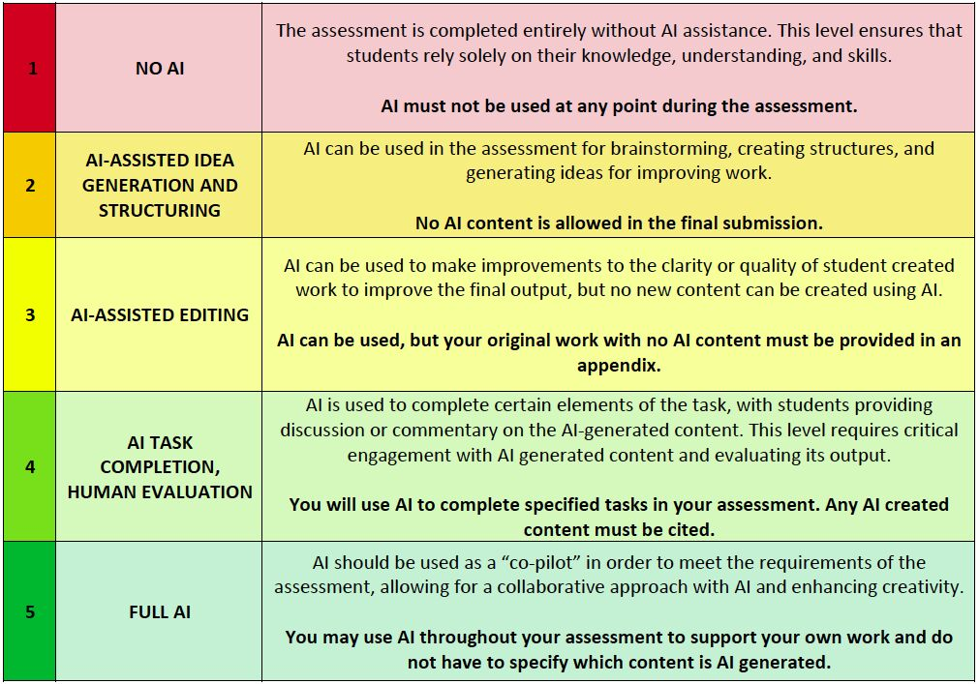
Course Policy:
Use of AI-Based Tools Permitted
OPTION 1: Use of AI-Based Tools Permitted
Please choose ONE option that best reflects your course policy and delete the other options before sharing with students
For some/all assignments in this course, the use of GenAI tools is permitted. For each assignment, information will be provided on whether you can use these tools, how these tools may be used, and how to be transparent about their use.
For example, on each assignment, you will see one of the following statements that clarifies whether you can use AI-based tools.
Do you have any questions about these statements?
Generative Artificial Intelligence for YorkU Students

Slide 17
Course Policy:
Use of AI-Based Tools Required
OPTION 2: Use of AI-Based Tools Required
Please choose ONE option that best reflects your course policy and delete the other options before sharing with students
COURSE SYLLABUS STATEMENT
In this course, the use of generative Artificial Intelligence (GenAI) tools is required for certain assignments / all course assessments. You are expected to use these tools as learning aids / to help plan assignments / to help produce assignments. Part of this requirement includes evaluating the generated output and citing the use of these tools properly.
Generative Artificial Intelligence for YorkU Students

Slide 18

Providing Documentation
[Include and edit this slide to provide instructions about the process for opting out of an assessment that requires use of GenAI. ] In this class, students have the option to opt out of an assessment that requires the use of GenAI. This option requires students to seek approval beforehand and to provide evidence of their learning through an alternative and equivalent assessment.
To opt out:
  Contact me by email for approval well before the submission deadline [TBD by the instructor].
  In this email, provide a brief explanation of why you wish to opt out.
  Indicate that you understand the requirements of the alternative assignment (more information provided in eClass/in the syllabus) and agree to complete it by the submission deadline.
  Students who complete these steps AND receive approval to opt out will not face academic penalties.
Include this section if selecting
OPTION 2: Use of AI-Based Tools Required
Student Right to Opt-Out of use of GenAI
Notes:
Students may have concerns about privacy, security, subscription fees, the impact on the environment, or other issues related to using GenAI. If you are asking students to use AI, you may want to be prepared with an alternative for those who have hesitations.
Can direct students to opt out of having ChatGPT use the data they enter for training: https://help.openai.com/en/articles/7730893-data-controls-faq

Slide 19
Course Policy:
No Use of AI-Based Tools
OPTION 3: No Use of AI-Based Tools
Please choose ONE option that best reflects your course policy and delete the other options before sharing with students
COURSE SYLLABUS STATEMENT
RATIONALE
The use of generative AI tools in the preparation or completion of homework, assignments, tests, exams, or any other form of assessment in this course is not permitted in this course. Using such tools for any part of an assessment may be treated as a case of academic misconduct as outlined in York University’s Senate Policy on Academic Conduct.
Share your why with students! If you choose this option, it is important to recognize that reliable detection tools for use of GenAI do not currently exist and the use of such tools is not recommended due to false positives, bias, and intellectual property concerns.
Add a note to this slide outlining the rationale
For example, does its use conflict in some way with the course subject matter? Do you have concerns about the ethical implications of using it (i.e. intellectual property right infringement, bias and the reinforcement of stereotypes, privacy, energy consumption and the environment, etc.)
Generative Artificial Intelligence for YorkU Students
Notes:
Some examples of concerns include:
Impact on higher education
Environmental costs involved in running GenAI
Data and privacy
Bias and misinformation
Equity issues: who has access to digital technologies and the skills to use them vs who does not?
In some disciplines, incorporating GenAI conflicts with the values of the course subject matter

Slide 20

Ethical Guidelines for using GenAI in this Course
In this course, GenAI is permitted, however students are required to:
cite any AI-generated material: for citation assistance, refer to the Citing Your Work: Artificial Intelligence (AI) Tools guide
only use AI-based tools at preliminary stages (e.g., to explain concepts, brainstorm ideas, generate an outline) / or at certain stages
fact-check all GenAI output
critically evaluate AI-generated content and integrate it with your own ideas
provide documentation of how you interacted with this tool (next slide)

Slide 21

Providing Documentation
To have students provide additional information on their use of GenAI on a particular assignment, consider requiring them to submit a completed checklist along with their assignment (either as a cover letter or an appendix). Below are three template checklists that you can use for this purpose. Each are provided in both PDF and Word formats. Use the Word version to customize.
  Declaration of AI-Based Tool Usage. This checklist is the simplest and most straightforward of the three. Students identify the tool used and communicate the way(s) in which they used it (choosing from a checklist).
      Declaration of AI-Based Tool Usage (PDF format)
      Declaration of AI-Based Tool Usage (.docx format)
  Appropriate Use Statement. This checklist prompts students to review the steps involved in using AI tools appropriately and responsibly and to identify that the work they submit is aligned with these expectations.
      Appropriate Use Statement (PDF format)
      Appropriate Use Statement (.docx format)
  Evaluation and Reflection Guide. This guides students through the process of fact-checking and evaluating AI output while encouraging reflection on what they have learned.
  Evaluation and Reflection (PDF format)
  Evaluation and Reflection (.docx format)
Guidelines for Providing Documentation on your use of GenAI in this course

Slide 22

Providing Documentation
In using AI-based tools in this course, we should all do so in ways that are thoughtful and equitable. These tools should be used to support learning and in ways that uphold academic integrity. Commitments that our learning community should uphold can include:
Equity and Inclusivity: using only free and publicly available tools; evaluating AI-generated content for any bias or discriminatory language
Transparency: being honest about GenAI use; citing and/or documenting its use
Original work: ensuring submitted work is my own, original work, not copied from an AI generator
Responsible: using tools in ways that support my learning, not undermine it; Understanding the ethical implications of using these tools; protecting personal information; opting out if desired
Co-Developing a Course Policy
with Students on the Use of GenAI Tools
DISCUSS
What are some ways that you can use these tools in ways that support your learning in this course?
What concerns do you have about students using AI-based tools in this course? In your program? In general?
Notes:
Source - Adapted from: https://docs.google.com/document/d/1Zex__bf7O6OqKTf1zMPL8KeyKCvcyxtw2UuRLU6tvig/edit
Ask students to comment on each, and to add to the list of commitments.
Students reflect on the previous class discussions to identify what should/should not be permitted in the course.
If students need more guidance on what "using tools that support my learning" are, here are some suggestions:
Breaking down concepts into steps or smaller parts
Generating an explanation or obtain clarification to support understanding
Developing sample test questions to test yourself
Brainstorming assignment topics
Obtaining feedback on your work
Source:
https://durhamcollege.ca/mydc/wp-content/uploads/sites/8/Student-Resource-FAQs-for-GenAI-2024.pdf)

Slide 23
Opportunities in using AI-based tools for academic work
REFLECT
DISCUSS
Reflect on each of the listed opportunities and consider how each could positively impact your learning and progress in this course.
AI-based tools could:
act as personal tutors
translate text
assist with test preparation
help with research, e.g.,
  provide a literature review
  conduct data analysis
provide feedback on writing
proofread your work
Could any of these AI opportunities compromise academic integrity? How? What can you do to ensure you are meeting academic integrity expectations in this course?
Are there any other opportunities associated with using these tools?
23
Generative Artificial Intelligence for YorkU Students

Slide 24
Critical Digital Literacies and Using GenAI

Slide 25






Digital Literacy
What is it?
Digital Literacy Resources for YorkU Students
“The ability and knowledge needed to access and operate internet-connected devices, to successfully use commonly available software, and to navigate and utilize online resources in order to effectively communicate and complete social and work-related tasks in a virtual space.”
Literacy Minnesota
Student Guide to eClass
Student Guide to Remote & Online Learning
LinkedIn Learning
Building your digital literacy skills
Accessing and operating devices
Navigating software and online resources
Communicating effectively virtually
Completing tasks virtually
Digital Scholarship Centre
Information Security at York
Software – Free or Discounted
Generative Artificial Intelligence for YorkU Students
Notes:
Literacy Minnesota: https://www.literacymn.org/digitalliteracy

Slide 26
Prompt Writing Tips
Writing an effective prompt for Generative AI tools to create content is a skill that you can practice and develop.
Prompt Writing Tip | Original Prompt | Improved Prompt Incorporating Tip
Be Specific | How do I make a cake? | Provide an easy recipe for a frosted chocolate cake that feeds six people and takes less than two hours.
Provide Context | What is a good recent movie? | I'm planning a movie night for a small group of friends in our 20s. We want to watch a recent comedy to relax over the break. I have Netflix. What should we watch?
Give an Action | Give me a summary of this article. | Extract the key messages from this article and summarize them in one easy to read paragraph.
Assign a Role | Write a social media caption. | Write a social media caption as a university student speaking to other students.
Microsoft Bing. (November 2023). Bing Chat: AI prompt writing 101. www.microsoft.com/en-us/bing/do-more-with-ai/ai-prompt-writing
Trust Insights. (July 2023). Instant Insights: How to Write an Effective ChatGPT Prompt. www.trustinsights.ai/insights/instant-insights/instant-insights-how-to-write-an-effective-chatgpt-prompt

Slide 27

Prompt Writing: RACE Formula
Writing an effective prompt for Generative AI tools to create is a skill that you can practice and develop.
The RACE Formula (Role, Action, Context, Execute) can help you in crafting a great prompt - use all four elements together in a couple of sentences.
Example: "Create an exam study schedule for me" becomes:
Role = You are a university student studying psychology. You have a full course load and a lot of material to cover.
Action = You will create a study plan for the exam season.
Context = The study plan is over a three-week period and includes the following exams: statistical methods, social psyc, cognition, and clinical psyc.
Execute = Make the study schedule using spaced practice and interleaving.
Generative Artificial Intelligence for YorkU Students
Notes:
Role = You are a university student studying psychology. You have a full course load and a lot of material to cover.
Action = You will create a study plan for the exam season.
Content = The study plan is over a three week period and includes the following exams: statistical methods, social psyc, cognition, and clinical psyc.
Execute = Make the study schedule using spaced practice and interleaving.

Slide 28
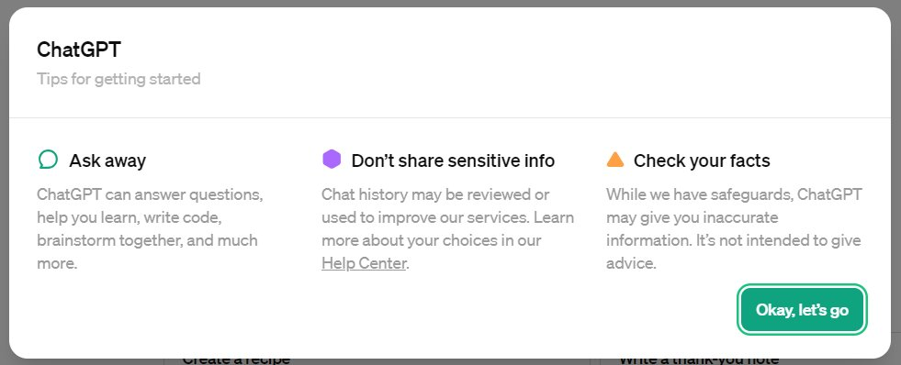

Thinking Critically About Generative AI
ChatGPT gives the following disclaimer:
Ask Yourself
Why does ChatGPT display this message? What does it mean?
How will I verify if the generated content is accurate?
What counts as sensitive info?
Knowing this – when should and shouldn't I use GenAI?
Critical Thinking =
“Actively and skillfully conceptualizing, applying, analyzing, synthesizing, and/or evaluating information gathered from observation, experience, reflection, reasoning, or communication, as a guide to belief and action.”
-BecomingYU, YorkU
Visit Learning Skills Services for resources and workshops to build your critical thinking skills!
Notes:
ChatGPT screen shot captured 05.15.2024
Learn More Icon Image: www.freepik.com

Slide 29
Thinking Critically With Generative AI
Generative AI can also support critical thinking by:
Asking you questions to help you solve a problem on your own;
Suggesting perspectives on a topic that you have not yet considered;
Brainstorming project ideas that you can compare with your own list of ideas.
Ask Yourself
Is what I am asking GenAI to do supporting or replacing my own thinking?
Are the suggestions generated by GenAI relevant? Appropriate?
After using GenAI to support my critical thinking, am I now more able to do so on my own?
Critical Thinking =
“Actively and skillfully conceptualizing, applying, analyzing, synthesizing, and/or evaluating information gathered from observation, experience, reflection, reasoning, or communication, as a guide to belief and action.”
-BecomingYU, YorkU
Visit Learning Skills Services for resources and workshops to build your critical thinking skills!
Notes:
ChatGPT screen shot captured 05.15.2024
Learn More Icon Image: www.freepik.com

Slide 30
Challenges in using AI-based tools for Academic Work
REFLECT
DISCUSS
Reflect on each of the listed challenges and consider how each could negatively impact your learning and progress in this course.
AI-based tools:
Can provide false information or leave out important information
May provide incorrect citations, false citations or no citations
May generate output containing certain viewpoints and biases
Can impact creativity and critical thinking skills
Might lead to a suspicion of academic misconduct
Can these challenges be overcome in ways that do not compromise your learning in this course? If so, how?
Are there any other challenges associated with using these tools?
30
Generative Artificial Intelligence for YorkU Students

Slide 31
Evaluating AI-Generated Information For...
As a student, you are responsible for the work you submit, and that means evaluating any output from AI-based tools
Accuracy of Information
Identifying
Biases
AI tools may reflect the biases (cultural, racial, gender, etc.) within its training data
Outdated/Missing Information
Verify citations by locating each source within YorkU’s Library to ensure that it exists and that the cited material is accurate
No citations listed? Prompt the AI tool to provide more information, including references that you can follow up on
Use a range of reliable outside sources rather than relying on one source to better ensure accuracy
AI tools may not be using the most current information, for example GPT-3.5 has been trained on data up to 2021
Read more on the topic making sure to consult more up-to-date sources to help you have an updated and fuller understanding of the topic.
AI tools may be missing valuable located behind firewalls or subscriptions
AI systems tend to simplify complex information and may lack important depth or nuance
Ask: Does the output attempt to persuade the reader to take on a certain viewpoint?
If you’re not sure, check outputs against other reliable sources
Ask: Does it incorporate different viewpoints?
Ask: Does it reinforce certain stereotypes?
Generative Artificial Intelligence for YorkU Students
Notes:
A final, important step of critical evaluation is exercising your own judgement: based on what you have learned from other sources, and based on what you already know, can the AI-generated output be trusted, or should you discount it?
Again, as a student, you are responsible for the work that you submit. If you use information from any AI-based tools, critically evaluating the information these tools provide is essential and an important part of the scholarly process.

Slide 32
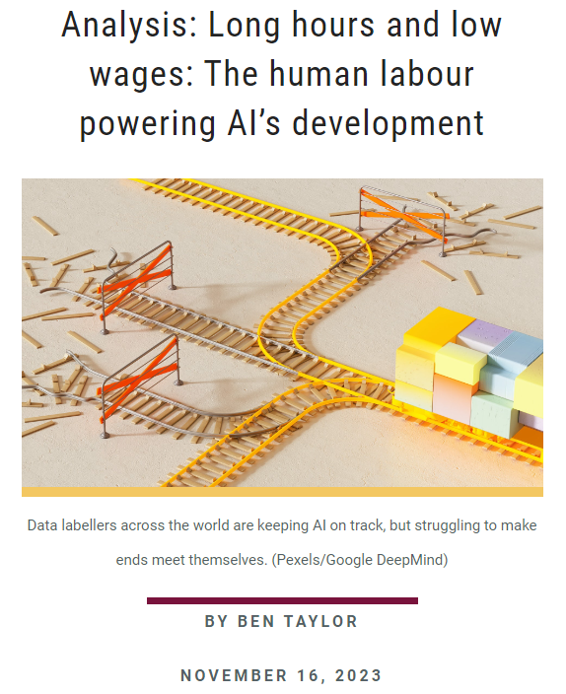

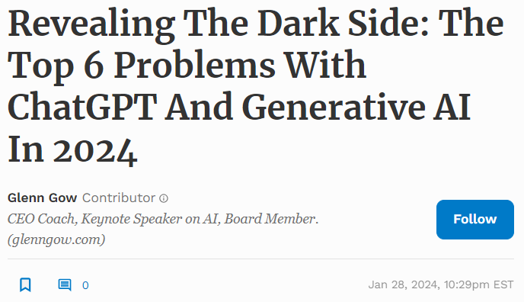
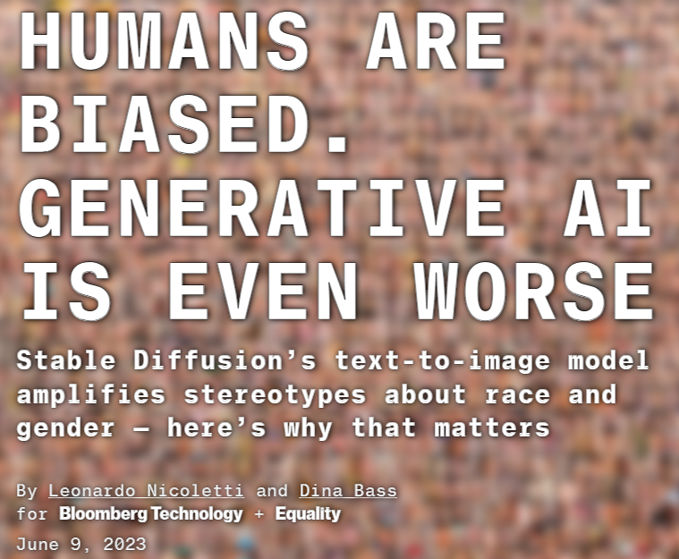
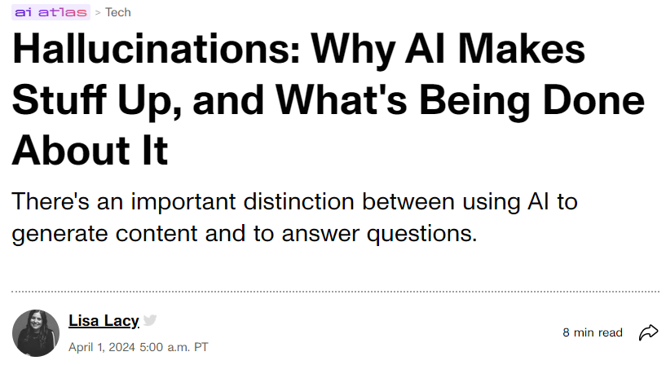
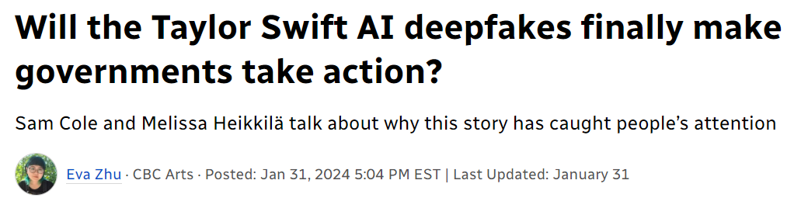
Ethical Concerns with GenAI
Notes:
Why AI is a disaster for the climate
"Basically, because AI requires staggering amounts of computing power. And since computers require electricity, and the necessary GPUs (graphics processing units) run very hot (and therefore need cooling), the technology consumes electricity at a colossal rate. Which, in turn, means CO2 emissions on a large scale – about which the industry is extraordinarily coy, while simultaneously boasting about using offsets and other wheezes to mime carbon neutrality."
https://www.theguardian.com/commentisfree/2023/dec/23/ai-chat-gpt-environmental-impact-energy-carbon-intensive-technology
Analysis: Long hours and low wages: The human labour powering AI’s development
"The Finnish tech firm Metroc recently began using prison labour to train a large language model to improve artificial intelligence (AI) technology. For 1.54 euros an hour prisoners answer simple questions about snippets of text in a process known as data labelling. Data labelling is often outsourced to labour markets in the Global South where companies can find workers who are fluent in English and willing to work for low wages."
https://brighterworld.mcmaster.ca/articles/analysis-long-hours-and-low-wages-the-human-labour-powering-ais-development/
Hallucinations: Why AI Makes Stuff Up, and What's Being Done About It
"According to Stefano Soatto, vice president and distinguished scientist at Amazon Web Services, a hallucination in AI is "synthetically generated data," or "fake data that is statistically indistinguishable from actual factually correct data."
"Estimates from gen AI startup Vectara show chatbots hallucinate anywhere from 3% to 27% of the time."
https://www.cnet.com/tech/hallucinations-why-ai-makes-stuff-up-and-whats-being-done-about-it/
Revealing The Dark Side: The Top 6 Problems With ChatGPT And Generative AI In 2024
1. Accuracy
2. Bias
3. Volume
4. Cybersecurity
5. Intellectual Property issues
6. Shadow AI
https://www.forbes.com/sites/glenngow/2024/01/28/revealing-the-dark-side-the-top-6-problems-with-chatgpt-and-generative-ai-in-2024/?sh=558f522d349a
HUMANS ARE BIASED. GENERATIVE AI IS EVEN WORSE
"As AI models become more advanced, the images they create are increasingly difficult to distinguish from actual photos, making it hard to know what’s real. If these images depicting amplified stereotypes of race and gender find their way back into future models as training data, next generation text-to-image AI models could become even more biased, creating a snowball effect of compounding bias with potentially wide implications for society."
https://www.bloomberg.com/graphics/2023-generative-ai-bias/
Will the Taylor Swift AI deepfakes finally make governments take action?
"the conversation around deepfakes finally seemed to explode in a new way because explicit AI-generated pornographic images using Taylor Swift's likeness were shared on X, a.k.a Twitter, and they went viral. Her fans reported the deepfakes. Then came an onslaught of reactions. First, the Hollywood actor's union condemned the images, then the White House felt compelled to weigh in."
https://www.cbc.ca/arts/commotion/will-the-taylor-swift-ai-deepfakes-finally-make-governments-take-action-1.7100874

Slide 33

Digital Safety
Security
Ownership
Fraud and Scams
Secure your:
Devices
Accounts
Connections
Get Cyber Safe provides information for Canadians about steps you can take to protect yourself online.
What happens to information that you share online or input to a GenAI software?
Before sharing, consider:
Who will have access to my data?
Where will it live?
How will it be used?
Phishing = messages that pretend to be from a trusted source to trick you into giving information
Malware = malicious software
Hacking = obtaining unauthorized access to a device
www.getcybersafe.gc.ca/en
Generative Artificial Intelligence for YorkU Students
Notes:
A Teacher’s Guide to Digital Literacy & Digital Literacy Skills in the Classroom
University of SanDiego
https://pce.sandiego.edu/digital-literacy/
https://www.getcybersafe.gc.ca/en/secure-your-devices/laptops-and-computers

Slide 34
Protecting Data and Privacy – Example: Microsoft Copilot
To better protect your data and privacy using this tool, here's what you can do:
Log in to Copilot using your YorkU email and PPY ID. You will see a green shield icon with a check in the top right – this indicates that you now have enhanced data protection.
Do not enter personal or private information, or information you do not own.
Manually save your interactions. When you have data protection enabled, your chats will not save automatically. You will need to copy or download to save your prompts and Copilot’s responses for future reference.
To ask Microsoft to remove any sensitive data you have accidentally provided, contact the support team https://support.microsoft.com/en-us/contactus
Generative Artificial Intelligence for YorkU Students
Notes:
This is from: https://ai.ctlt.ubc.ca/chatgpt-3-5/

Slide 35

GenAI and Academic Integrity

Slide 36
What is Academic Integrity?
Although academic integrity and academic misconduct are sometimes used interchangeably, there is a difference.
Academic integrity is a commitment to six fundamental values honesty, trust, fairness, respect, responsibility, and courage (ICAI, 2021). For more information about academic integrity, please visit York's Academic Integrity website.
Academic misconduct refers to certain actions undertaken to gain an unfair academic advantage, and which serve to undermine academic integrity.
As per York's Academic Conduct policy, if students use AI-based tools, they are required to be transparent about their use by citing their use and/or documenting their use in some other way.

Slide 37
Citing Your Work: Artificial Intelligence (AI) Tools
Using and citing sources appropriately:
Demonstrates reliability of the information
Allows readers to visit the original source for more information
Identifies who is (and isn't) part of the academic conversation you are engaging in
Credits the originator of the concept/theory
Helps you avoid committing plagiarism
Ask Yourself
Has my course director explicitly given permission to use GenAI in this assignment?
Have I verified that the generated content is accurate?
Have I cited all my sources (including text, images, etc.)?
SPARK (Student Papers and Academic Research Kit)
Plagiarism = "Representing someone else's ideas, writing, images or other intellectual property as your own constitutes plagiarism and is another form of academic dishonesty. Any use of the work of others, whether published, unpublished or posted electronically, attributed or anonymous, must include proper acknowledgment."
-SPARK (Student Papers and Academic Research Kit)
Visit YorkU Libraries for additional resources on citing your work!
Includes guides for citing AI in APA, MLA, and Chicago formats.
Notes:
https://researchguides.library.yorku.ca/c.php?g=679413&p=5316500
https://spark.library.yorku.ca/academic-integrity-using-and-citing-sources/

Slide 38
QUESTIONS?

Slide 39
Summary of Important Links
Academic Integrity-Related Links:
AI Technology & Academic Integrity: Information for Students
Academic Integrity Student Resources
Avoiding a Breach of Academic Misconduct
York University Libraries' GenAI Citation and Research Resources
Artificial Intelligence: Workshops, Guides & More, which includes links to upcoming workshops for students as well as information on how to cite Artificial Intelligence (AI) tools
Research on Artificial Intelligence guide

Slide 40
Contacts
This resource was developed collaboratively by:
For more information on this resource, you can reach out to:
Robin Sutherland-Harris, Educational Developer, Teaching Commons - robinsh@yorku.ca
Nicole Joron, Learning Skills Specialst, Learning Skills Services - njoron@yorku.ca
Angela Clark, Academic Integrity Specialist, Office of the Vice Provost Academic - angclark@yorku.ca
Learning Skills Services
Teaching Commons
Vice-Provost Academic's Office
September 2024
Generative Artificial Intelligence for YorkU Students

Slide 41
References
Euchner, J. (2023). Generative AI. Research-Technology Management, 66(3), 71–74. https://doi.org/10.1080/08956308.2023.2188861
Furze, L., Perkins, M., Roe, J., & MacVaugh, J. (2024). The AI Assessment Scale (AIAS) in action: A pilot implementation of GenAI supported
assessment. arXiv preprint arXiv:2403.14692. https://arxiv.org/pdf/2403.14692v2.pdf
Lawton, G. (October 2023) What is generative AI? Everything you need to know. The TechTarget Network.
Marr, B. (July 2023). The Difference Between Generative AI And Traditional AI: An Easy Explanation For Anyone. Forbes.
Microsoft Bing. (November 2023). Bing Chat: AI prompt writing 101. www.microsoft.com/en-us/bing/do-more-with-ai/ai-prompt-writing
Pasick, A. (2023, March 27). Artificial Intelligence Glossary: Neural Networks and Other Terms Explained. The New York Times. https://www.nytimes.com/article/ai-artificial-intelligence-glossary.html
Risko, E. F., & Gilbert, S. J. (2016). Cognitive Offloading. Trends in Cognitive Sciences, 20(9), 676–688.
https://doi.org/10.1016/j.tics.2016.07.002
Trust Insights. (July 2023). Instant Insights: How to Write an Effective ChatGPT Prompt.
www.trustinsights.ai/insights/instant-insights/instant-insights-how-to-write-an-effective-chatgpt-prompt

